Slide 1
Droplet Breakup & Evaporation
AAE-E3030 Numerical Modeling of Multiphase Flows
4.3.2019
D.Sc. (Tech) Ossi Kaario

Slide 2
Motivation
Why learn about the modeling of fuel sprays ?
Modeling increases our understanding of sprays
We can predict real life scenarios
We can plan experiments
We can improve the injection process
We can reduce emissions

Slide 3
Contents
Spray breakup phenomena
Droplet evaporation

Slide 4
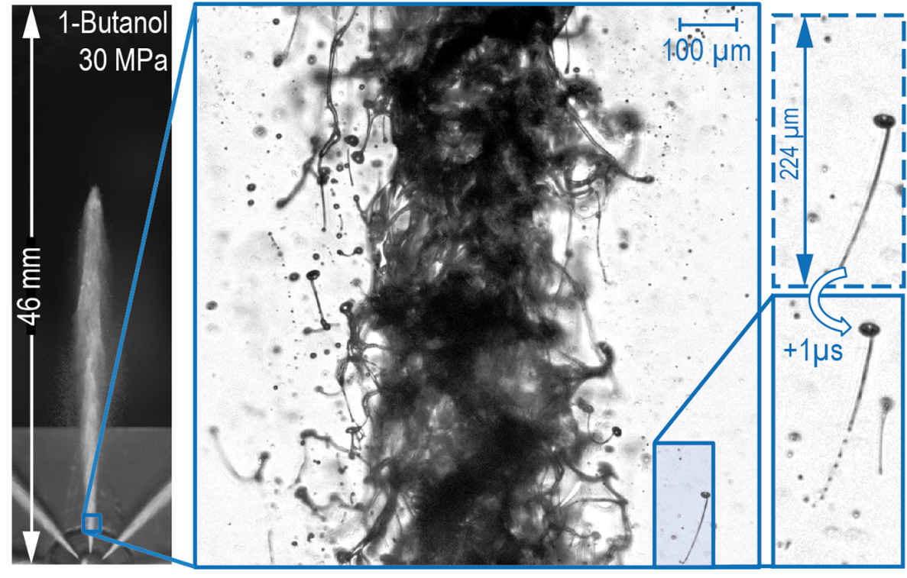
Atomization and breakup
Basically two different phenomena
Atomization: liquid column breaks up into various size ligaments, blobs, and droplets
Secondary breakup: Already broken up droplets (or bigger structures) breakup again into smaller droplets

Slide 5
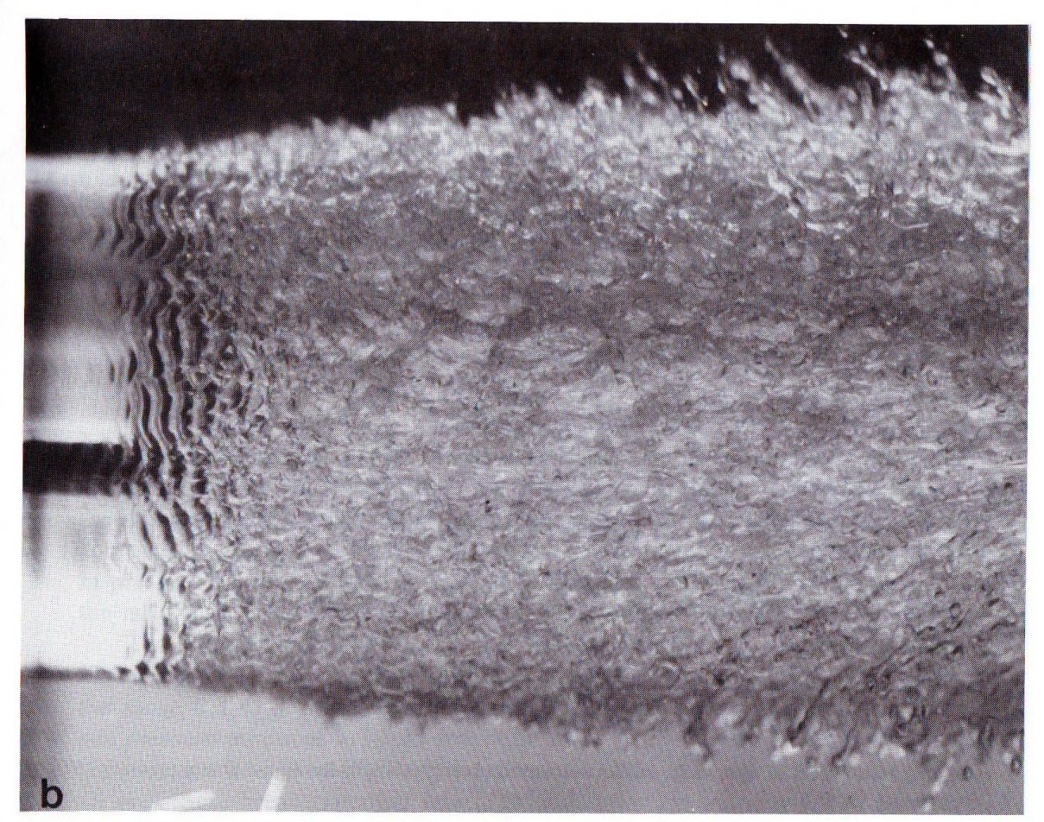
Atomization
Figure by A.H. Lefebre, Atomization and Sprays
K-H instability (discussed previously)

Slide 6
Initial Drop Size Distributions
If only large (~ nozzle hole size) droplets are used for injection, this may not lead to totally realistic evaporation behavior.
Power law
where r is drop radius and r₀ nozzle
radius, and n is a coefficient,
typically n=0.5.
Rosin-Rammler
where d is drop diameter, Q is the fraction of the total volume contained in drops of diameter less than d, and X and q are constants. q is typically between 1.5…4. X is a drop diameter such that a certain fraction of the total volume is below the diameter.

Slide 7
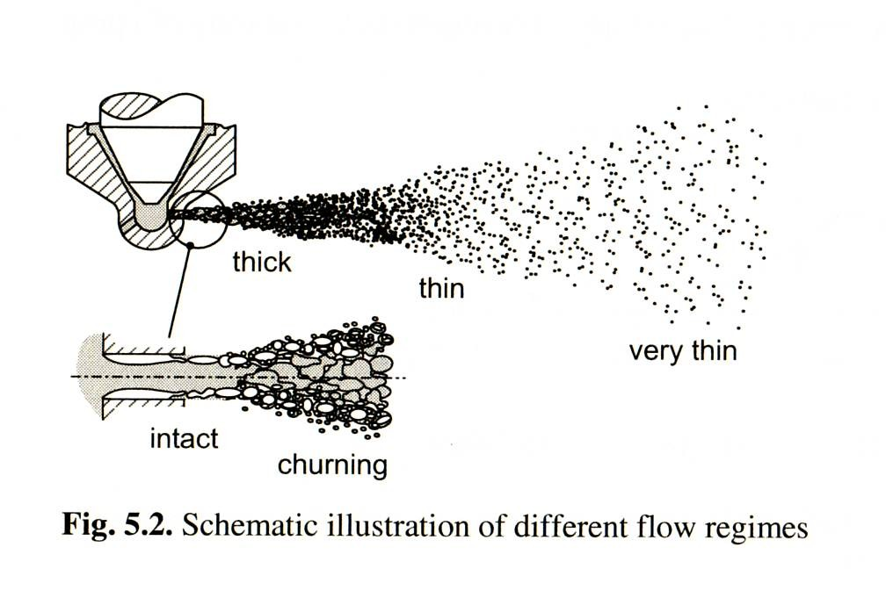
Spray Breakup Mechanisms
Current view of the most important mechanisms leading to spray/droplet atomization and breakup:
Aerodynamic breakup
Cavitation
Nozzle turbulence induced instabilities

Slide 8
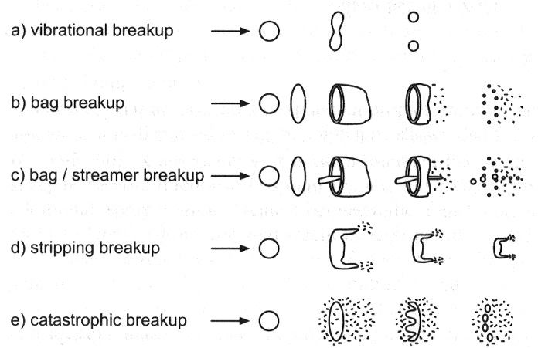

Droplet Breakup
Atomization → Secondary breakup
Weber number
We
~ 12
< ~ 25
$$We=\frac{ρ_{g }d{ u}_{rel}^{2}}{σ}$$
< ~ 50
< ~ 100
> ~ 100

Slide 9
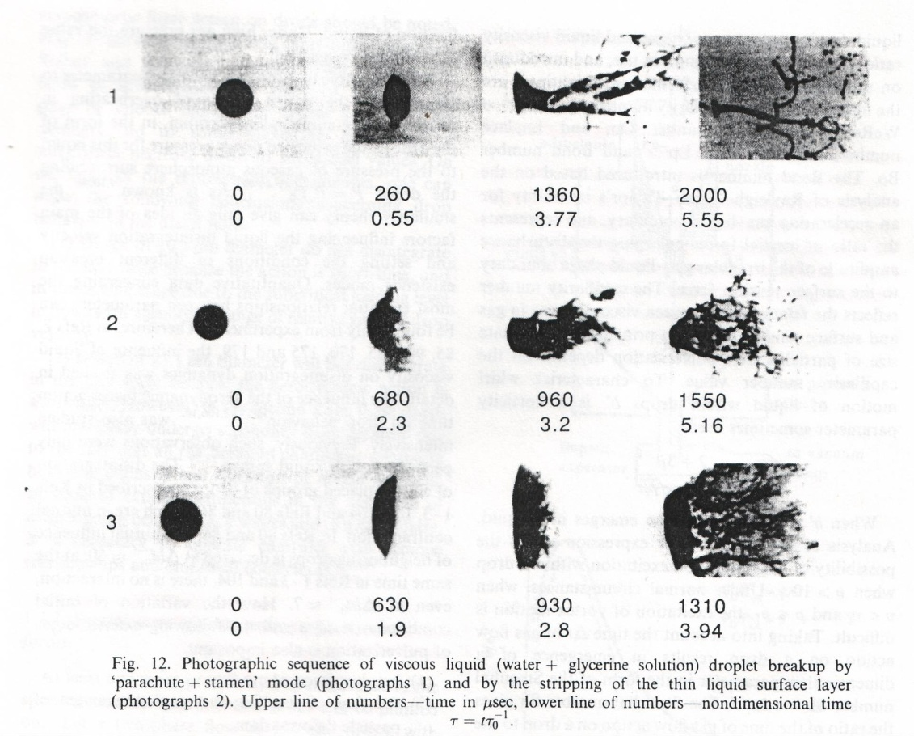
Droplet Breakup
We=60
Re=4500
We=90
Re=7400
We=110
Re=8300
Figures by B.E. Gelfand, 1996
Proc. Energy Combust. Sci. Vol. 22

Slide 10
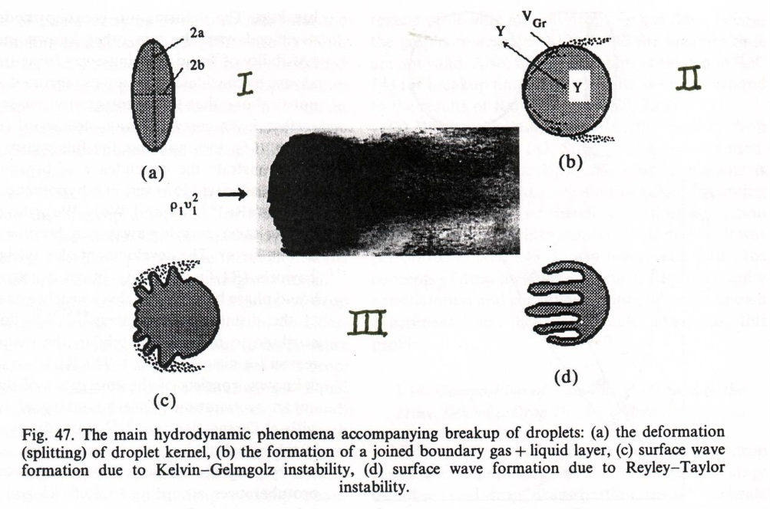
Droplet Breakup
The main hydrodynamic phenomena accompanying droplet breakup: (a) deformation of droplet, (b) formation of boundary layer ’gas + liquid’, (c) surface wave formation by Kelvin-Helmholtz (KH) instability, (d) surface wave formation by Rayleigh-Taylor (RT) instability
B.E. Gelfand, 1996
Proc. Energy Combust. Sci. Vol. 22

Slide 11
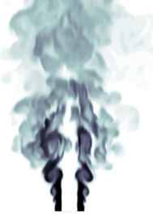
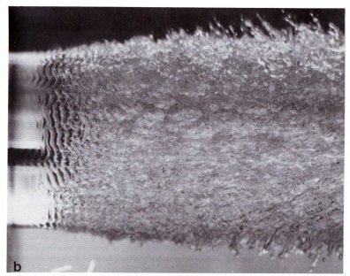
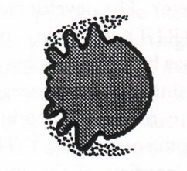
Kelvin-Helmholtz Instabilities
Already discussed with the context of jets and primary atomization
Can also be associated with droplet breakup
K-H wave formation leading to stripping breakup
Vuorinen, 2011

Slide 12
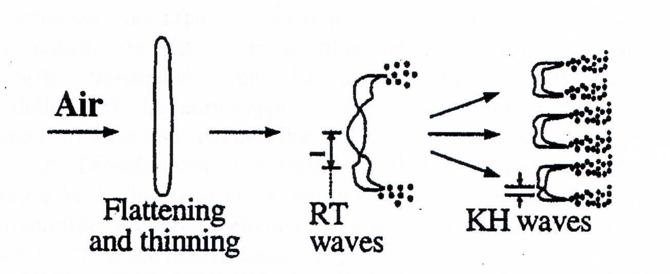
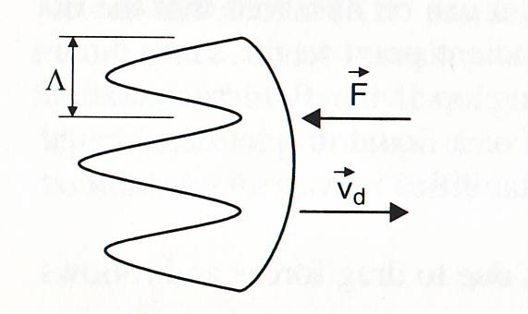

Rayleigh-Taylor Instabilities
The Rayleigh-Taylor mechanism is incorporated into some breakup models.
Typically R-T instabilities account for the large droplet formation near the nozzle.
The K-H instabilities form the small droplets due to surface stripping.

Slide 13
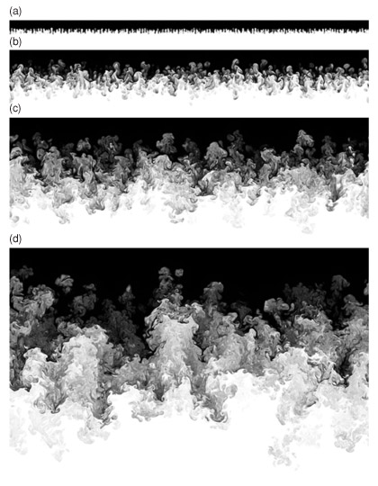
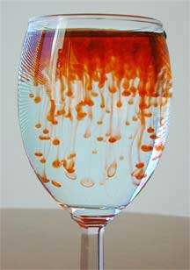
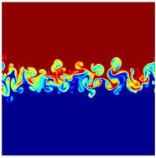
Rayleigh-Taylor Instabilities
Occurs between fluids with different densities
E.g. heavier fluid on top of lighter fluid. Gravity pulls the heavier fluid into the lighter one.

Slide 14
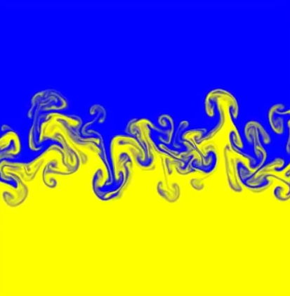

Rayleigh-Taylor Instabilities

Slide 15
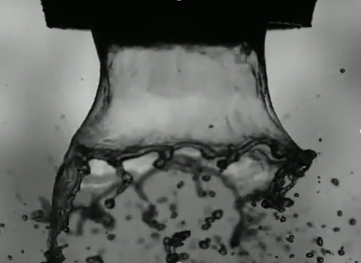
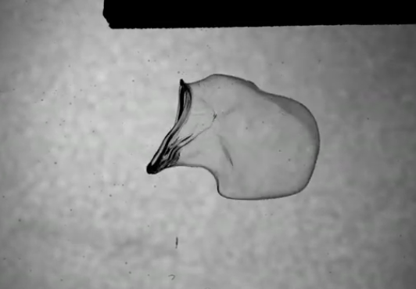
Atomization & Droplet Breakup

Slide 16
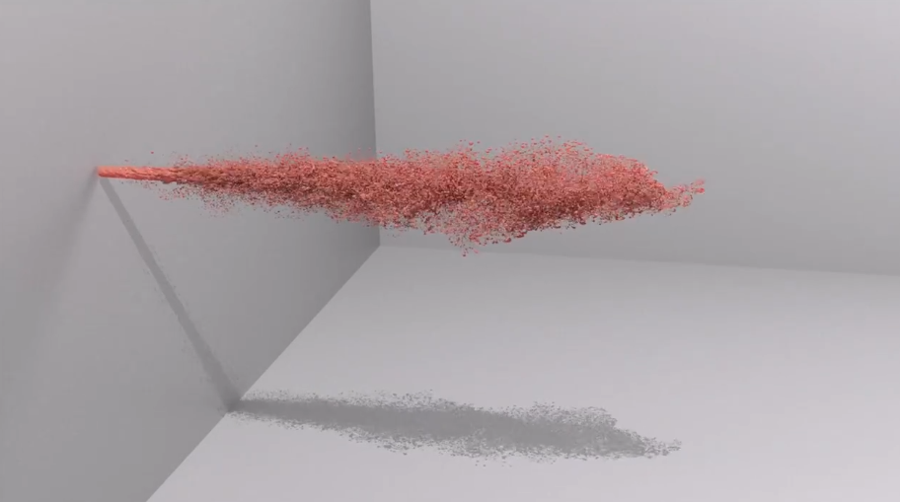
Atomization & Droplet Breakup

Slide 17

Droplet Breakup Modeling
Reitz-Diwakar model
Breakup rate
where is the breakup time scale and is the stable droplet size .
For bag breakup, We > 12, the time scale is
For stripping breakup, , the time scale is
, typically C_{s} =20 (ranging between 2…30)
$$\frac{d(d)}{dt}=\frac{d−d_{s}}{τ_{b}}$$

Slide 18
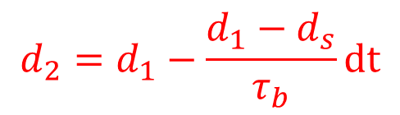

Droplet Breakup Modeling
$$\frac{d(d)}{dt}=\frac{d−d_{s}}{τ_{b}}$$
From we get
Eq. (3) can be used to asses the droplet breakup process.
The stable Weber -number is obtained by assuming We=12
and calculating the equivalent droplet size.
$$d_{2}=d_{1}−\frac{d_{1}−d_{s}}{τ_{b}}dt$$
(3)

Slide 19
Exercise
Droplet Weber number is 20 and
Reynolds number is 300. Fuel density is 800kg/m3,
gas density is 1.2 kg/m3, surface tension is 0.03 N/m.
The gas velocity is 100 m/s and the droplet velocity is
200 m/s. Droplet diameter is 50 μm
Calculate
  What is the stable droplet size (We=12) ?
  Bag or stripping type of breakup mode ?
  Calculate the new droplet diameter after one breakup. Dt=10μs.

Slide 20
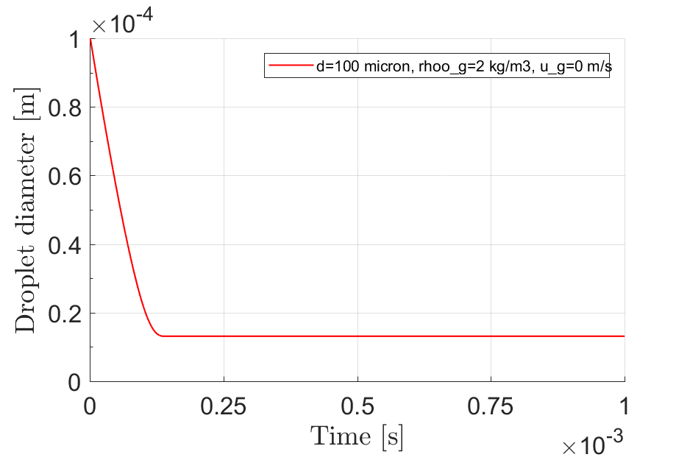
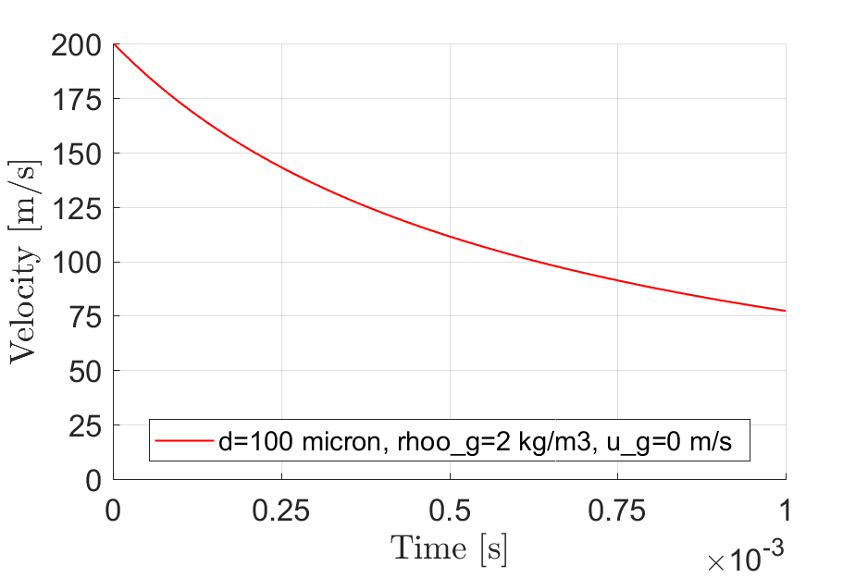
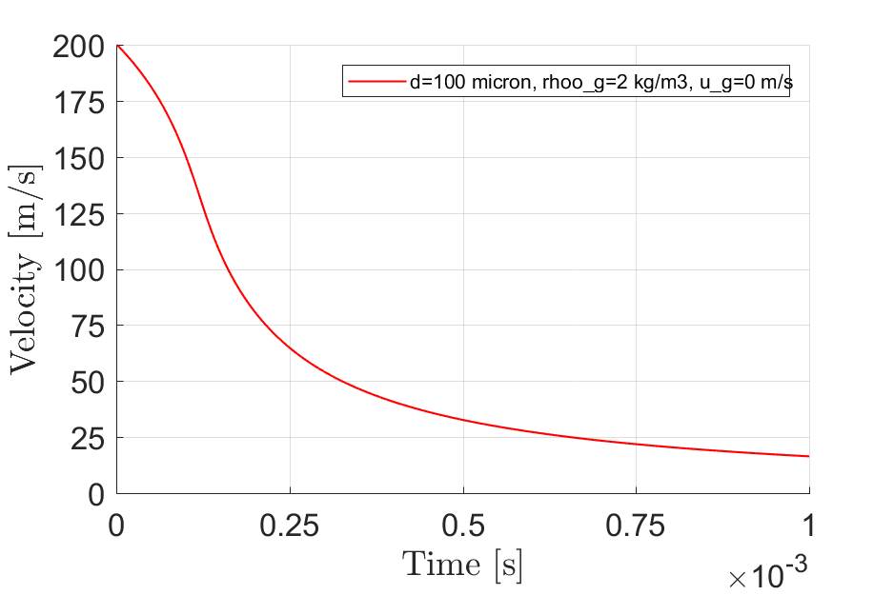
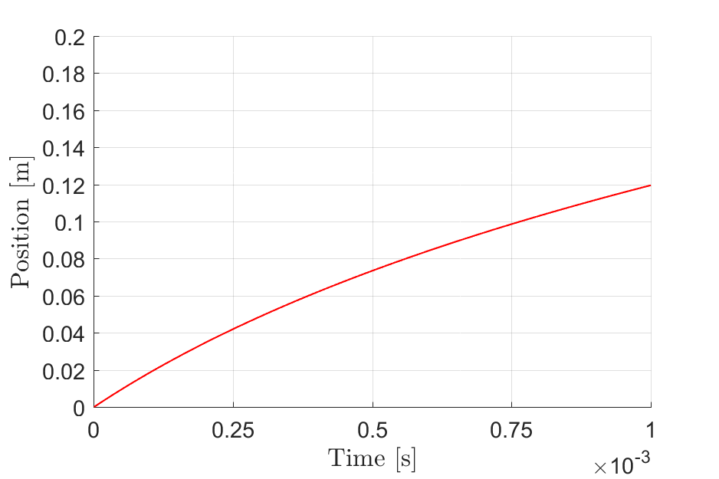
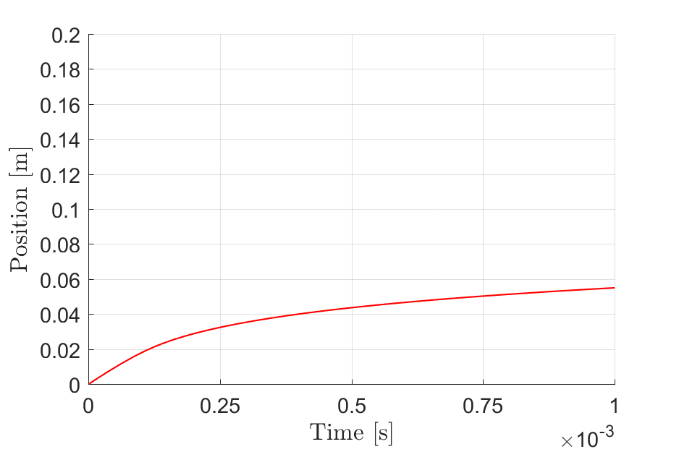
0d Matlab results
Breaking up drops
No breakup

Slide 21
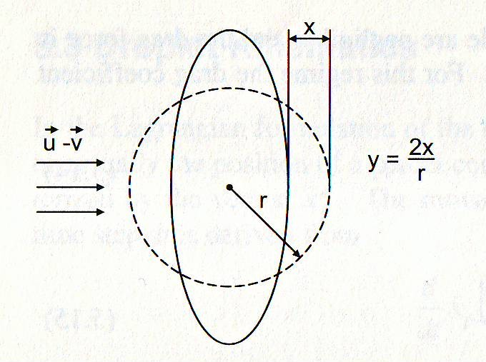
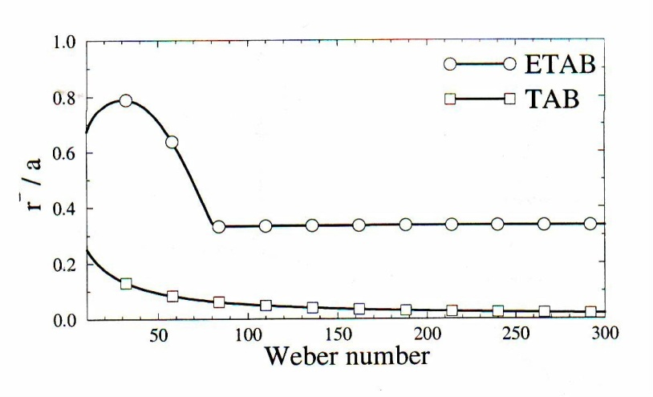

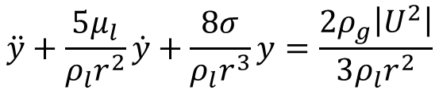
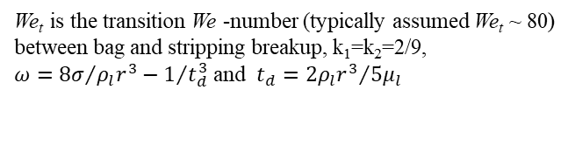

Droplet breakup Modeling
ETAB model
Distortion of droplet by drop deformation parameter
Equation for y is given by the
harmonic oscillator
This can be solved for y
The main idea of ETAB is to delay the first drop breakup in order to yield bigger droplets after breakup as the TAB model predicts generally too small droplets
This is done by initializing drops with negative deformation velocity
The breakup rate
$$\ddot{y}+\frac{5μ_{l}}{ρ_{l}r^{2}}\dot{y}+\frac{8σ}{ρ_{l}r^{3}}y=\frac{2ρ_{g}\left|U^{2}\right|}{3ρ_{l}r^{2}}$$
$$\frac{r_{child}}{r_{parent}}$$
$$\dot{y}\left(0\right)<0$$
where
We_{t} is the transition We -number (typically assumed We_{t} ~ 80) between bag and stripping breakup, k₁=k₂=2/9,
$ω={8σ}/{ρ_{l}r^{3}−1/{t_{d}^{3}}}$ and $t_{d}={2ρ_{l}r^{3}}/{5μ_{l}}$

Slide 22

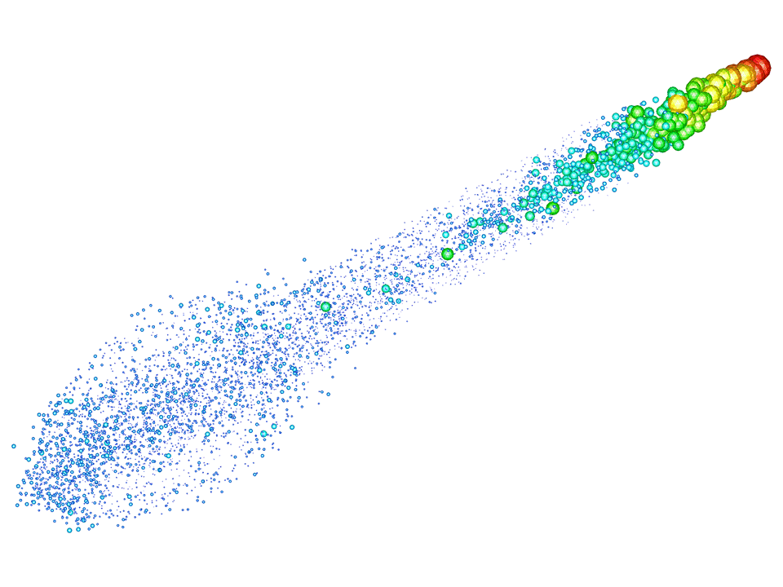
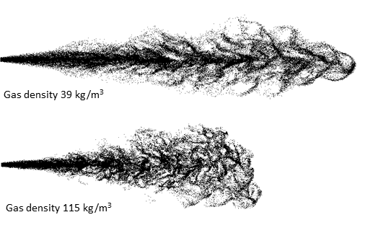
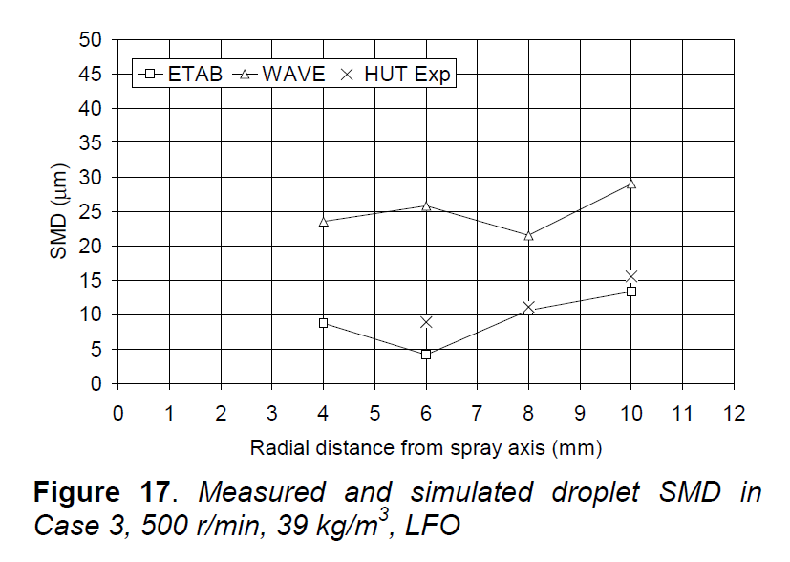
Some Results
RANS spray
LES spray
Kaario et al., Ilass 2002
All SMD results are about 60mm from the nozzle
At this distance, the correspondence between experiments and measurements is rather good
However, little is known about the rate of breakup before the measurement point
Larmi et al., SAE 2002-01-0946
Kaario et al., 2013

Slide 23

Characteristic numbers
Sauter mean diameter (SMD)
Weber number
Ohnesorg number
Stokes number
$$SMD=\frac{\sum_{1}^{n}{d^{3}}}{\sum_{1}^{n}{d^{2}}}$$

Slide 24
Group Work
Discuss in pairs (about 10 min):
What are the most important mechanisms leading to droplet breakup ?
What two surface wave / instability types are responsible for final droplet breakup ?
What dimensionless number governs the breakup phenomena ? What physical quantities in that number are most important ?
How is the breakup phenomena described in the Reitz-Diwakar (Wave) breakup model ?

Slide 25
Evaporation

Slide 26


Droplet Evaporation
Heat is transferred to the droplet (conduction, convection)
Vapor is transferred from the droplet (conduction, convection)
Possible temperature increase
Overall rate depends:
  Droplet properties:
    Diameter
    Temperature
    Relative droplet-gas velocity
  Surrounding gas properties:
    Pressure
    Temperature
    Composition
$$\dot{q}$$
$${\dot{m}}_{d}$$
T[Cº]

Slide 27

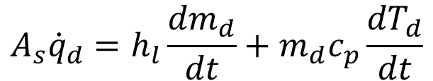


Droplet Evaporation
$$\dot{q}$$
$${\dot{m}}_{d}$$
Droplet energy balance
where is surface heat flux, h is the heat transfer coefficient, and is the latent heat of phase change.
Heat transfer coefficient has to be evaluated, typically correlations based on Nusselt number, conductivity and droplet size.
Eventually wet-bulb temperature is reached (wet bulb temperature means droplet surface temperature during steady-state evaporation)
$$A_{s}{\dot{q}}_{d}=h_{l}\frac{{dm}_{d}}{dt}+m_{d}c_{p}\frac{{dT}_{d}}{dt}$$
T[Cº]
${\dot{q}}_{d}=h\left(T_{d}−T\right)$

Slide 28
Drop Evaporation
Figure G. M. Faeth
Heat up phase
  -low fuel vapor concentration at the drop surface
  -strong temperature gradient
Later, increased fuel vapor concentration
  -this reduces the heat transfer to the droplet
  -eventually the wet bulb temperature is reached where all the heat goes to the latent heat of evaporation

Slide 29
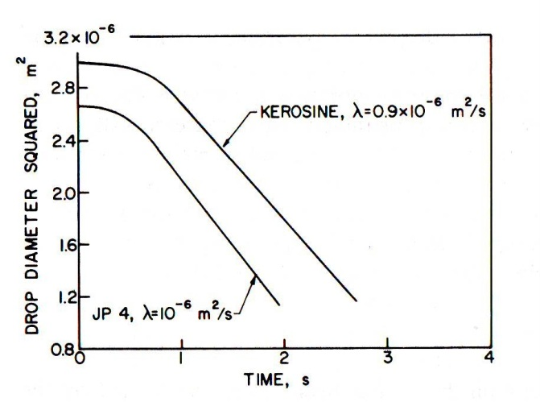
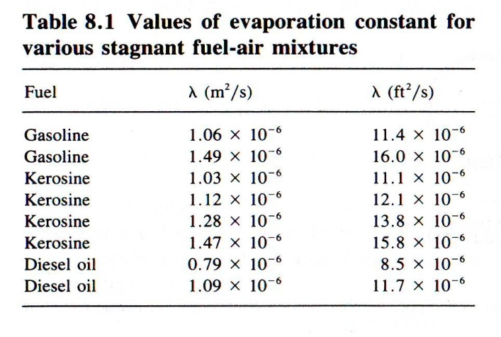

Measurement of evaporation rate
When droplet evaporation is measured, after an initial transitional period, drop diameter decreases according to
or
This is called the “D² law” where
is the evaporation constant
Straight line indicates wet-bulb
temperature
Setting $d=0$ gives us the evaporation
time
Figures A. Lefebvre, 1989

Slide 30

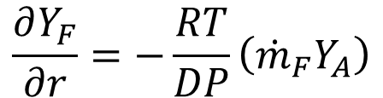


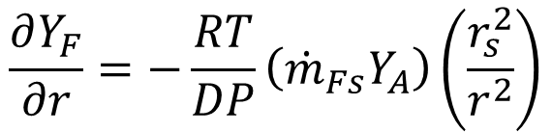



Mass Transfer
$$Y_{Fs}$$
$$Y_{F}$$
$$r_{s}$$
$$r$$
Equation for the rate of evaporation of a fuel drop
The derivation for the droplet evaporation equation
is cumbersome and hence only main points are
presented. Further reading in A. H. Lefebvre and G. M.
Faeth (see end of presentation for more details).
Assuming the driving force for species diffusion is the concentration gradient in the direction of the diffusion path, the following expression is obtained for an evaporating drop when starting from vapor phase convection – diffusion equation, and using the ideal gas law:
From continuity of the mass rate of diffusion, we
get from
$$\frac{∂Y_{F}}{∂r}=−\frac{RT}{DP}\left({\dot{m}}_{F}Y_{A}\right)$$
$$Y_{F}=fuel mass fraction$$
$Y_{A}=air mass fraction$
$$\dot{\begin{aligned}{ \dot{m}}_{F}=mass rate of diffusion \\ (per unit area)\end{aligned}}$$
$$D=diffusion coefficen$$
$P=pressure$
$T=temperature$
$${\dot{m}}_{Fs}4πr_{s}^{2}={\dot{m}}_{F}4πr^{2}$$
$$\frac{∂Y_{F}}{∂r}=−\frac{RT}{DP}\left({\dot{m}}_{Fs}Y_{A}\right)\left(\frac{r_{s}^{2}}{r^{2}}\right)$$

Slide 31
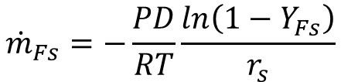

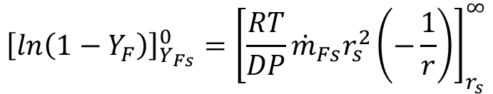

Mass Transfer
Rearranging gives ($Y_{A}=1−Y_{F})$
Boundary conditions are
Integrating between r=r_{s}→r∞
_{Or}
$0−ln\left(1−Y_{Fs}\right)=0 −\frac{RT}{DP}{\dot{m}}_{Fs}r_{s}^{2}\left(−\frac{1}{r_{s}}\right)$
We get
$$\frac{dY_{F}}{1−Y_{F}}=−\frac{RT}{DP}{\dot{m}}_{Fs}r_{s}^{2}\frac{dr}{r^{2}}$$
$${\left[ln\left(1−Y_{F}\right)\right]}_{Y_{Fs}}^{0}={\left[\frac{RT}{DP}{\dot{m}}_{Fs}r_{s}^{2}\left(−\frac{1}{r}\right)\right]}_{r_{s}}^{∞}$$
$${\dot{m}}_{Fs}=−\frac{PD}{RT}\frac{ln\left(1−Y_{Fs}\right)}{r_{s}}$$

Slide 32
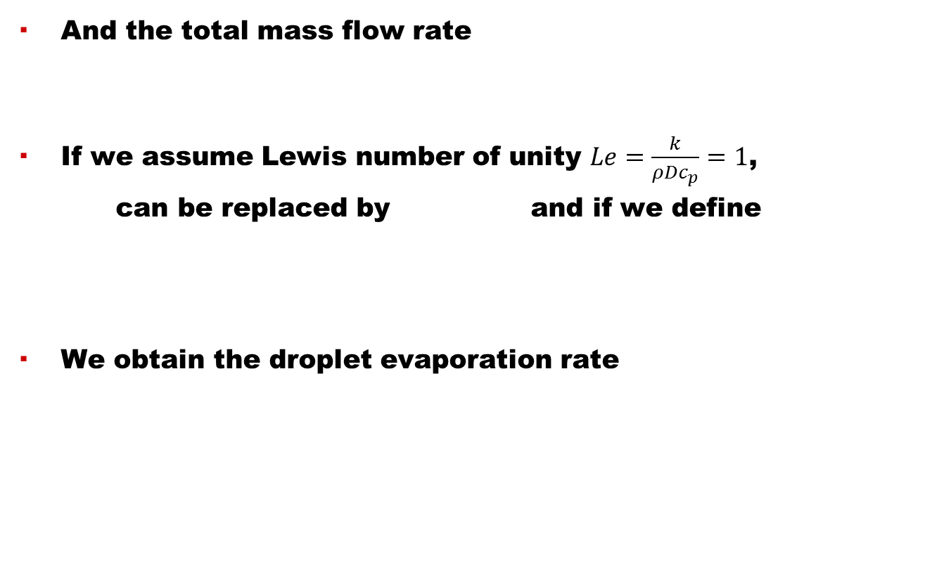
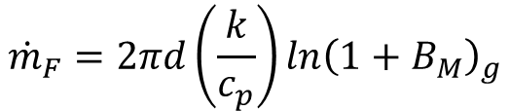
Mass Transfer
And the total mass flow rate
If we assume Lewis number of unity $Le=\frac{k}{ρDc_{p}}=1$,
can be replaced by and if we define
We obtain the droplet evaporation rate
$${\dot{m}}_{F}=4πr_{s}^{2}{\dot{m}}_{Fs}=4πr_{s}ρDln\left(1−Y_{Fs}\right)$$
$${\dot{m}}_{F}=2πd{\left(\frac{k}{c_{p}}\right)ln\left(1+B_{M}\right)}_{g}$$
[kg/s]

Slide 33
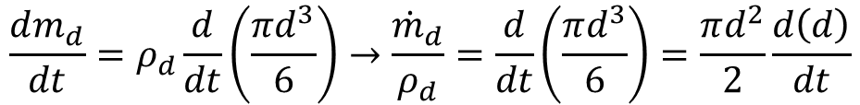
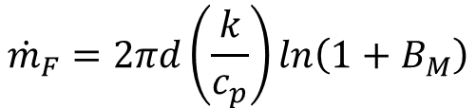
Droplet lifetime
Now we have the Eq. for evaporation rate
and the evaporation time
What would be the total evaporation time ?
Droplet mass is
And the rate of mass change is
$${\dot{m}}_{F}=2πd\left(\frac{k}{c_{p}}\right)ln\left(1+B_{M}\right)$$
derivate
$$\frac{dm_{d}}{dt}=ρ_{d}\frac{d}{dt}\left(\frac{πd^{3}}{6}\right)→\frac{{\dot{m}}_{d}}{ρ_{d}}=\frac{d}{dt}\left(\frac{πd^{3}}{6}\right)=\frac{πd^{2}}{2}\frac{d\left(d\right)}{dt}$$

Slide 34





Droplet lifetime
Evaporation constant is
then
We have
derivate
$λ=−\frac{d\left(d^{2}\right)}{dt}→2d\frac{d\left(d\right)}{dt}$ →
$$\frac{d(d)}{dt}=\frac{λ}{2d}$$
$$\frac{{\dot{m}}_{d}}{ρ_{d}}=\frac{πd^{2}}{2}\frac{d\left(d\right)}{dt}$$
$$\frac{{\dot{m}}_{d}}{ρ_{d}}=−\left(\frac{π}{4}\right)λd$$
or
$${\dot{m}}_{d}=−\left(\frac{π}{4}\right)ρ_{d}λd$$

Slide 35


Droplet Lifetime
Now the vapor mass rate must equal the droplet mass change
Solving for we get
Now we can use to obtain the equation for
the droplet lifetime without convection
$${\dot{m}}_{F}={\dot{m}}_{d}→2πd{\left(\frac{k}{c_{p}}\right)}_{g}ln\left(1+B_{M}\right)=−\left(\frac{π}{4}\right)ρ_{d}λd$$
$$λ=\frac{8{\left(k/{c_{p}}\right)}_{g}}{ρ_{d}}ln\left(1+B_{M}\right)$$
[s]

Slide 36






Calculation of Mean Properties
The accuracy of the below equation is
dependent on the choice of the values
for k and c_{p}.
Average mixture or film properties can be estimated e.g.
  One-third or two-thirds rule
  50-50 rule
$$T_{∞}$$
$$r_{s}$$
$$T_{s}$$
$${\dot{m}}_{F}=2πd{\left(\frac{k}{c_{p}}\right)}_{g}ln\left(1+B_{M}\right)$$
$$Y_{Fs}$$
$$Y_{F∞}$$
In OpenFOAM
In Star-CD

Slide 37
Calculation of Mean Properties
Mixture (film) specific heat and thermal conductivity
when
Assuming fuel concentration is zero in the far field
and
  Two-thirds rule gives
  50-50 gives

Slide 38

Effect of Convection
When there is relative velocity between surrounding gas and droplets, the rate of evaporation can be greatly enhanced.
A 100 times increase is possible.
It has been shown that the effects of convection can be taken into account by a correction factor.
Correlations by N. Frössling, and Ranz & Marshall
First one is used when diffusion effects are controlling and the lower one when heat transfer rates are controlling.
$$Re=\frac{ρ_{g}\left|U−U_{p}\right|d}{μ_{g}}$$

Slide 39


Effect of Convection
Rate of fuel evaporation with convection is
Droplet lifetime can be now calculated from
$${\dot{m}}_{F}=2πd{\left(\frac{k}{c_{p}}\right)}_{g}ln\left(1+B_{M}\right)\left(1+0.30{Re}^{0.5}{Pr}^{0.33}\right)$$
$$t_{e}=\frac{ρ_{F}d^{2}}{8\left(k/{c_{p}}\right)ln\left(1+B_{M}\right)\left(1+0.3{Re}^{0.5}{Pr}^{0.33}\right)}$$
[s]

Slide 40

Alternative formulation of droplet mass transfer
Droplet evaporation rate can also be formulated as (Bird et al.)
where is the ambient pressure, is the vapor pressure in the droplet surroundings, and is the vapor pressure at the droplet surface.
The mass transfer coefficient is given by
D_{m} is the mixture (film) vapor diffusivity, R_{m} is the mixture gas constant, and T_{m} is the mean temperature.
This droplet evaporation model is used e.g. in Star-CD
$$\frac{dm_{d}}{dt}=−A_{d}K_{g}p_{g}ln\frac{\left(p_{g}−p_{v,∞}\right)}{\left(p_{g}−p_{v,s}\right)}$$

Slide 41


Model by Bird et al.
From the rate of mass change
We get to the new droplet mass by
$$\frac{dm_{d}}{dt}=−A_{d}K_{g}p_{g}ln\frac{\left(p_{g}−p_{v,∞}\right)}{\left(p_{g}−p_{v,s}\right)}$$
$m_{d,new}=m_{d,old}−A_{d}K_{g}p_{g}ln\left(\frac{p_{g}−p_{v,∞}}{p_{g}−p_{v,s}}\right)$dt
(4)

Slide 42






0d Matlab results
Conditions
$$p_{v,∞}=0 Pa$$
$$p_{v,d}=1.3e+5 Pa$$
Time 1 ms → 40 ms
Evaporating drops, no breakup
No evaporation, no breakup

Slide 43



Some Results
Fuel droplets
Temperature scale 800 – 2500K
Moderate temperatures within the fuel spray ~1000K
High fuel concentration ~30%
High gas pressure ~100bar
LES: Evaporation and breakup of a spray
10 mm
$$μm$$
Drop sizes between 10 – 0.01
Drop temperatures between 363 – 580 K

Slide 44
Dimensionless numbers
Lewis number is the ration of thermal and mass diffusivities
where and D is mass diffusivity
  It can also be expressed as
Prandtl number is the ration of momentum and thermal diffusivities
Schmidt number is the ration of momentum and mass diffusivities

Slide 45
Dimensionless numbers
Sherwood number is dimensionless concentration gradient at the surface
Nusselt number is dimensionless temperature gradient at the surface

Slide 46
Primary Factors Influencing Drop
Lifetime
The physical properties of the ambient gas (T, P, Cp..)
The relative velocity between the drop and the surroundings
The properties of the liquid and its vapor (P_{v}, k_{v}, C_{pv}..)
The initial condition of the drop, especially size

Slide 47
Exercise
A 200μm n-heptane fuel droplet is evaporating in 900K environment without convection. Density of the fuel is 700kg/m3, the mean k and c_{p} can be assumed to be 0.04W/mK and 1000J/kgK respectively. The fuel vapor mass fraction at the droplet surface is assumed to be . Calculate the time needed to evaporate the droplet.
The same situation as in 1) but now the relative velocity between the droplet and the surrounding gas is 10 m/s which yields a Reynolds number of 200. Calculate the time needed to evaporate the droplet.

Slide 48
Additional Reading
B.E. Gelfand, Droplet breakup phenomena in flows with velocity lag, Prog. Energy Combust. Sci., Vol. 22, pp. 201-265, 1996.
Reitz, RD, Modeling atomization processes in high-pressure vaporizing sprays, Atomization and spray technology, vol. 3, pp. 309-337, 1987.
F.X. Tanner, Liquid jet atomization and droplet breakup modeling of non-evaporating diesel fuel sprays, SAE paper 970050, 1997.
A., H., Lefebvre, Atomization and Sprays, ISBN 0-89116-603-3, 1989.
Crowe, C.T., Schwarzkof, J.D., Sommerfeld, M., and Tsuji, Y., Multiphase Flows with Droplets and Particles, 2nd edition, CRC Press, ISBN 978-1-4398-4050-4, 2012.

