Slide 1
Masters course in circular economy for Materials Processing
MC-CEMP 2019
5 ECTS
This course has been financed by EIT-RM and created by the following Universities and Institute:
Aalto University, Lappeenranta University of Technology – LUT, KTH royal institute of technology, Mineral and Energy Economy Research Institute of the PAS, Tallinn University of Technology TTU, Technical University of Košice – Tuke, University of Trento.
Responsibe Professor Prof. Rodrigo Serna
rodrigo.serna@aalto.fi
Pedagogical coordinator
Emmi Ollila
emmi.ollila@aalto.fi

Slide 2
Today’s agenda
3rd workshop 11.3.2019
Vk 9 Mon 25.2. 10:15-12 R001/U359b
Starting to work on the problem definition
Vk 10 Mon 4.3. 10:15-12 R001/U359b
Presenting problem definition
Feedback
Starting to work on the solution
Vk 11 Mon 11.3. 10:15-12 R001/U359b
Presenting the possible solution
Feedback
Starting to work on recognising the potential stakeholders
https://pxhere.com/en/photo/1098100
Vk 12 Mon 18.3. 10:15-12 R001/U359b
Presenting the potential stakeholders
Feedback
Starting to work on the business opportunities
Vk 13 Mon 25.3. 10:15-12 R001/U359b
Presenting the whole project, including the business opportunities
Feedback
Developing the project and working on the project report
Vk 15 Mon 8.4. at 23:55
Final project report DL

Slide 3
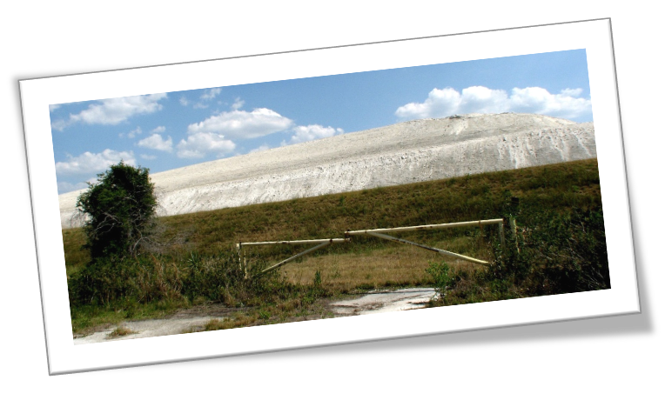
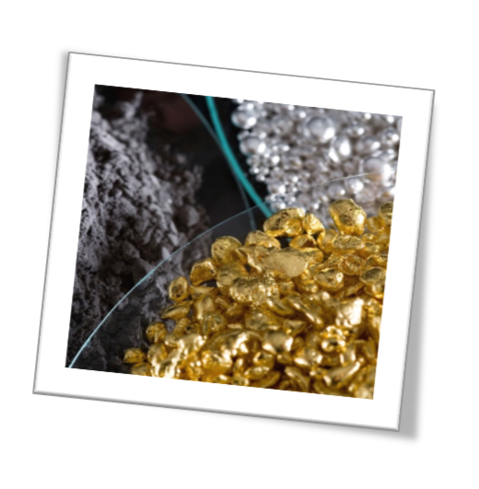
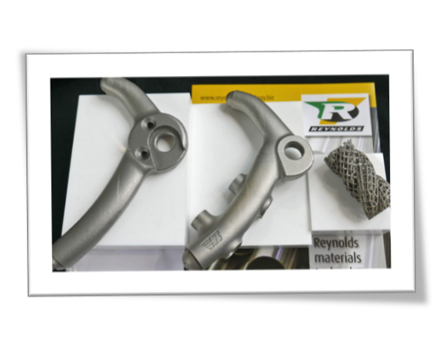
The cases… Presenting current findings:
Utilization prosphogypsum as source of rare earth elements (REE)
Recovery of PM from WEEE
3D printing of metals
Carbon fiber composites in engineering applications
A
By Harvey Henkelmann, Attribution, https://commons.wikimedia.org/w/index.php?curid=2061028
D
B
C

Slide 4
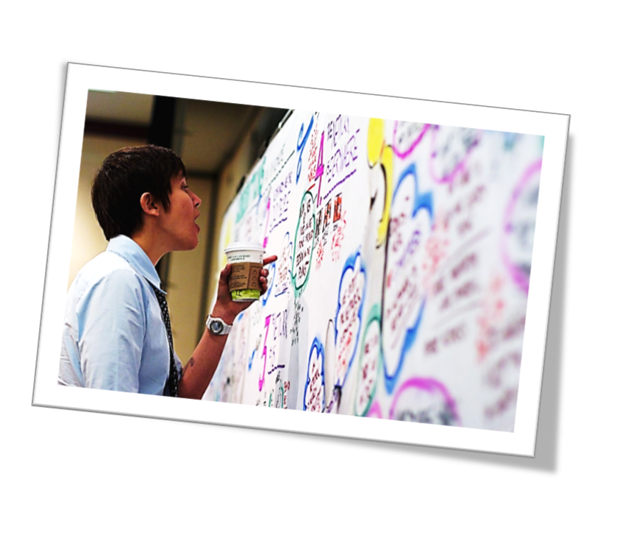
Starting to recognize the stakeholders
Think about your project case and brainstorm:
Write down quick thoughts first by your self:
Who could be our stakeholders?
= Who are affected by our solution?
companies, organizations, groups…
1 thought / post-it
Discuss with your team and organize the post-its
Find information about these stakeholders:
What do they do?
How could that help your project?
Ask for guidance as needed!
Inspiration and tools: Circular Design Guide:
https://www.circulardesignguide.com/methods
https://pxhere.com/en/photo/450206
https://pxhere.com/en/photo/511340

Slide 5
Next steps
Self-guided project work in teams:
Meet up, find information to understand your case, recognize the stakeholders, find information and get ready to present it
Ask for guidance as needed!
https://pixabay.com/en/team-motivation-teamwork-together-386673/
Vk 12 Mon 18.3. 10:15-12 R001/U359b
Presenting the stakeholders (1st version) (~10 min / team)
Feedback
Starting to work on defining the potential business opportunities
https://pixabay.com/en/lamp-hand-bulb-idea-strategy-2247538/

Slide 6
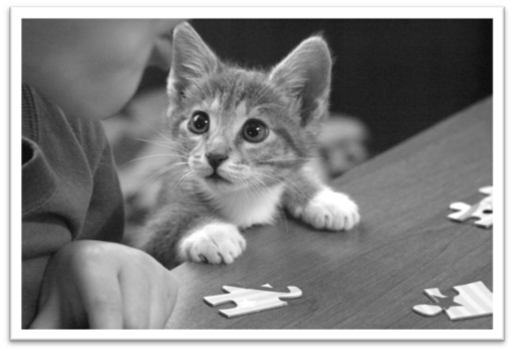
Puzzled?
https://en.wikipedia.org/wiki/File:%C2%BF%C2%BF%C2%BFReally%C2%BF%C2%BF%C2%BF.jpg
Send a message: emmi.ollila@aalto.fi

Slide 7
Acknowledgements
Thank you to EIT-RM for its financial support to create this course.

