Slide 1
Probabilistic Robotics
Bayes Filter Implementations
FastSLAM
ELEC-E8111 Autonomous Mobile Robots
Arto Visala
13. 3.2019

Slide 2
The SLAM Problem
SLAM stands for simultaneous localization and mapping
The task of building a map while estimating
the pose of the robot relative to this map
Why is SLAM hard?
Chicken and egg problem:
a map is needed to localize the robot and
a pose estimate is needed to build a map

Slide 3
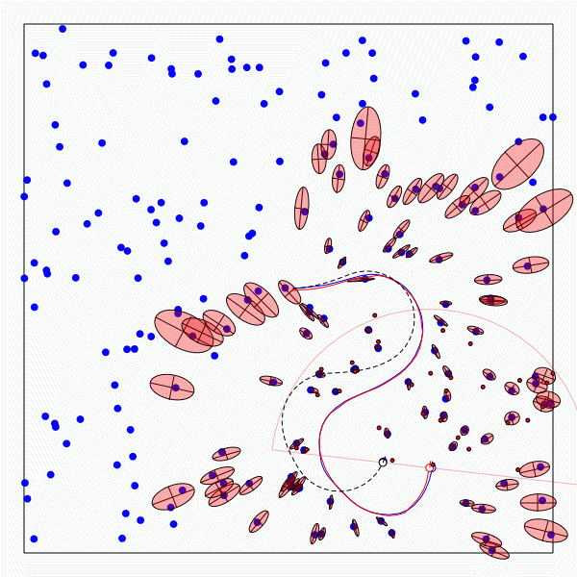
The SLAM Problem
A robot moving though an unknown, static environment
Given:
  The robot’s controls
  Observations of nearby features
Estimate:
  Map of features
  Path of the robot

Slide 4
Why is SLAM a hard problem?
SLAM: robot path and map are both unknown!
Robot path error correlates errors in the map

Slide 5
Why is SLAM a hard problem?
Robot pose
uncertainty
In the real world, the mapping between observations and landmarks is unknown
Picking wrong data associations can have catastrophic consequences
Pose error correlates data associations

Slide 6
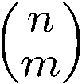
Data Association Problem
A data association is an assignment of observations to landmarks
In general there are more than
(n observations, m landmarks) possible associations
Also called “assignment problem”

Slide 7
Particle Filters
Represent belief by random samples
Estimation of non-Gaussian, nonlinear processes
Sampling Importance Resampling (SIR) principle
  Draw the new generation of particles
  Assign an importance weight to each particle
  Resampling
Typical application scenarios are
tracking, localization, …

Slide 8
Particle Filter algorithm 1/3

Slide 9
Particle Filter algorithm 2/3

Slide 10
Particle Filter algorithm 3/3

Slide 11
Localization vs. SLAM
A particle filter can be used to solve both problems
Localization: state space < x, y, θ>
SLAM: state space < x, y, θ, map>
  for landmark maps = < l₁, l₂, …, l_{m}>
  for grid maps = < c₁₁, c₁₂, …, c_{1n}, c₂₁, …, c_{nm}>
Problem: The number of particles needed to represent a posterior grows exponentially with
the dimension of the state space!

Slide 12
Dependencies
Is there a dependency between the dimensions of the state space?
If so, can we use the dependency to solve the problem more efficiently?

Slide 13
Dependencies
Is there a dependency between the dimensions of the state space?
If so, can we use the dependency to solve the problem more efficiently?
In the SLAM context
  The map depends on the poses of the robot.
  We know how to build a map given the position of the sensor is known.

Slide 14
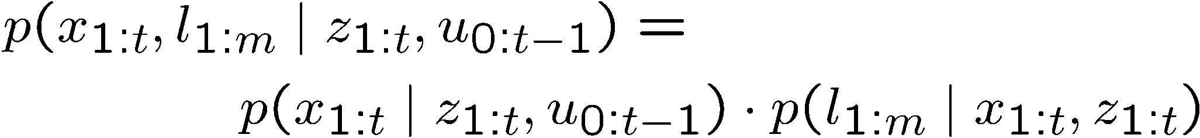
Factored Posterior (Landmarks)
poses
map
observations & movements
Factorization first introduced by Murphy in 1999

Slide 15
Factored Posterior (Landmarks)
poses
map
observations & movements
SLAM posterior
Robot path posterior
landmark positions
Does this help to solve the problem?
Factorization first introduced by Murphy in 1999

Slide 16
Mapping using Landmarks
Landmark 1
l₁
z₁
z₃
observations
x₀
x₁
x₂
x₃
. . .
x_{t}
Robot poses
controls
u₀
u₁
u₁
u_{t-1}
z₂
z_{t}
Landmark 2
l₂
Knowledge of the robot’s true path renders landmark positions conditionally independent

Slide 17
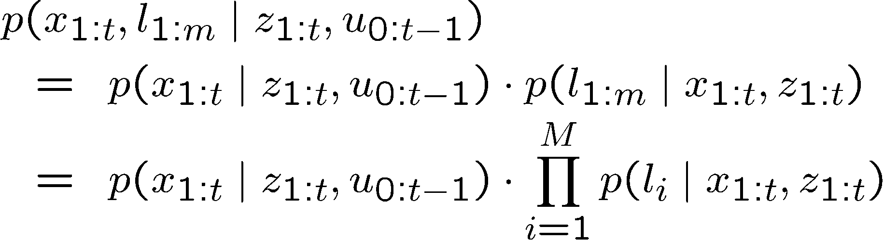
Factored Posterior
Robot path posterior
(localization problem)
Conditionally independent
landmark positions

Slide 18
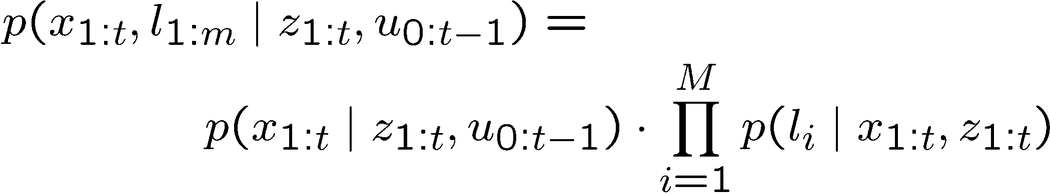
Rao-Blackwellization
This factorization is also called Rao-Blackwellization
Given that the second term can be computed efficiently, particle filtering becomes possible!

Slide 19
FastSLAM
Rao-Blackwellized particle filtering based on landmarks [Montemerlo et al., 2002]
Each landmark is represented by a 2x2
Extended Kalman Filter (EKF)
Each particle therefore has to maintain M EKFs
Particle
#1
x, y, θ
Landmark 1
Landmark 2
Landmark M
…
Particle
#2
x, y, θ
Landmark 1
Landmark 2
Landmark M
…
…
Particle
N
x, y, θ
Landmark 1
Landmark 2
Landmark M
…

Slide 20
FastSLAM algorithm, feature = landmark

Slide 21
FastSLAM – Action Update
Landmark #1
Filter
Particle #1
Landmark #2
Filter
Particle #2
Particle #3

Slide 22
FastSLAM – Sensor Update
Landmark #1
Filter
Particle #1
Landmark #2
Filter
Particle #2
Particle #3

Slide 23
FastSLAM – Sensor Update
Particle #1
Weight = 0.8
Particle #2
Weight = 0.4
Particle #3
Weight = 0.1

Slide 24
FastSLAM Complexity
O(N)
Update robot particles based on control u_{t-1}
Incorporate observation z_{t} into Kalman filters
Resample particle set
Constant time per particle
O(N•log(M))
Log time per particle
O(N•log(M))
Log time per particle
N = Number of particles
M = Number of map features
O(N•log(M))
Log time per particle

Slide 25
Data Association Problem
Which observation belongs to which landmark?
A robust SLAM must consider possible data associations
Potential data associations depend also
on the pose of the robot

Slide 26
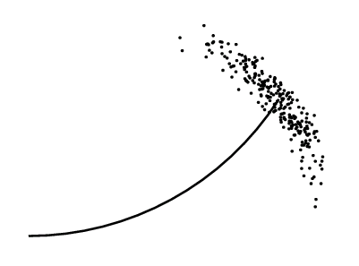
Multi-Hypothesis Data Association
Data association is done on a per-particle basis
Robot pose error is factored out of data association decisions

Slide 27
Per-Particle Data Association
Was the observation
generated by the red
or the blue landmark?
P(observation|red) = 0.3
P(observation|blue) = 0.7
Two options for per-particle data association
  Pick the most probable match
  Pick an random association weighted by
  the observation likelihoods
If the probability is too low, generate a new landmark

Slide 28
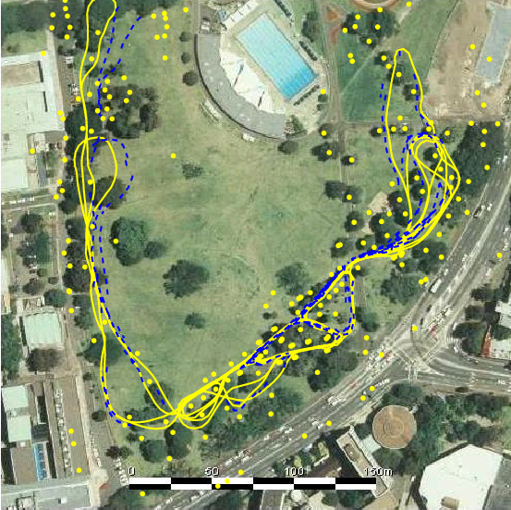
Results – Victoria Park
4 km traverse
< 5 m RMS position error
100 particles
Blue = GPS
Yellow = FastSLAM
Dataset courtesy of University of Sydney

Slide 29
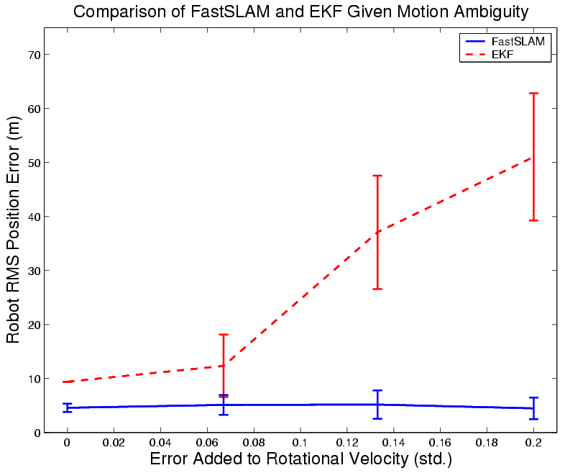
Results – Data Association

Slide 30
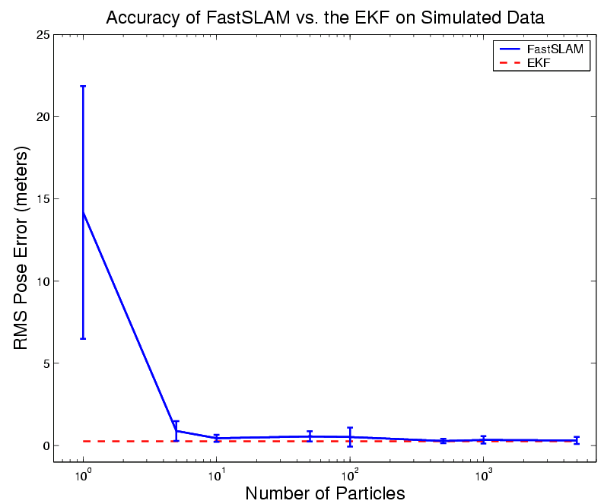
Results – Accuracy

Slide 31
Grid-based SLAM
Can we solve the SLAM problem if no pre-defined landmarks are available?
Can we use the ideas of FastSLAM to build grid maps?
As with landmarks, the map depends on the poses of the robot during data acquisition
If the poses are known, grid-based mapping is easy (“mapping with known poses”)

Slide 32
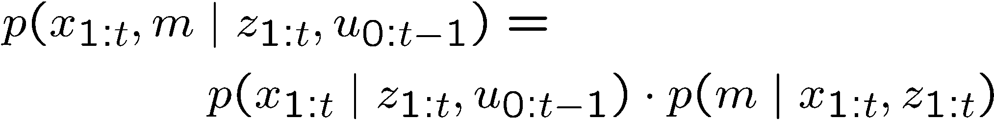
Rao-Blackwellization
poses
map
observations & movements
Factorization first introduced by Murphy in 1999

Slide 33
Rao-Blackwellization
poses
map
observations & movements
SLAM posterior
Robot path posterior
Mapping with known poses
Factorization first introduced by Murphy in 1999

Slide 34
Rao-Blackwellization
This is localization, use MCL
Use the pose estimate
from the MCL part and apply
mapping with known poses

Slide 35
MCL Monte Carlo Localization

Slide 36
A Graphical Model of Rao-Blackwellized Mapping
u
u
u
0
1
t-1
x
x
x
...
x
0
1
2
t
m
z
z
z
1
2
t

Slide 37
Rao-Blackwellized Mapping
Each particle represents a possible trajectory of the robot
Each particle
  maintains its own map and
  updates it upon “mapping with known poses”
Each particle survives with a probability proportional to the likelihood of the observations relative to its own map

Slide 38
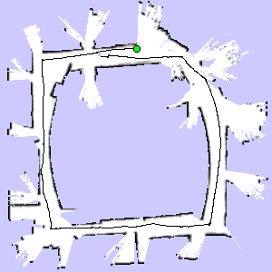
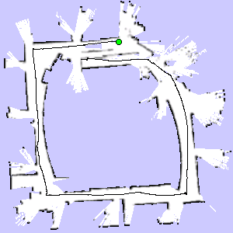

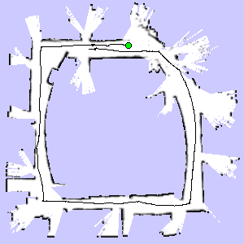
Particle Filter Example
3 particles
map of particle 1
map of particle 3
map of particle 2

Slide 39
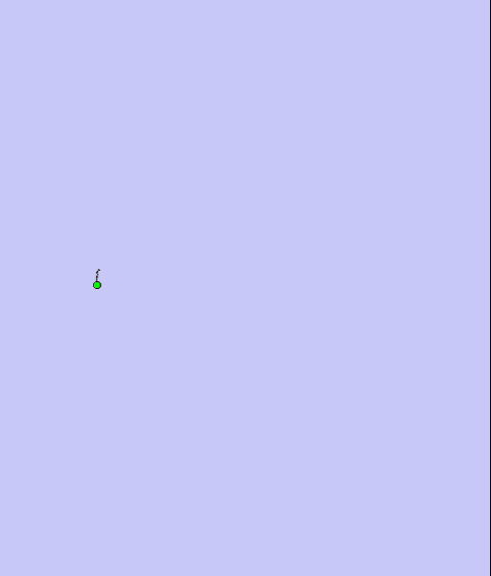
Occupancy grid Fast SLAM

Slide 40
Problem
Each map is quite big in case of grid maps
Since each particle maintains its own map
Therefore, one needs to keep the number of particles small
Solution:
Compute better proposal distributions!
Idea:
Improve the pose estimate before applying the particle filter

Slide 41
Pose Correction Using Scan Matching
Maximize the likelihood of the i-th pose and map relative to the (i-1)-th pose and map
current measurement
robot motion
map constructed so far
Notes:
To compute consistent maps, we apply a recursive scheme.
At each point in time we compute the most likely position of the robot, given the map constructed so far.
Based on the position hat l-t, we then extend the map an incorporate the scan obtained at time t.

Slide 42
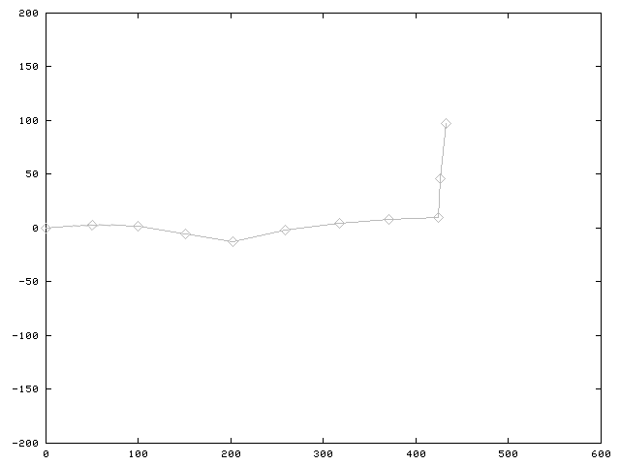
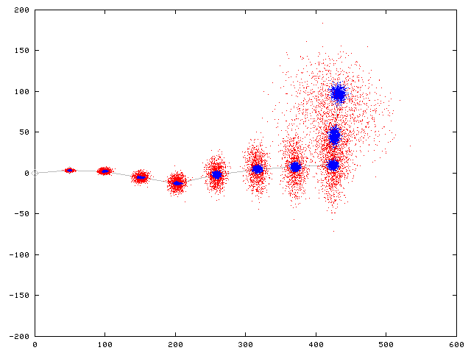
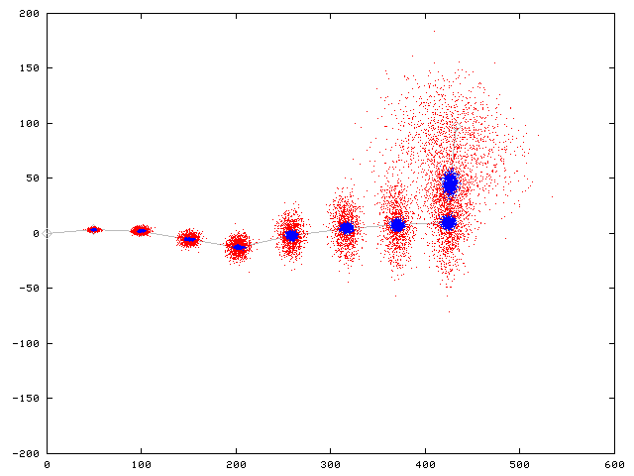
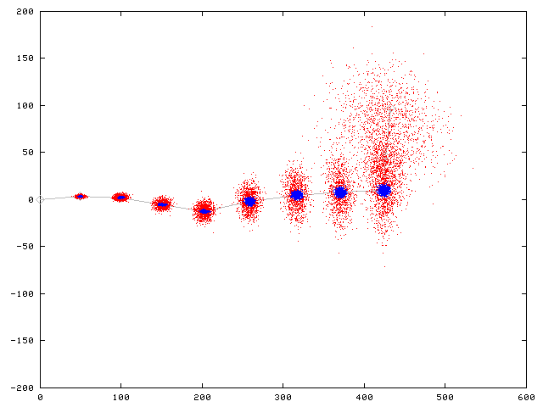
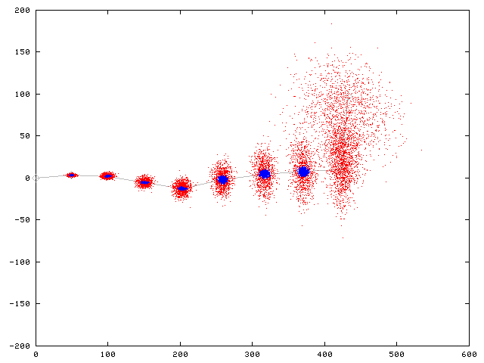







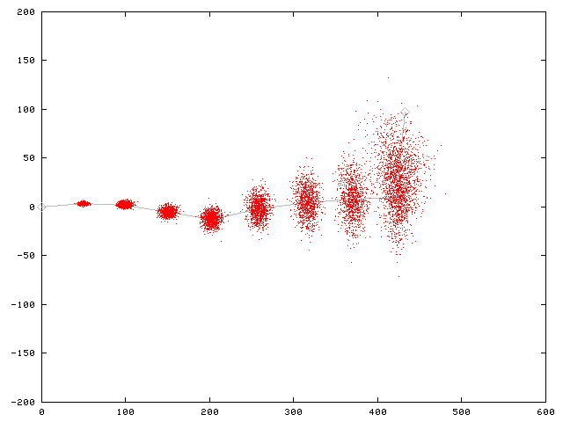
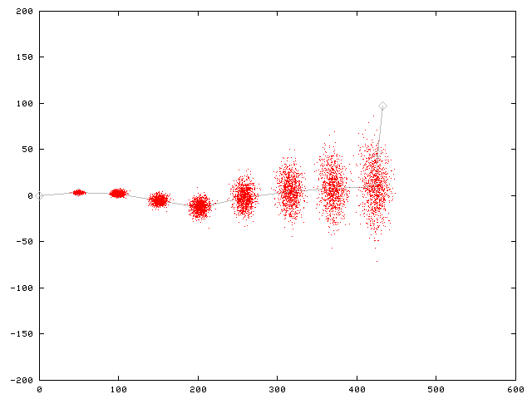
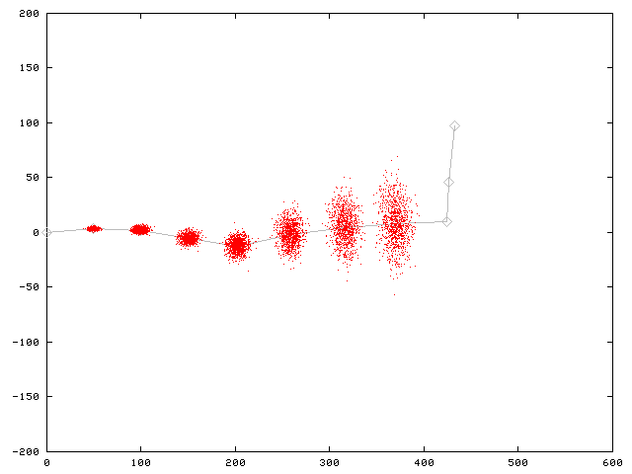
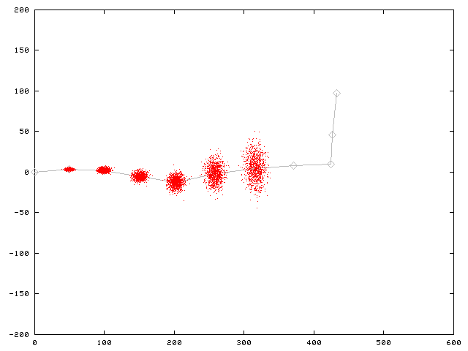
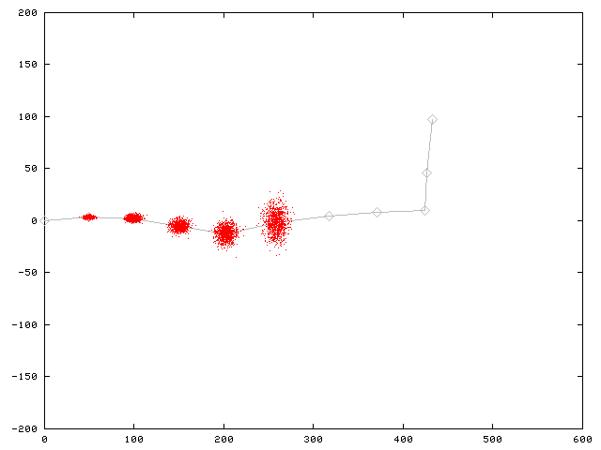
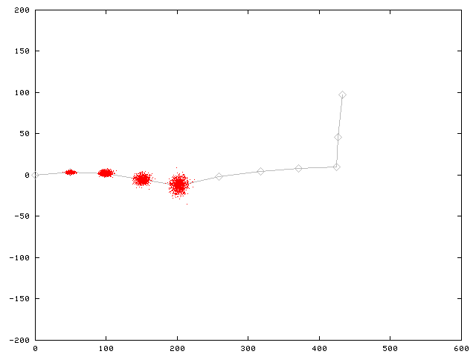
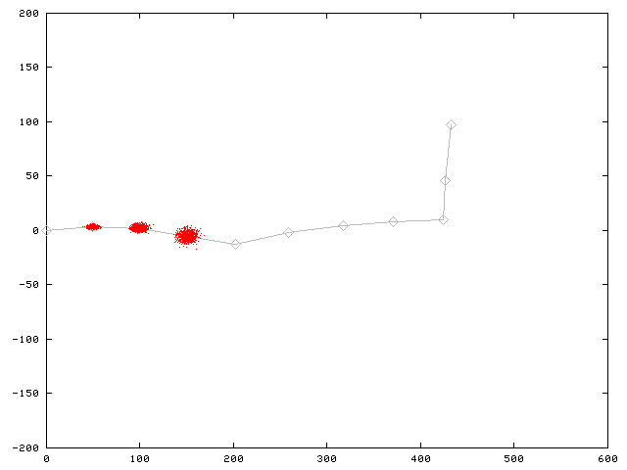
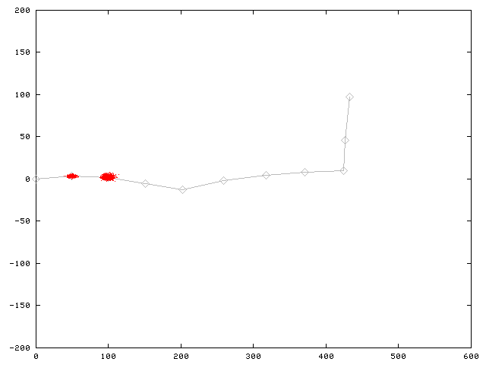
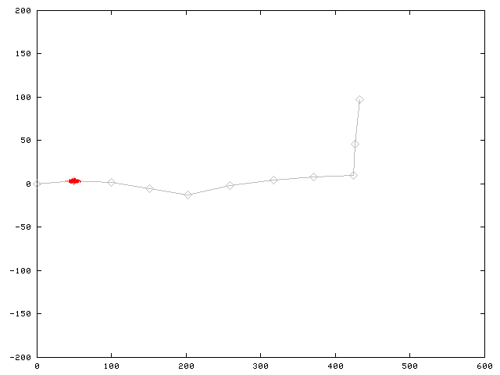
Motion Model for Scan Matching
Raw Odometry
Scan Matching

Slide 43
FastSLAM with Improved Odometry
Scan-matching provides a locally consistent pose correction
Pre-correct short odometry sequences using scan-matching and use them as input to FastSLAM
Fewer particles are needed, since the error in the input in smaller
[Haehnel et al., 2003]

Slide 44
Graphical Model for Mapping with Improved Odometry
u
...
u
u
...
u
u
...
u
0
z
k-1
k
z
2k-1
...
n·k
(n+1)·k-1
z
...
z
...
z
...
z
1
k-1
k+1
2k-1
n·k+1
(n+1)·k-1
u'
u'
...
u'
1
2
n
x
x
x
...
x
0
k
2k
n·k
m
z
z
...
z
k
2k
n·k

Slide 45
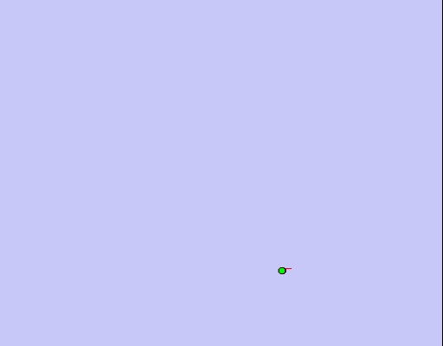
FastSLAM with Scan-Matching

Slide 46
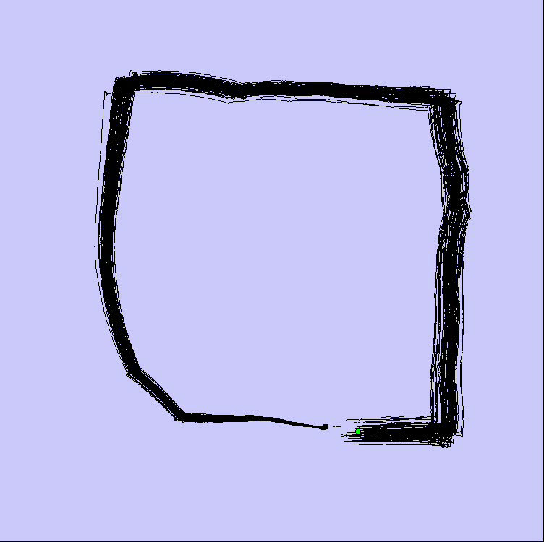
FastSLAM with Scan-Matching
Loop Closure

Slide 47
Further Improvements
Improved proposals will lead to more
accurate maps
They can be achieved by adapting the proposal distribution according to the most recent observations
Flexible re-sampling steps can further improve the accuracy.

Slide 48
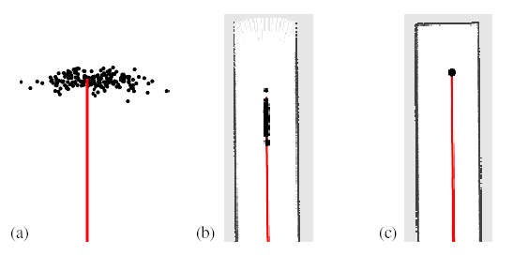
Improved Proposal
The proposal adapts to the structure of the environment

Slide 49
Selective Re-sampling
Re-sampling is dangerous, since important samples might get lost
(particle depletion problem)
In case of suboptimal proposal distributions re-sampling is necessary to achieve convergence.
Key question: When should we re-sample?

Slide 50
Conclusion
The ideas of FastSLAM can also be applied in the context of grid maps
Utilizing accurate sensor observation leads to good proposals and highly efficient filters
It is similar to scan-matching on a per-particle base
The number of necessary particles and
re-sampling steps can seriously be reduced
Improved versions of grid-based FastSLAM can handle larger environments than naïve implementations in “real time” since they need one order of magnitude fewer samples

Slide 51
More Details on FastSLAM
M. Montemerlo, S. Thrun, D. Koller, and B. Wegbreit. FastSLAM: A factored solution to simultaneous localization and mapping, AAAI02
D. Haehnel, W. Burgard, D. Fox, and S. Thrun. An efficient FastSLAM algorithm for generating maps of large-scale cyclic environments from raw laser range measurements, IROS03
M. Montemerlo, S. Thrun, D. Koller, B. Wegbreit. FastSLAM 2.0: An Improved particle filtering algorithm for simultaneous localization and mapping that provably converges. IJCAI-2003
G. Grisetti, C. Stachniss, and W. Burgard. Improving grid-based slam with rao-blackwellized particle filters by adaptive proposals and selective resampling, ICRA05
A. Eliazar and R. Parr. DP-SLAM: Fast, robust simultanous localization and mapping without predetermined landmarks, IJCAI03

