Slide 1
SpecClips

Slide 2
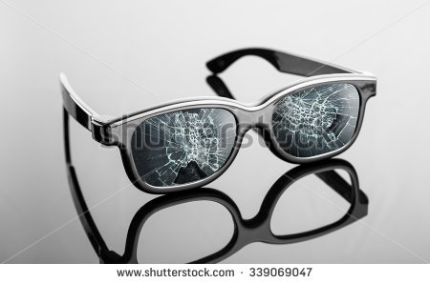
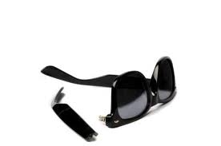
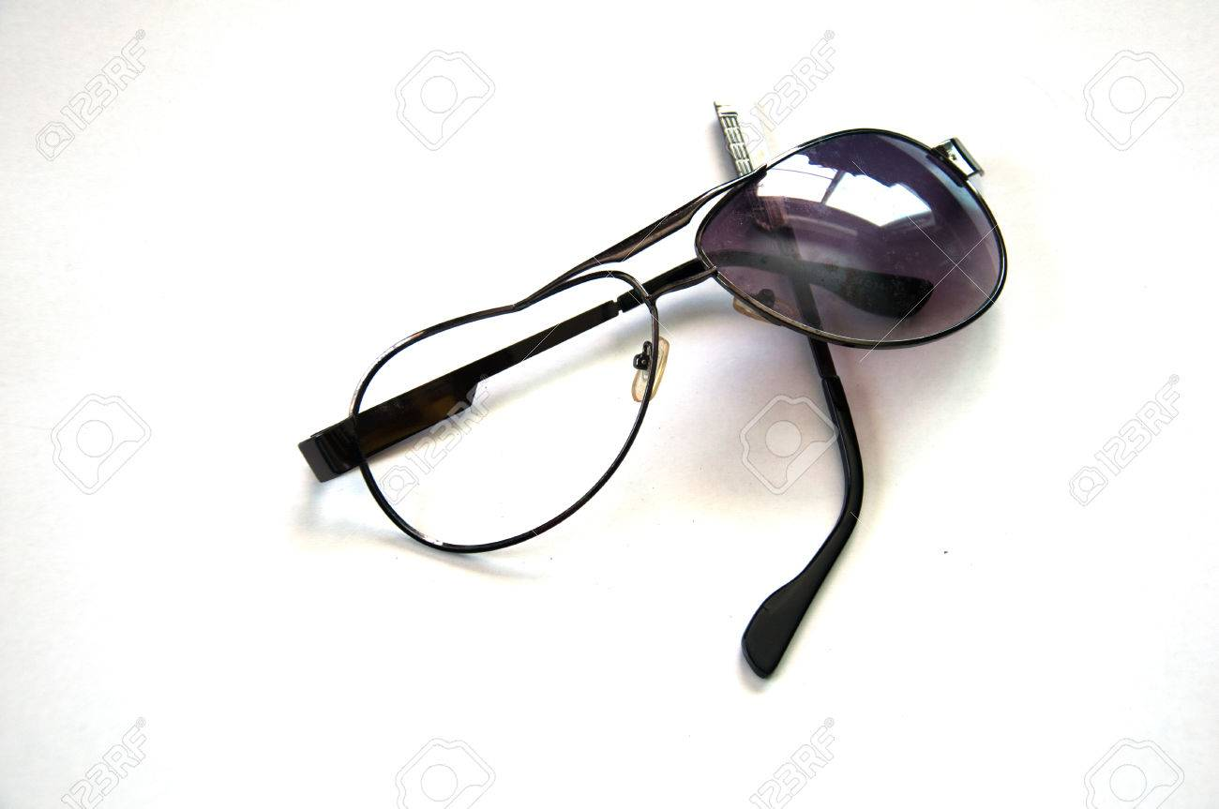

Slide 3
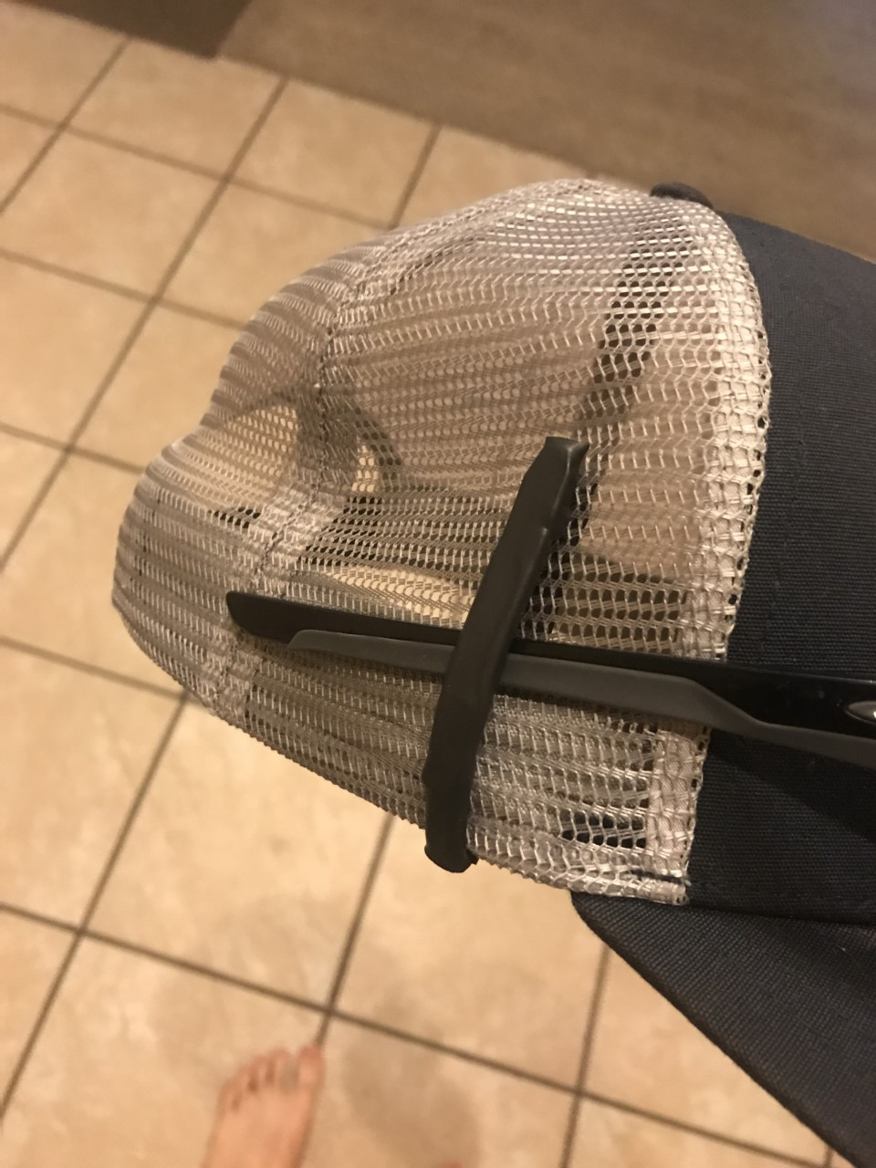
SpecClips?
“Saving everyone’s favorite glasses, one pair at a time!”
This device helps secure sunglasses to one’s cap when the glasses are not in use.
It is unrecognizable, easy-to-use and it actually works.
Using this device, eliminates a very high percentage of having your glasses fall, resulting in damaging or losing of your glasses.

Slide 4
Potential Market
Anyone who has the chance of wearing sunglasses on one’s baseball-style cap.
Athletes
Baseball/softball players, golfers, tennis players, coaches, outdoor refs
Fisherman
Construction workers w/ safety glasses
Average Joes

Slide 5
Industry
181.1 million pairs of glasses sold in the U.S. alone in 2016 w/ 95 million being sunglasses.
Average cost per pair = $125 each
44 million MLB baseball caps sold in U.S in 2016
No number for all baseball style caps

Slide 6
Competition and Advantage
Competitors
Lids Lash - Selling on Amazon - $9.95
Croakies - Selling everywhere - $6.95 - $12.89
Built in pockets - RealTree - $9.99
Advantage
Less Bulky
Discreet
Faster and easier to use
Survey
Over 100 people and more are likely to buy my product

Slide 7
Key Partners
Self
Start by bootstrapping
website
Investors
Open the door
Mass production
Brian Jensen - Fishidy
Over 1 million users - advertising campaigns
Manufacturing - Plastech Engineering in Lake Geneva, WI
Magnets - Cheryl Chen - AliExpress
Distribution - Direct to customer. Weight in product and packaging is light

Slide 8
Key Activities
Filed for Patent
Meeting with engineer
Plastech - Lake Geneva, WI
Found manufacturer
Plastech - Lake Geneva, WI
Creating website and videos
NEXT / Launch
Advertise the product
Social Media
Fishidy
Sell
Website
SpecClips.com

Slide 9
Start-Up Cost
Filing for patent - $150
Engineer consulting - $1000
Website $100 / 3 yrs
Videos - $200
Product = $1200 for mold (for injection molding)
LLC - $170
-$2,820
Raised
$150 grant
$1000 LaunchPad
Potential
Business Plan competition - $3000
Selling Equity to partners - $??????

Slide 10
Operational
Based on demand of product
Each unit finished and packaged = approx $2
$.30 mold + $.10 mags + approx $1.00 package and shipping + approx $.25 assembly per unit (Assembly based on employee $15/hr & extra cushion of $.35 for taxes)
Example month: demand for 10,000 units = $20,000
My salary is yet to be determined

Slide 11
Feasibility/Profitability
Highly Feasible
Potential Profit
Short term - 1 - 2 years
95 million sun glasses sold in U.S.
0.5-1%= 475,000 - 950,000 units
Selling $9.99 = profit of $6.99 per unit
$3.3 million - $6.6 million / year
Long Term - 2 years +
95 million sun glasses sold in U.S.
1-5% = 950,000 - 4.75 million
Selling $9.99 = profit of $6.99 per unit
$6.6 million - $33.2 million / year

