Slide 1
Digiprints Laura Isoniemi 2019

Slide 2
Digital printing is the most egological way of textile printing.No screens are needed

Slide 3
The method is mixing serie production and handicraft possibilites and makes photo illusions possible

Slide 4
It benefits a variety of schecthing possibilities

Slide 5
Skecthing technics and its possibilities

Slide 6
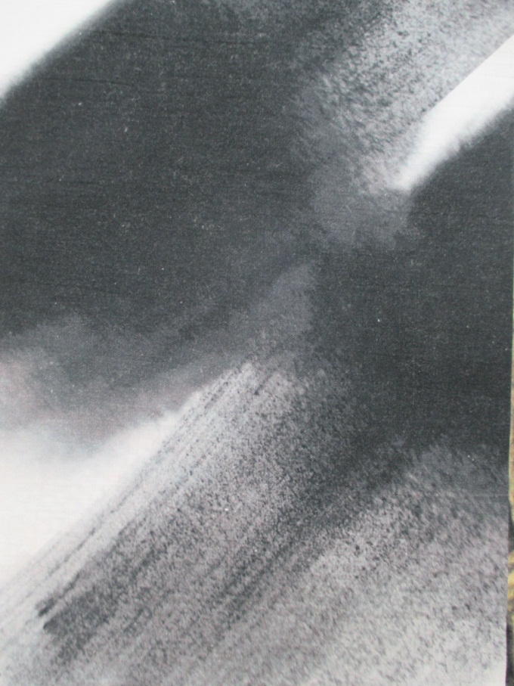

Slide 11
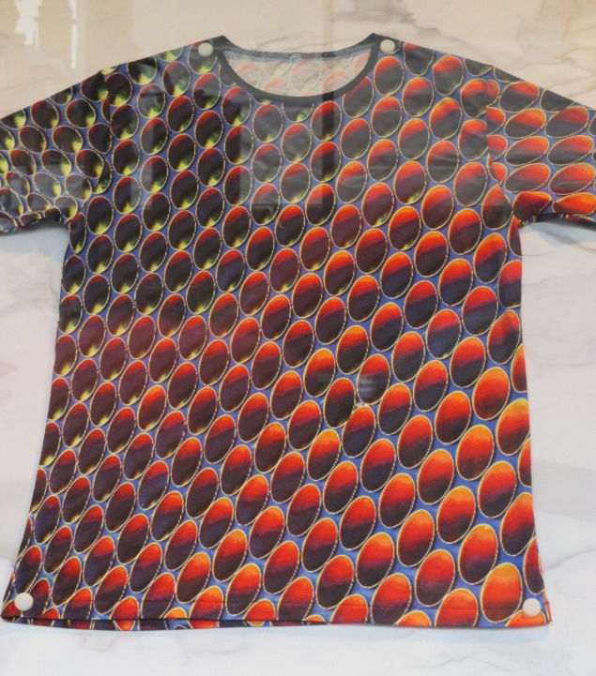

Slide 13
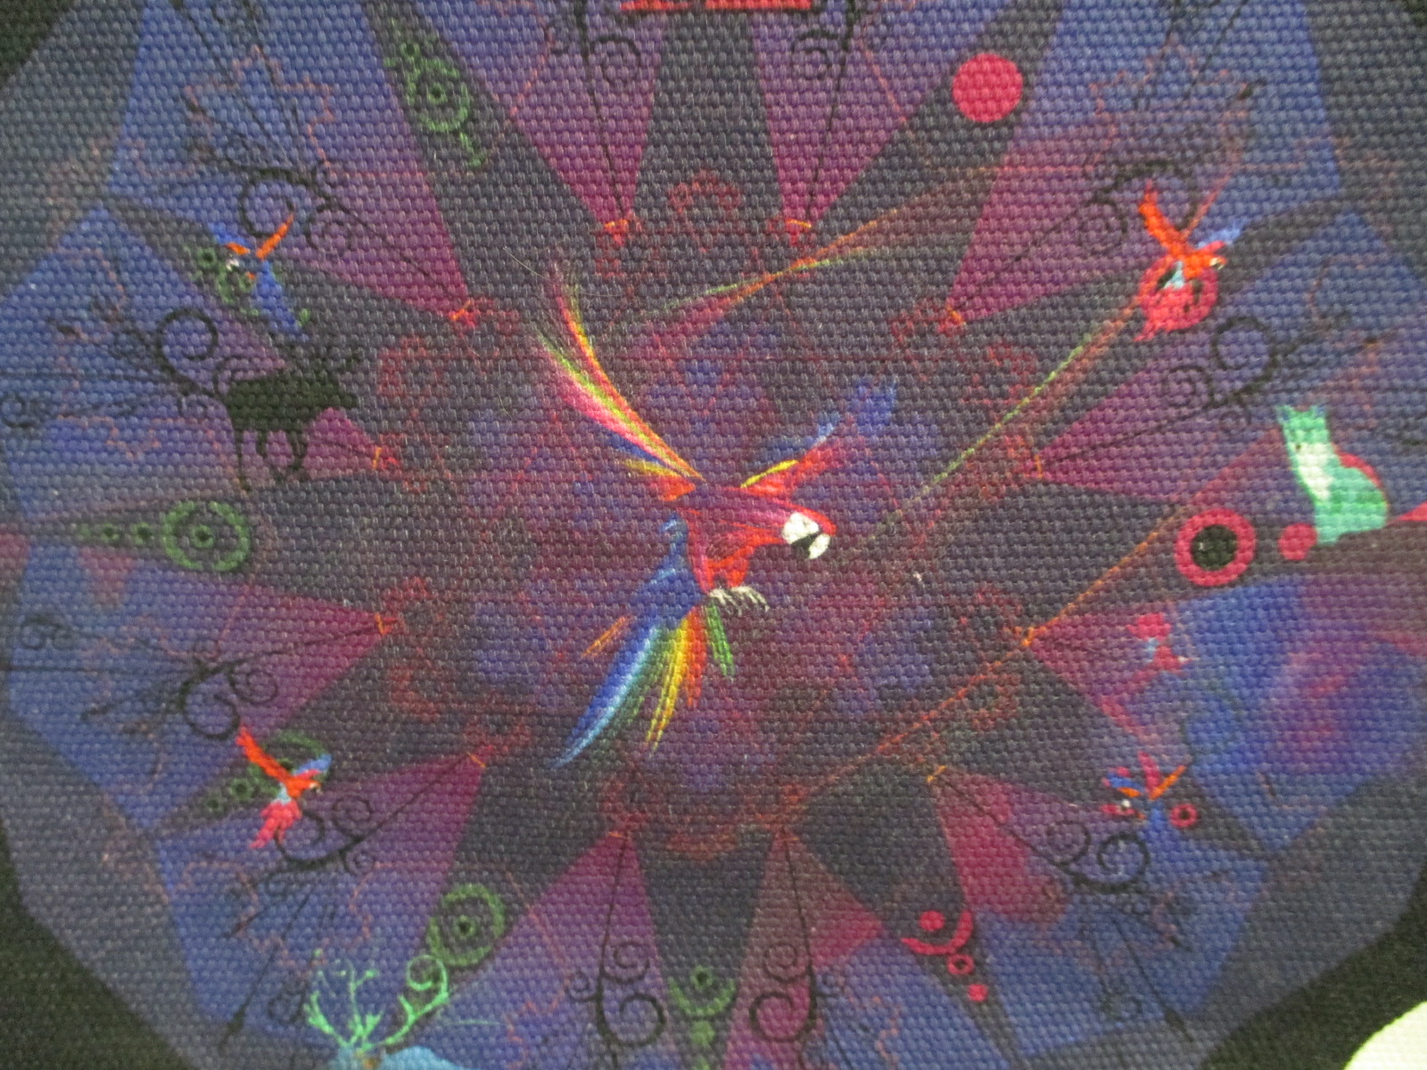

Slide 16
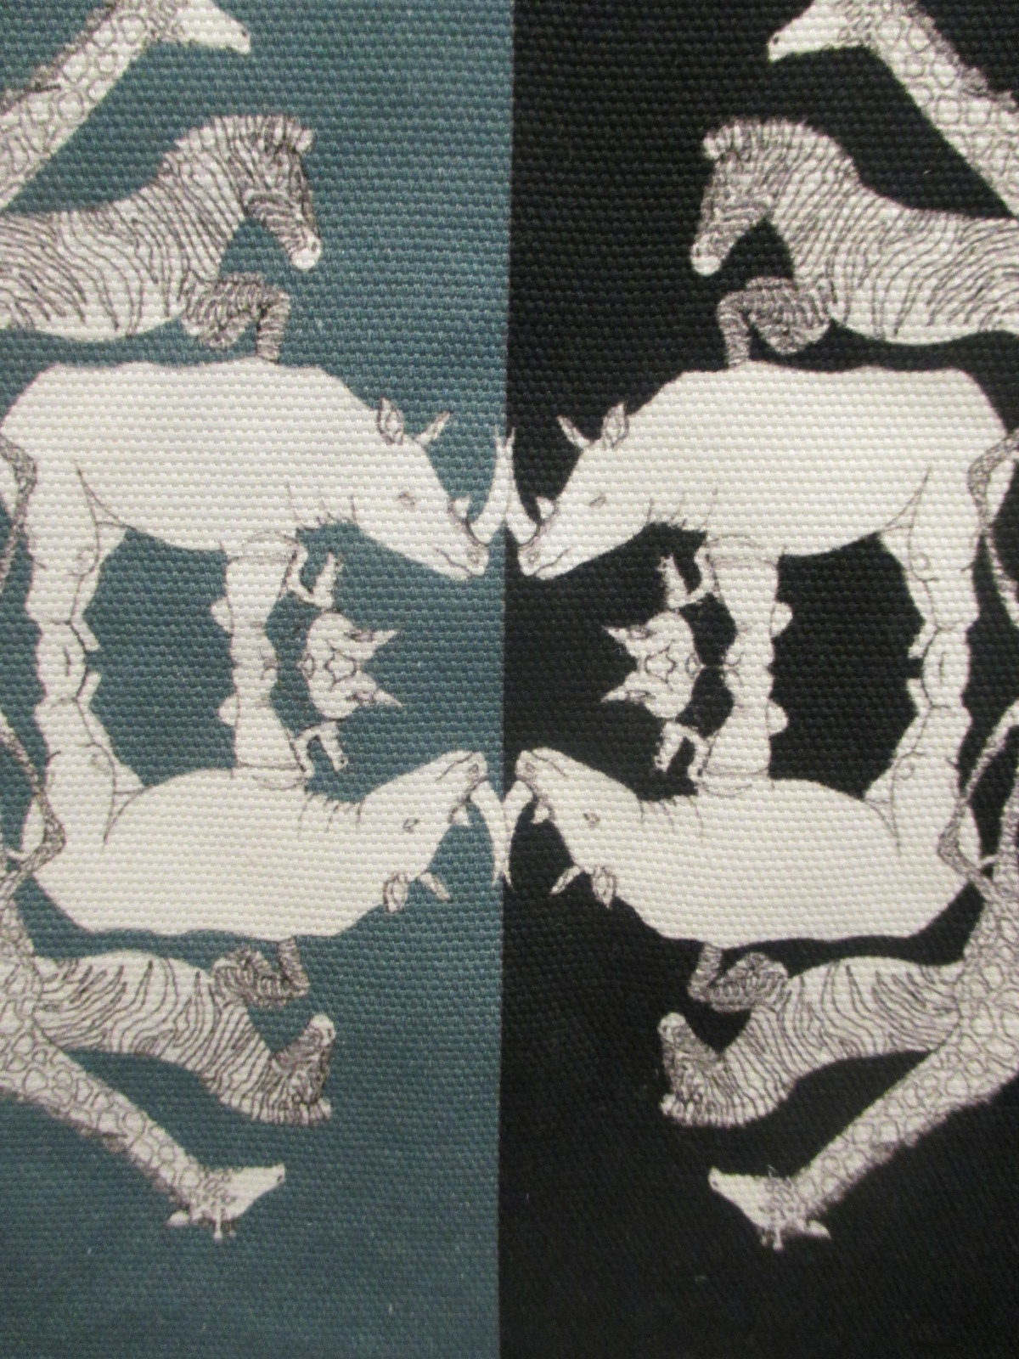

Slide 17
Illusions and photomanipulations

Slide 20
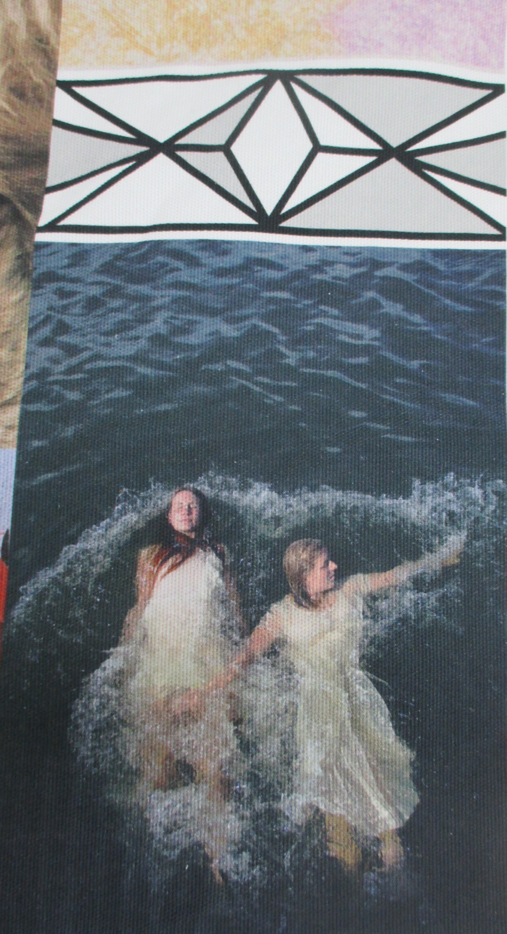

Slide 22
Scaling

Slide 26
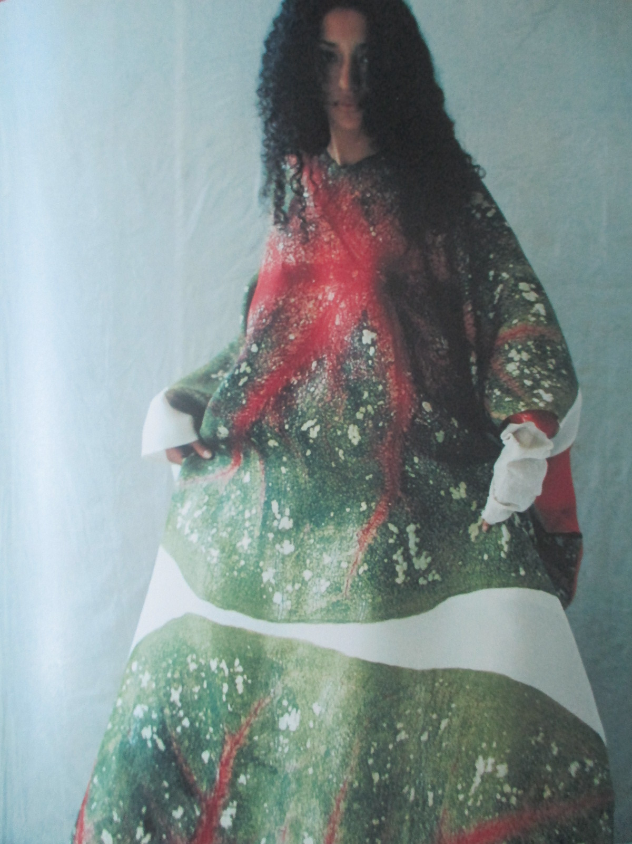

Slide 29
Material illusions

Slide 33
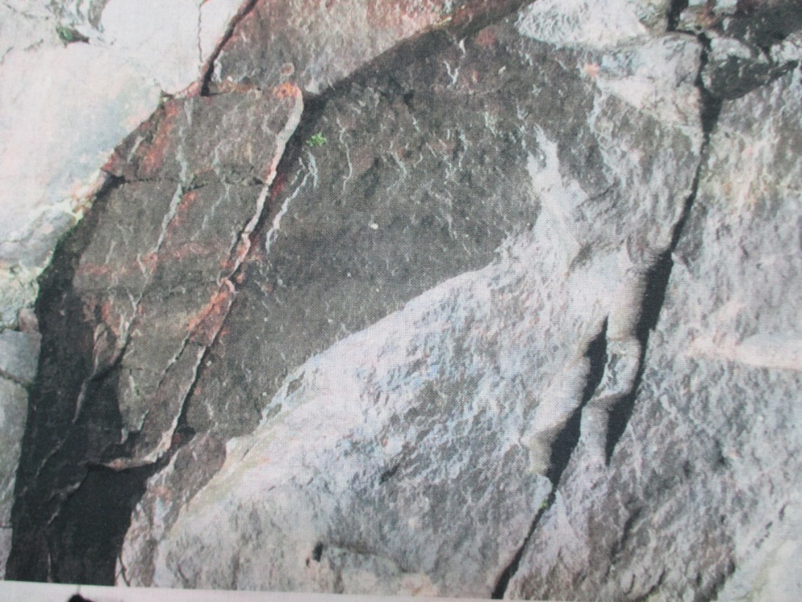

Slide 36
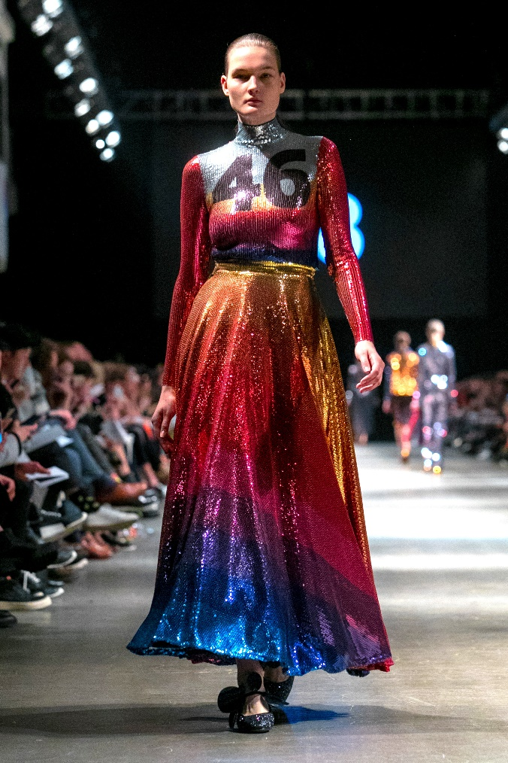

Slide 40
Photo tailoring to cloth

Slide 42
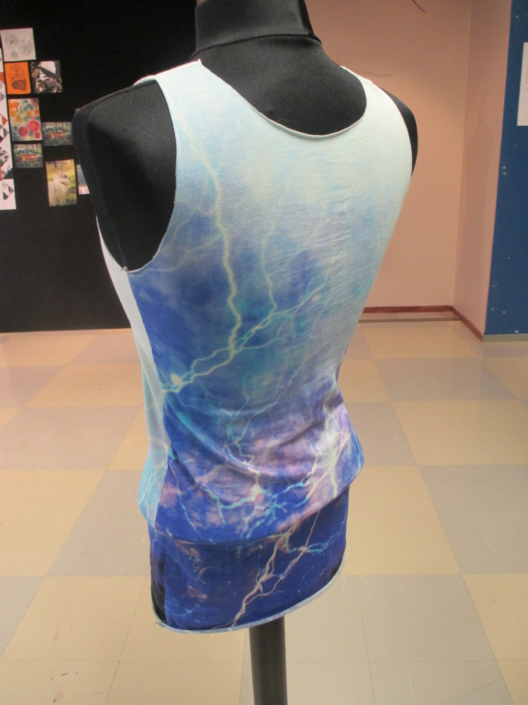

Slide 50
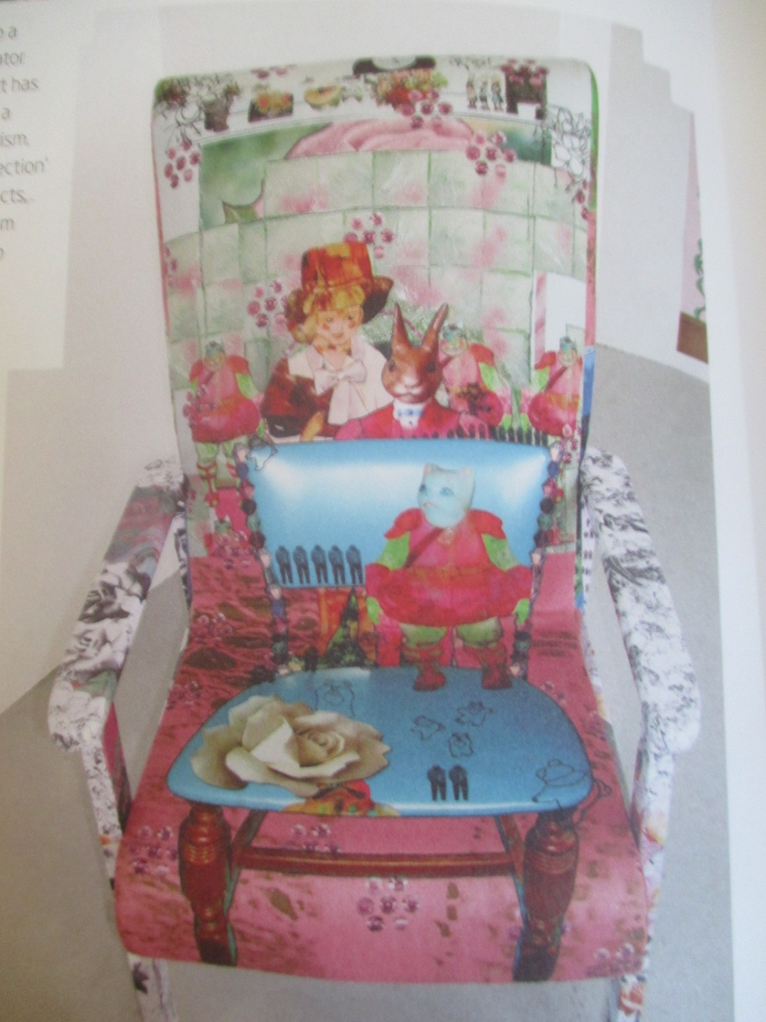

Slide 51
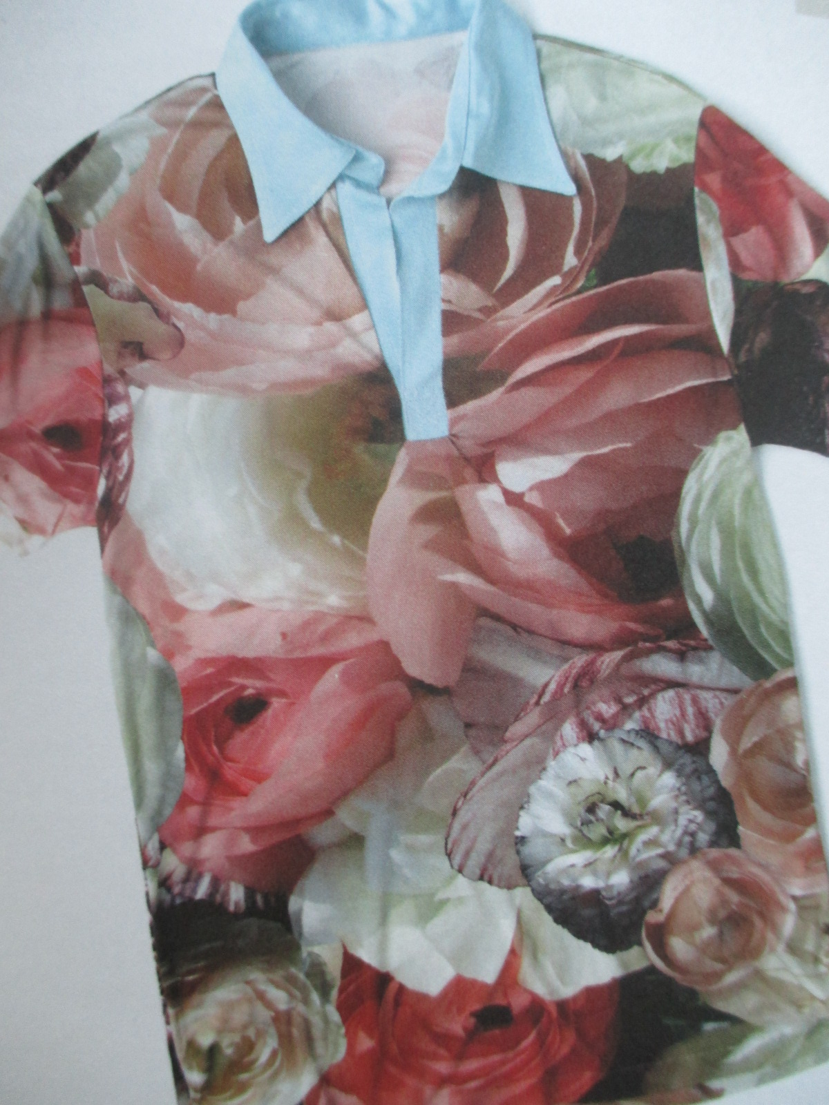

Slide 54
Digiprinting in happenings

Slide 56
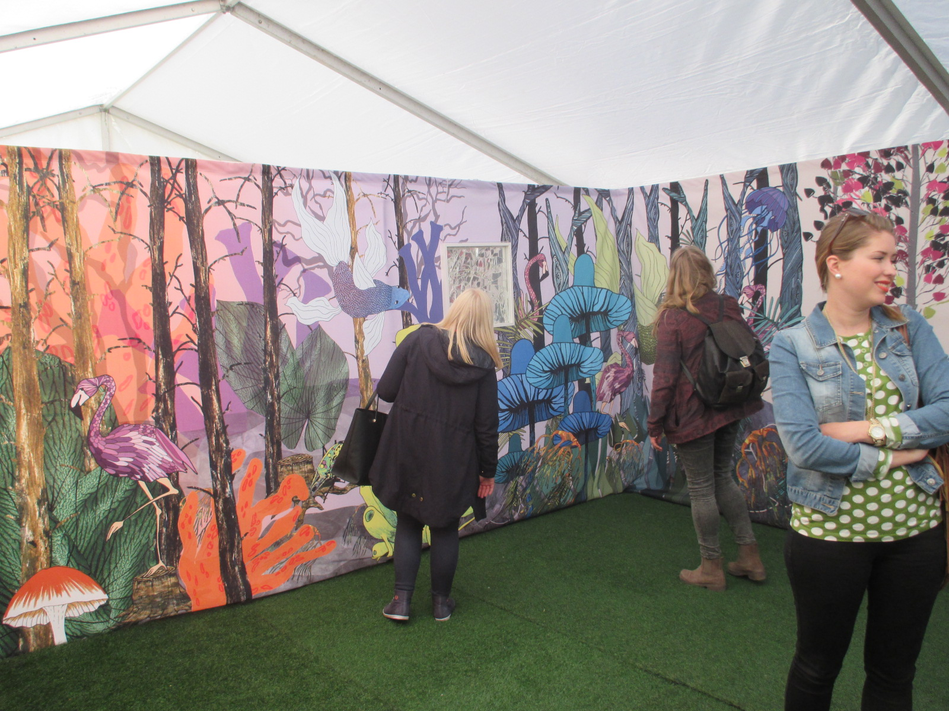

Slide 57
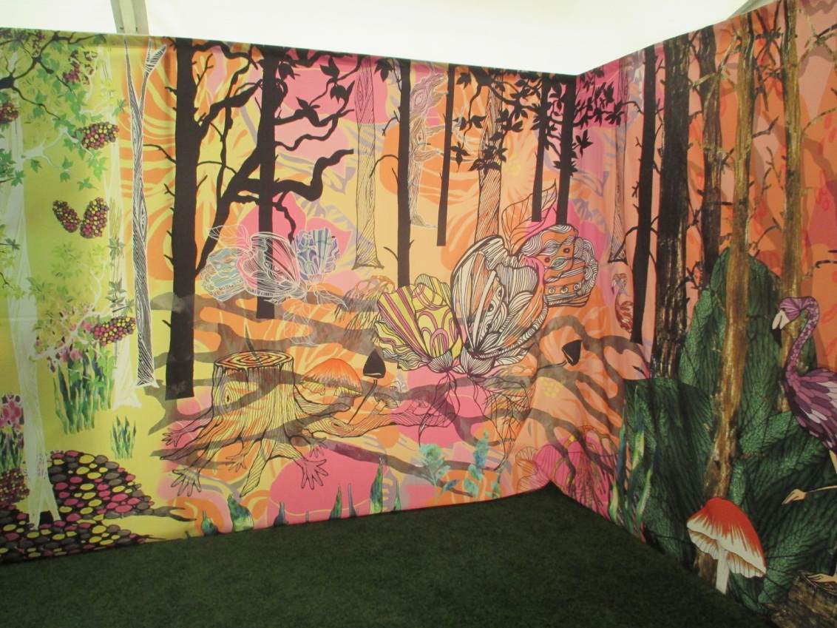

Slide 59
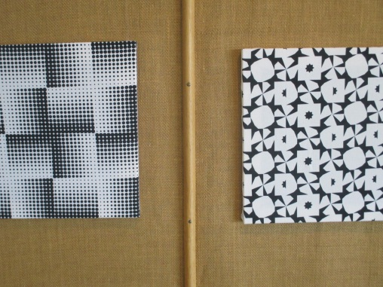

Slide 60
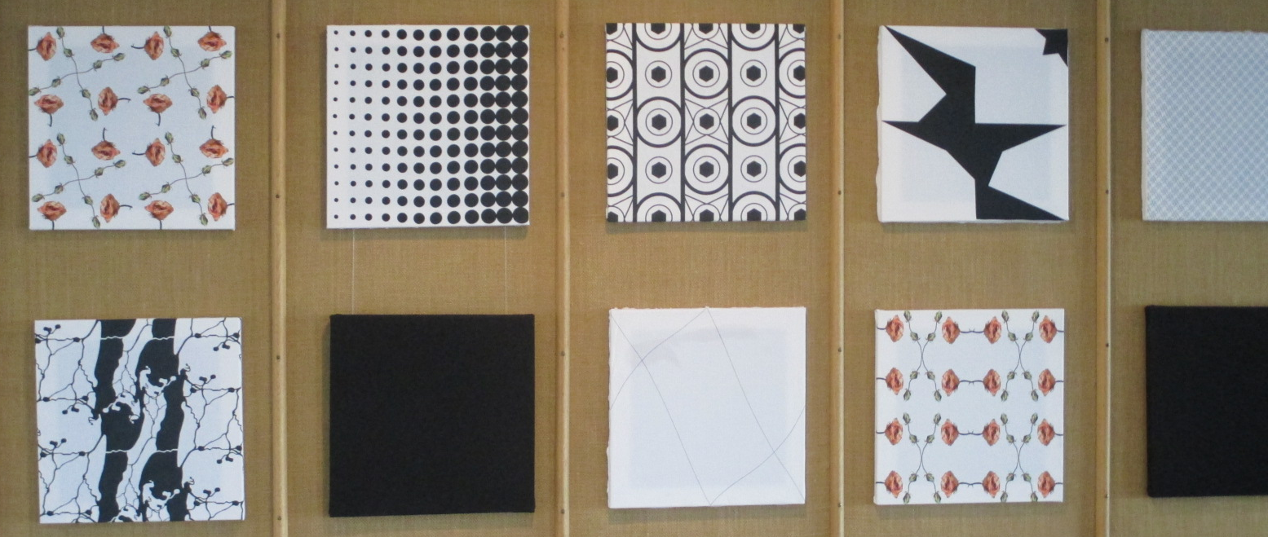

Slide 61
