Slide 1
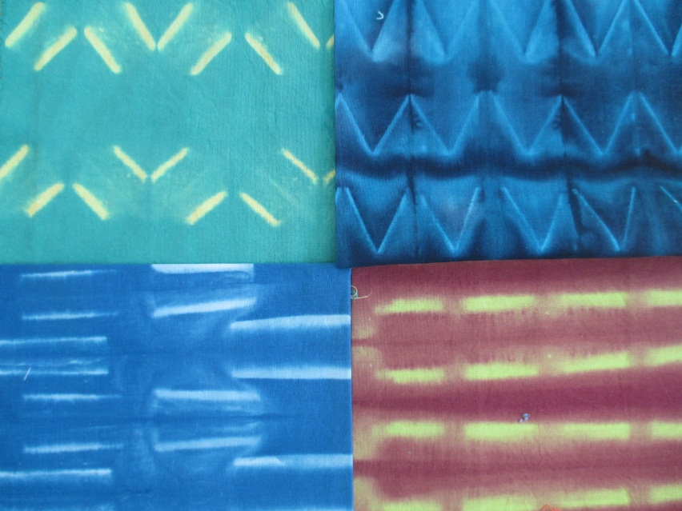
Fold ,tie and dye
Chrystal Flowers in The Halls of Mirros
Laura Isoniemi
Aalto Arts 26.3 2019

Slide 2
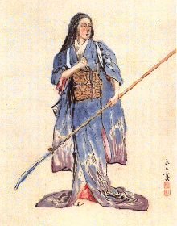
Tie and dye method
Tie and dye method is the first way to create repetitive figures on fabrics .The names for the methods vary around the world but the methods os are quite the same and based on same logics despite the continent.

Slide 3
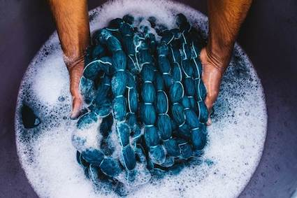

Slide 4
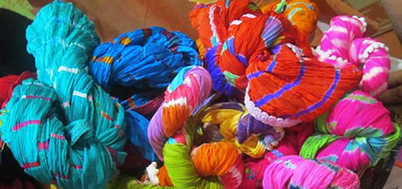
Method is old and primitive but offers many artistic and also mathematical challenges and opportunities for the dyer. The figures are done by preventing the color to enter the fabric.
The way the prevents , folds or figures composed are set into rhythm, make the fabrics composition. Repeat reveals when opening the folds.

Slide 6
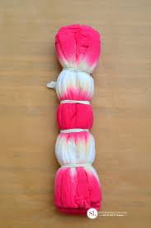

Slide 7
Tie and dye technics is based on fast and strong dye bath. The dye bath is stronger than normally and the dying time is shorter in order to that the prevented parts of the textile would not become dyed ( the undyed parts make the figure ).

Slide 8
3 Basic styles: PLANGI
African way of making often round shapes. The figure born, when fabric is tied with tight yarns. Folds can also be called plangi.
They can be done with the help out of very small objects such as rice, which typically is very time consuming. The origin is that the whole village makes the figures together.

Slide 10
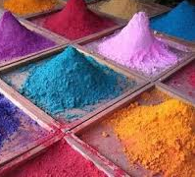
PLANGI

Slide 11
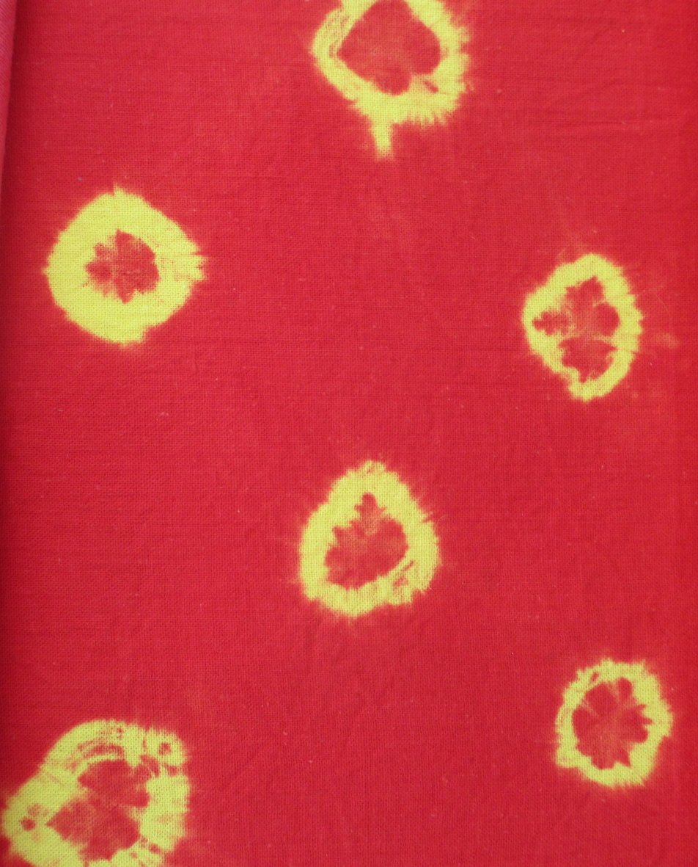

Slide 12
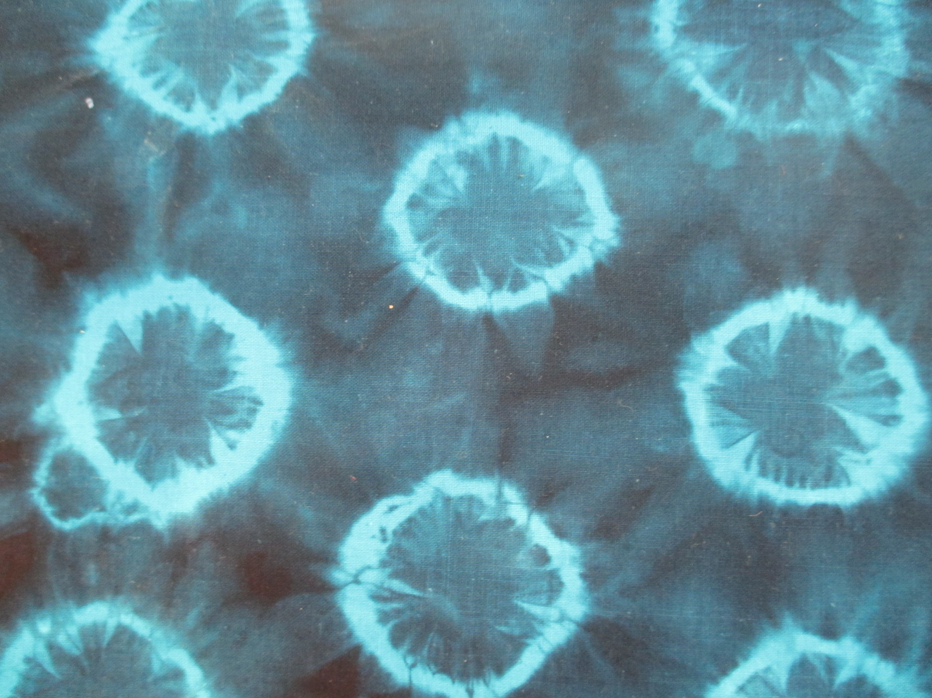

Slide 13
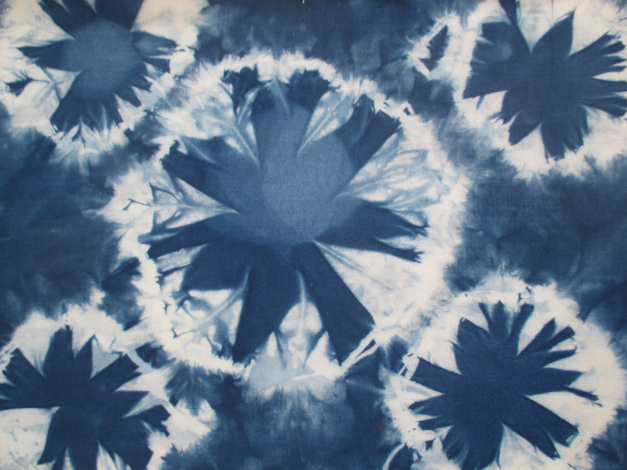

Slide 14
TRITIK
African way of sewing and tightening up and through that way making figures into
textiles.

Slide 15
TRITIK

Slide 16
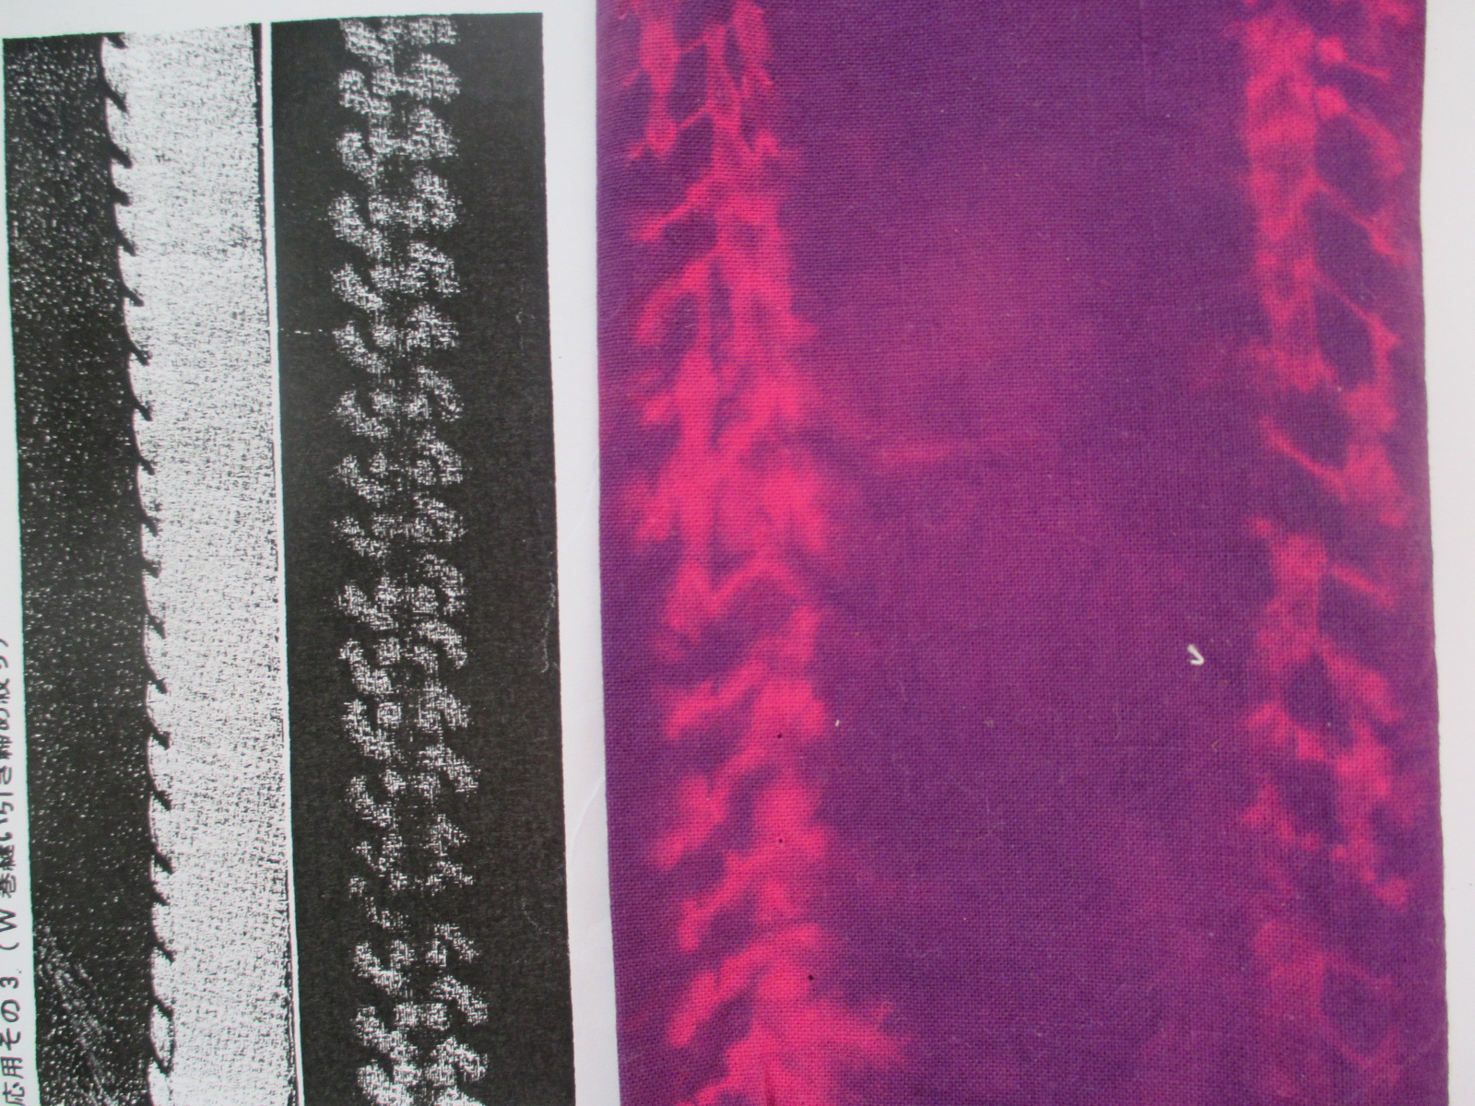

Slide 18
SHIBORI
A Japanese way of figuring fabrics.Typical way of figuring silk kimonos, and is specially working for thin materials.
Small, sensitive and fragile figures and folding methods are typical to shibori.Stripes and stars are the figures that are used in kimonos in different rhythms.

Slide 19
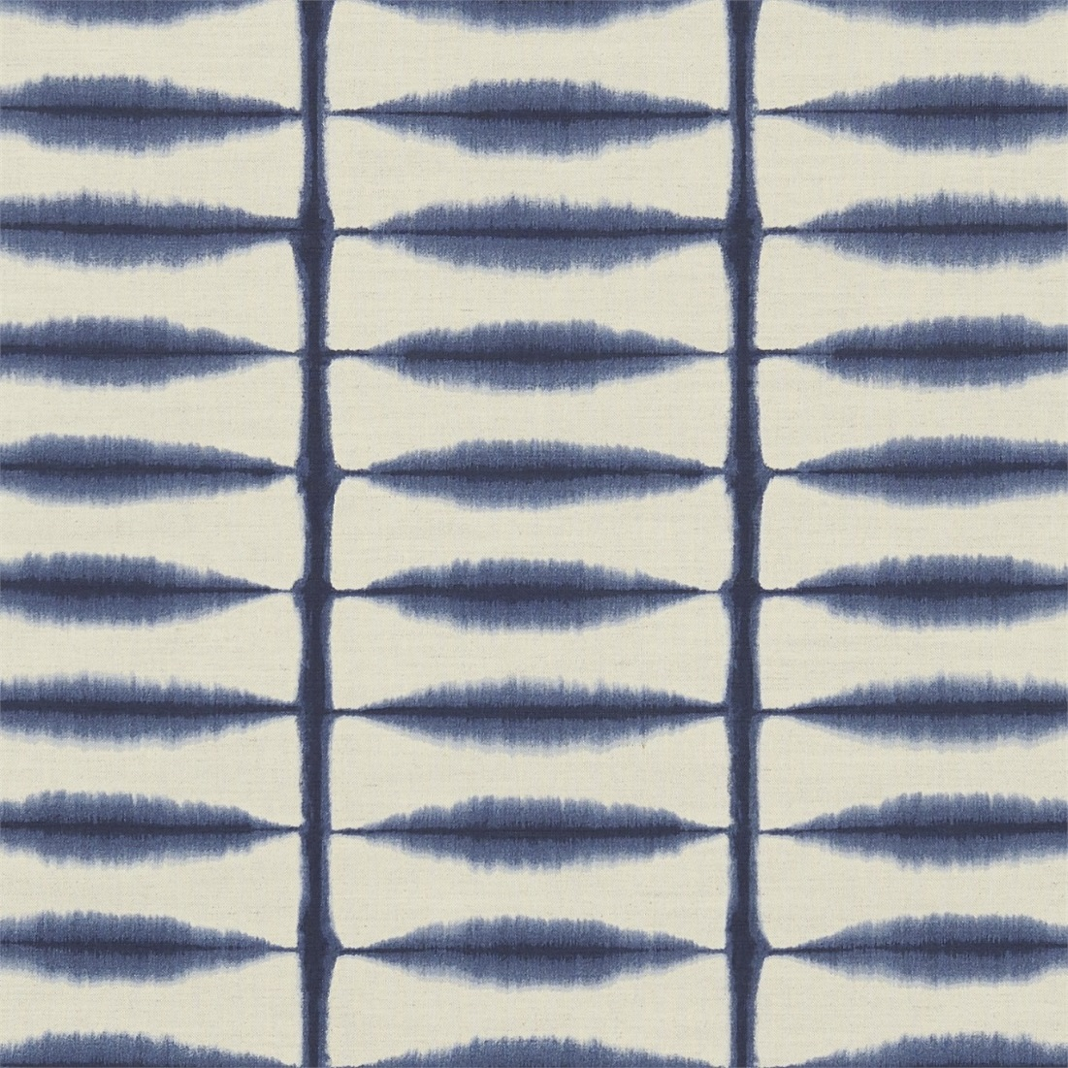

Slide 20
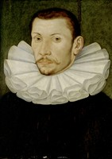
Folds on fabrics
History with nobels and monarchies

Slide 24
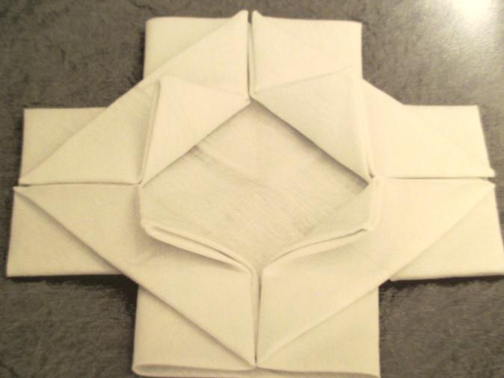
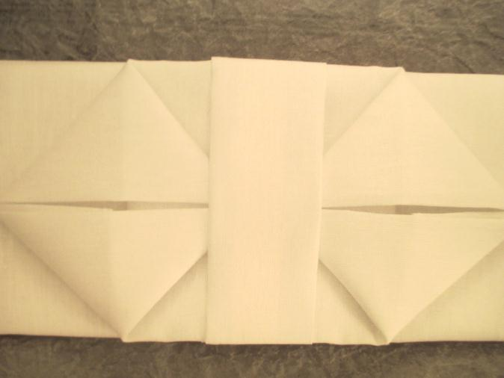

Slide 28
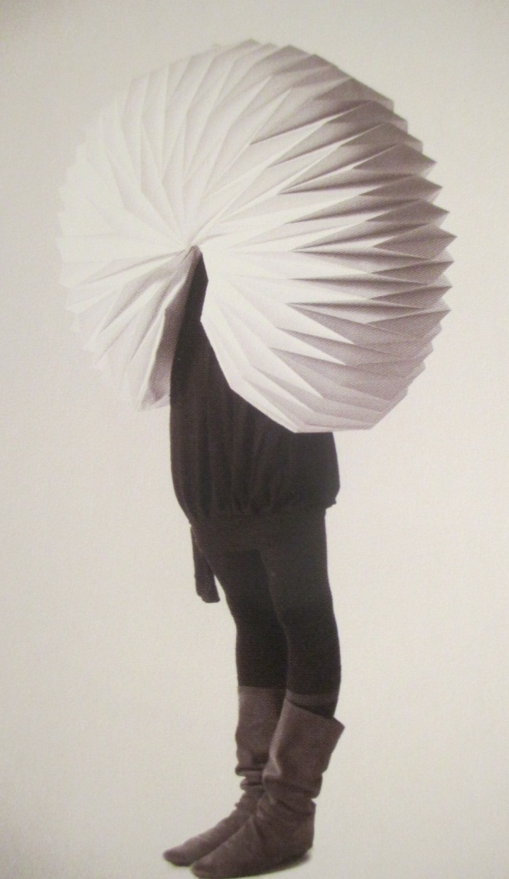
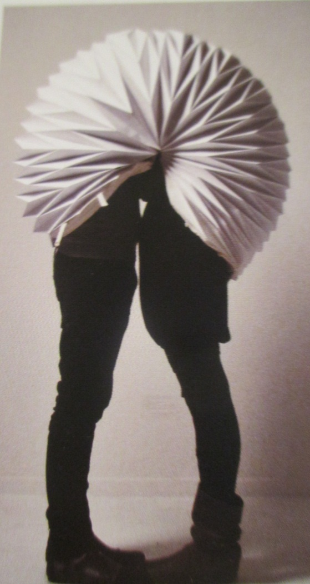

Slide 29
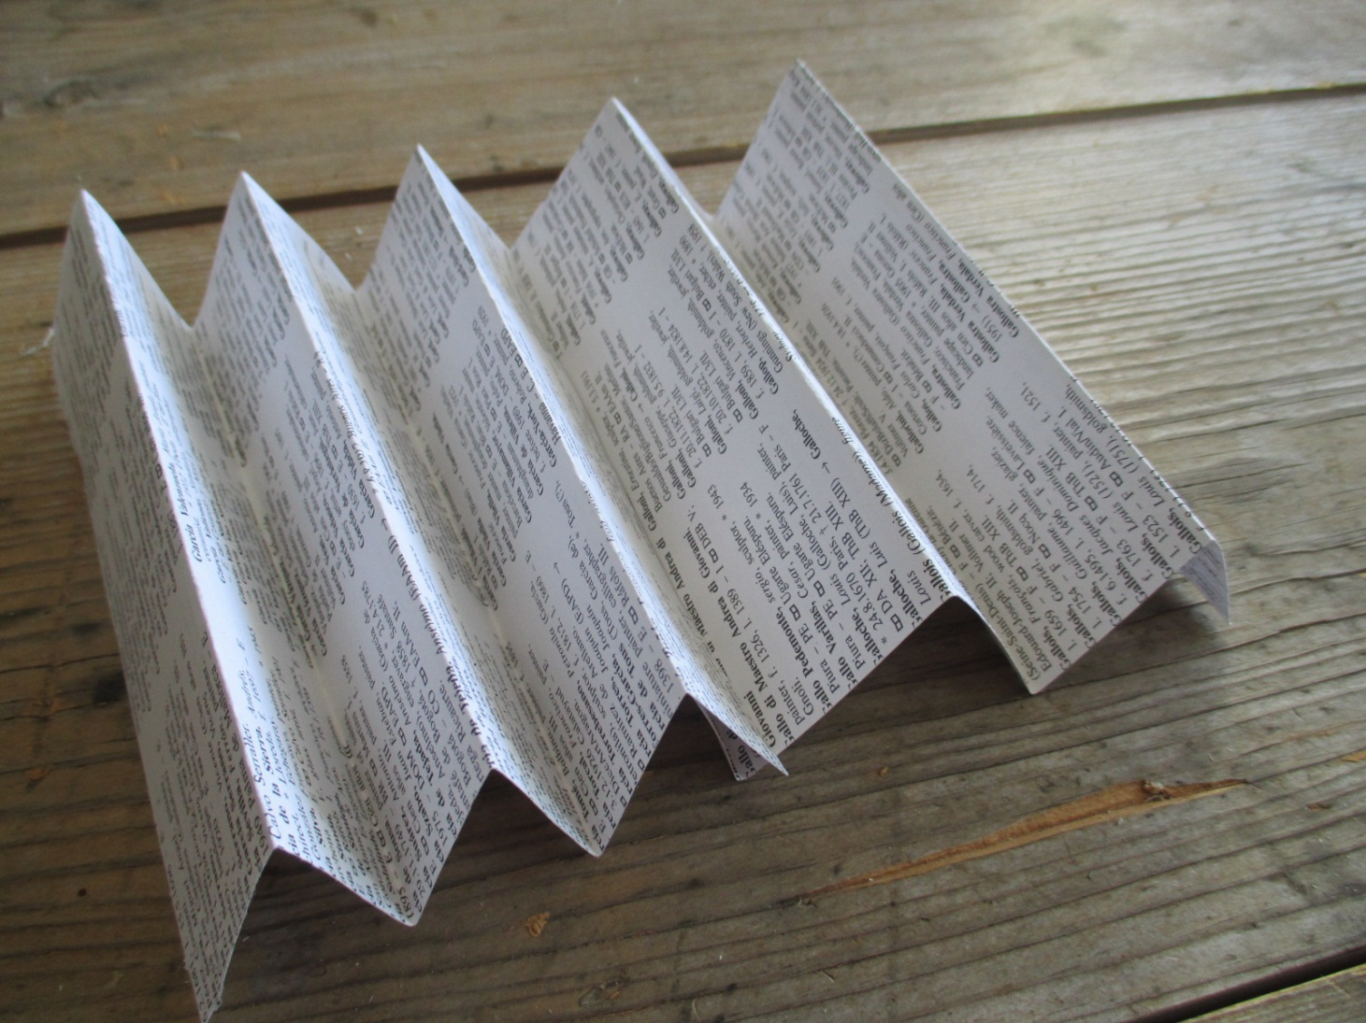
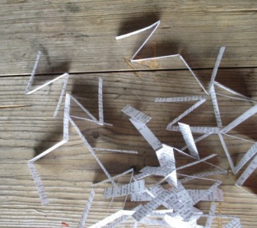

Slide 30
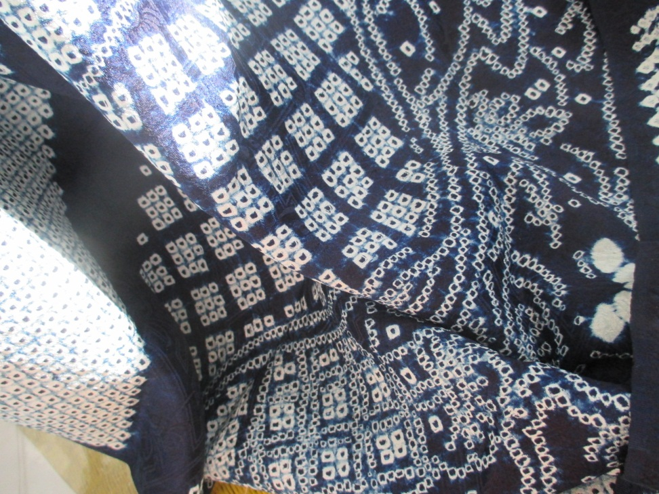
Past meets the present

Slide 31
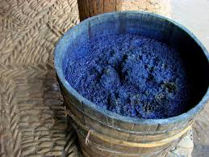

Slide 32
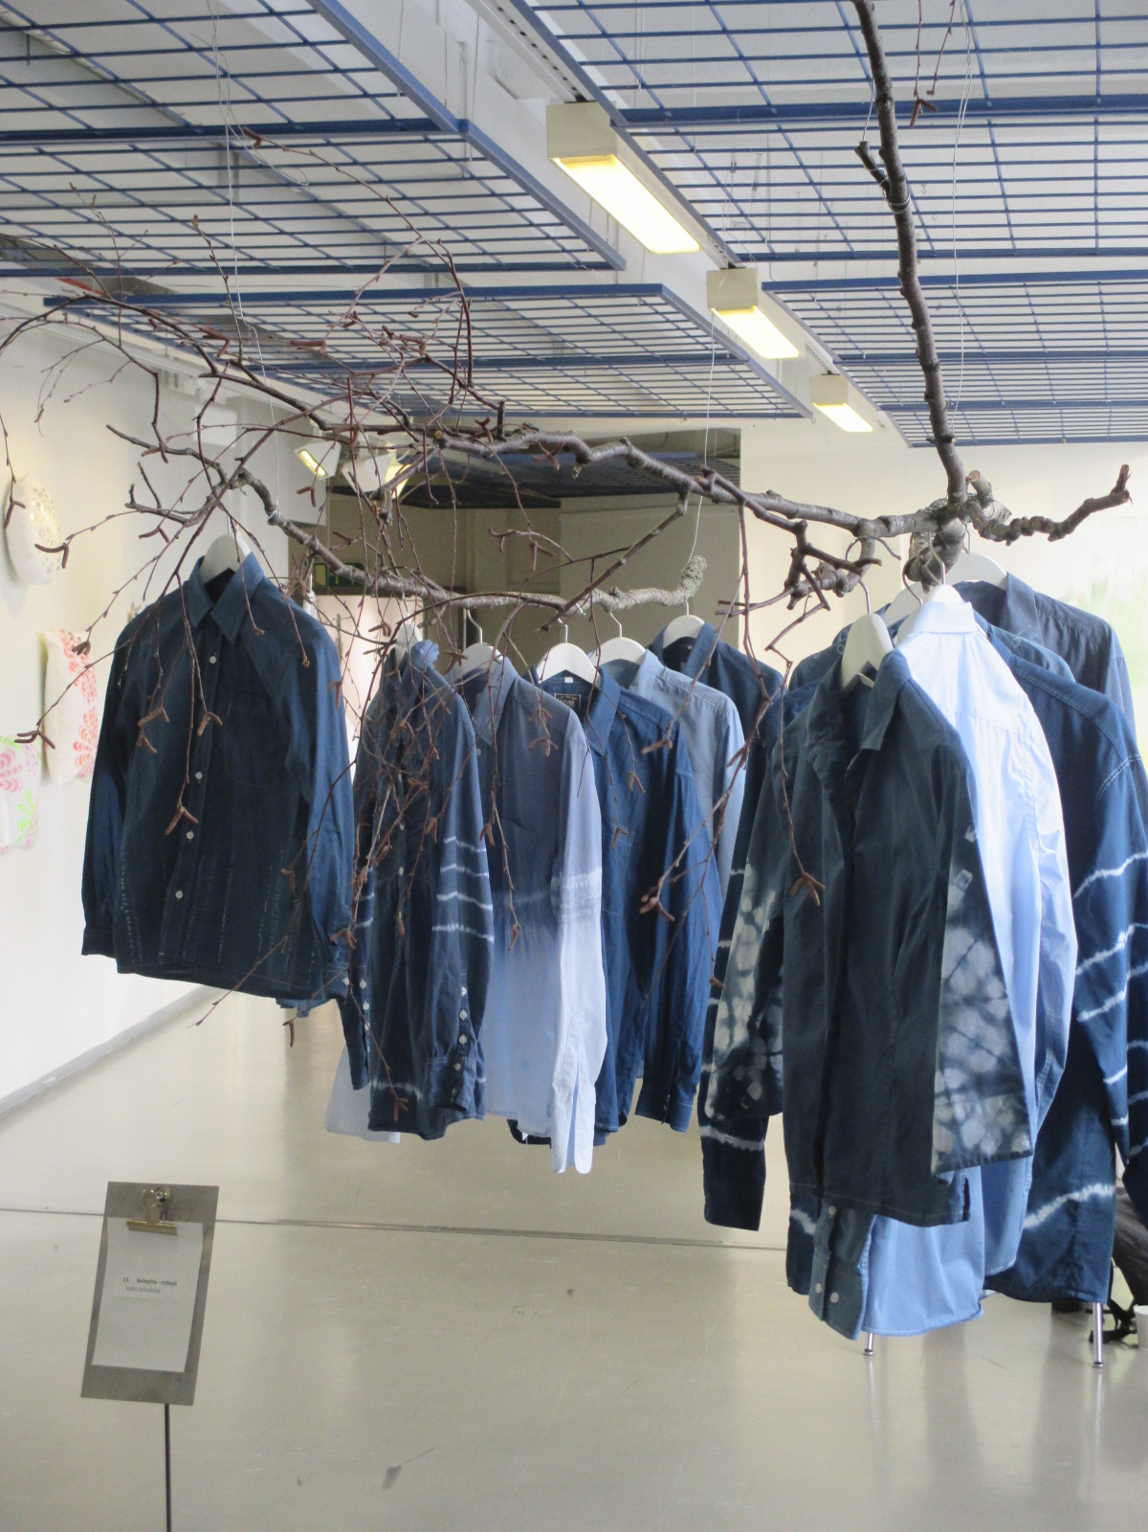

Slide 35
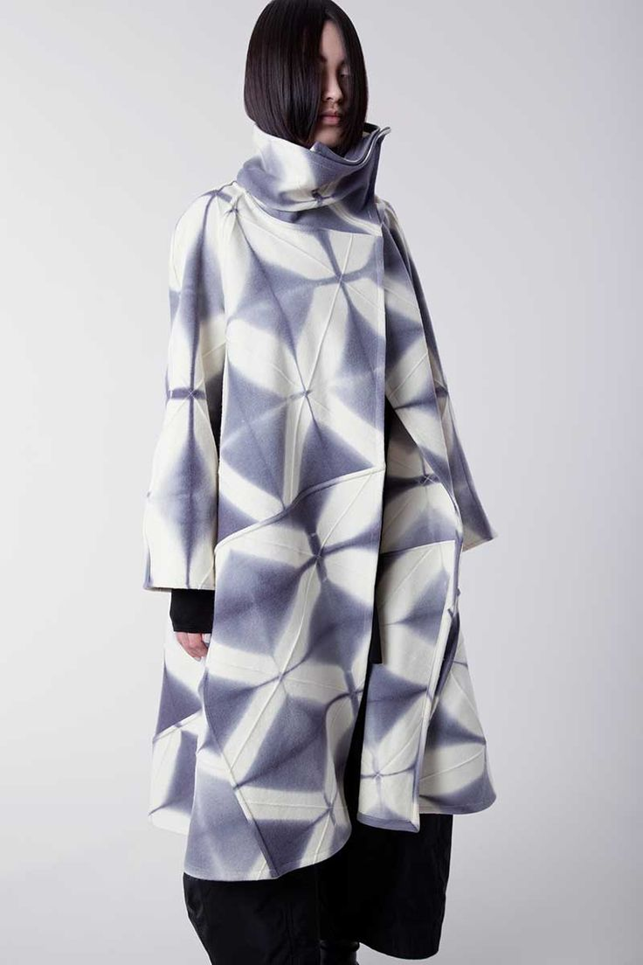
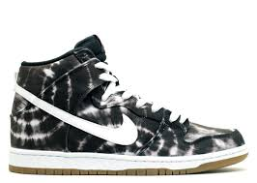

Slide 36
Digital way of dying

Slide 38
Folds and preventions

Slide 39
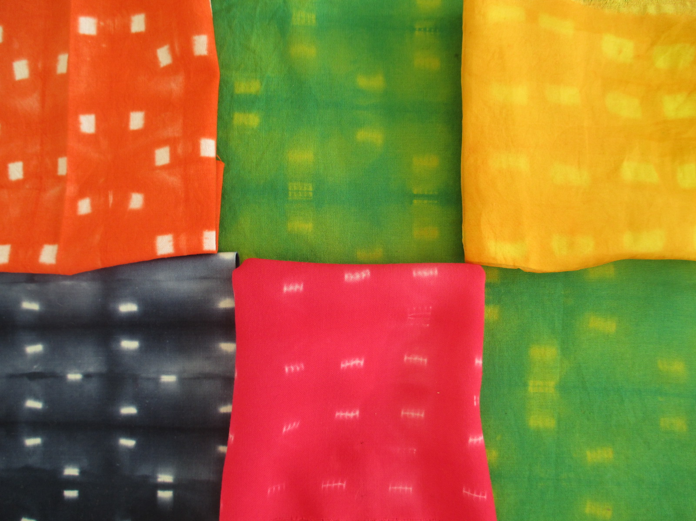

Slide 40
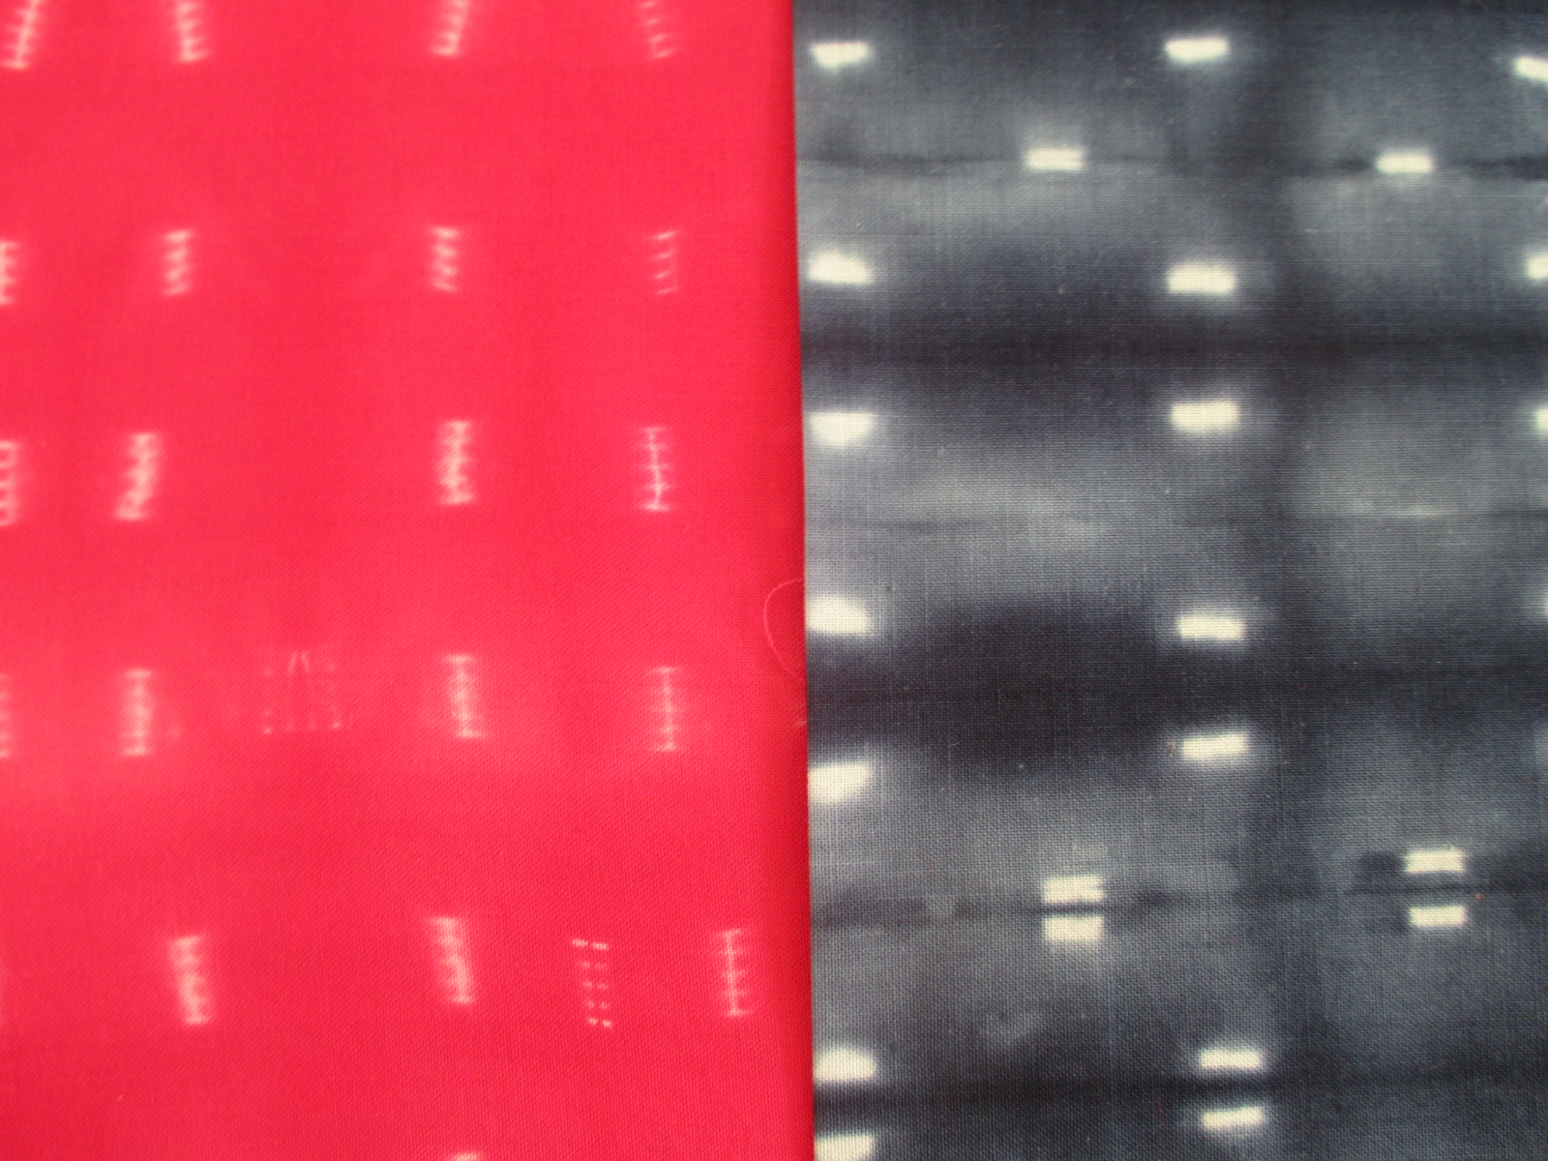

Slide 42
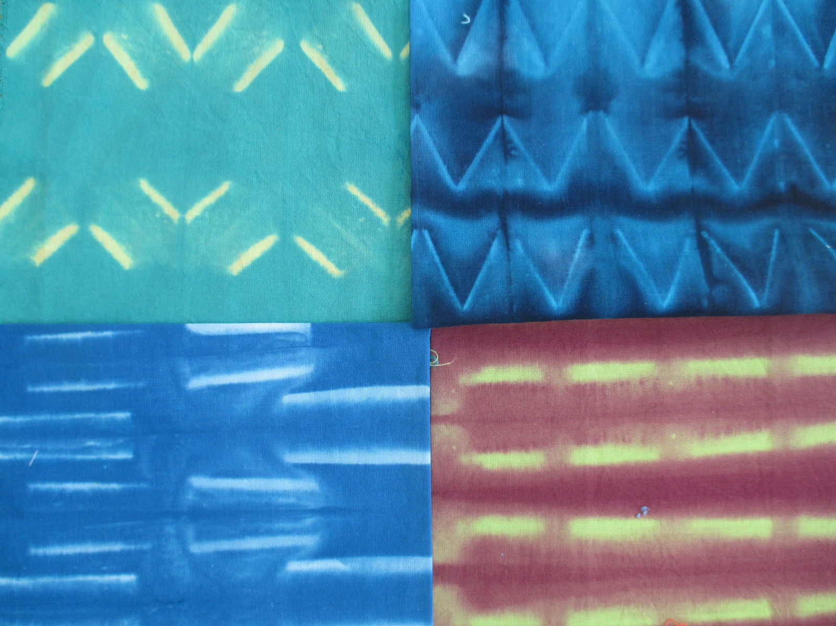

Slide 43
Triangles and preventions

Slide 44
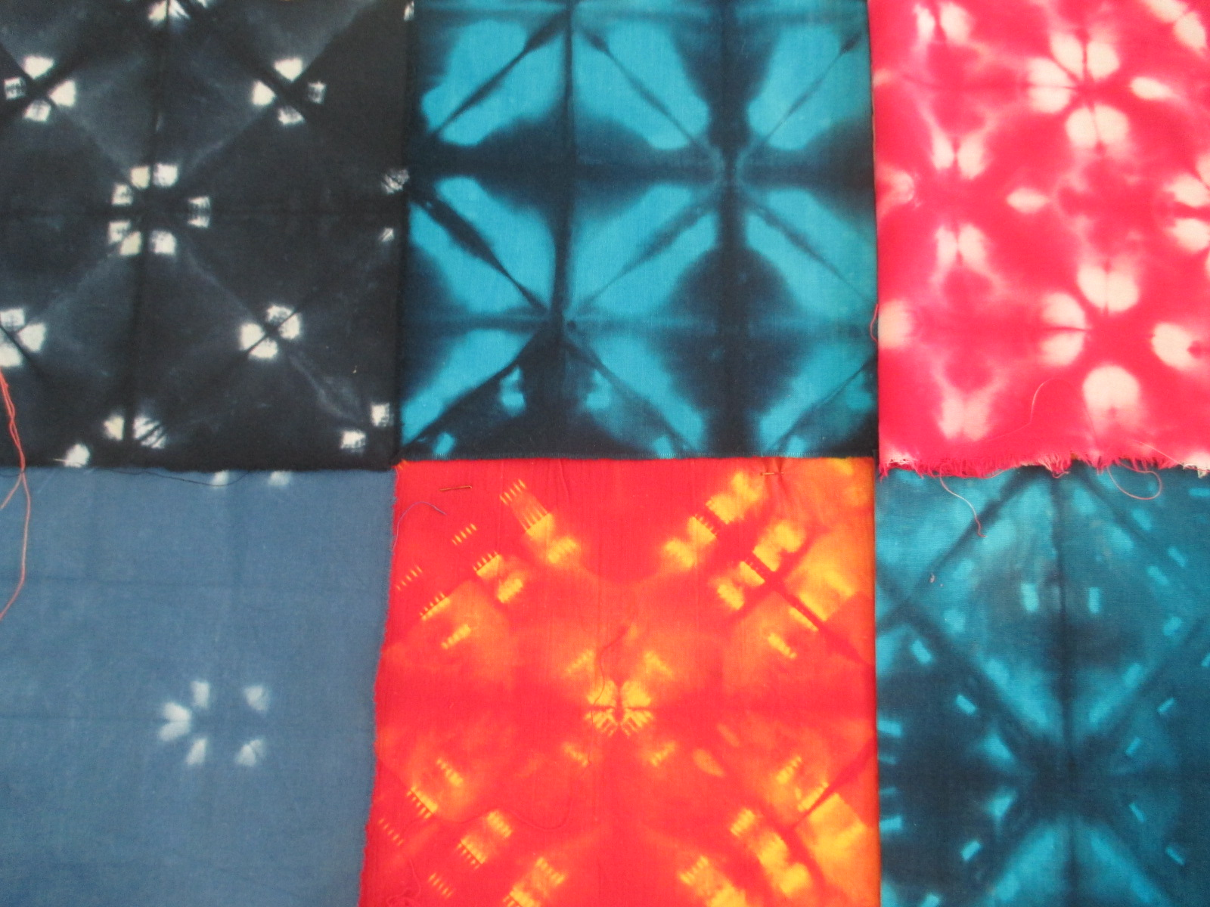

Slide 46
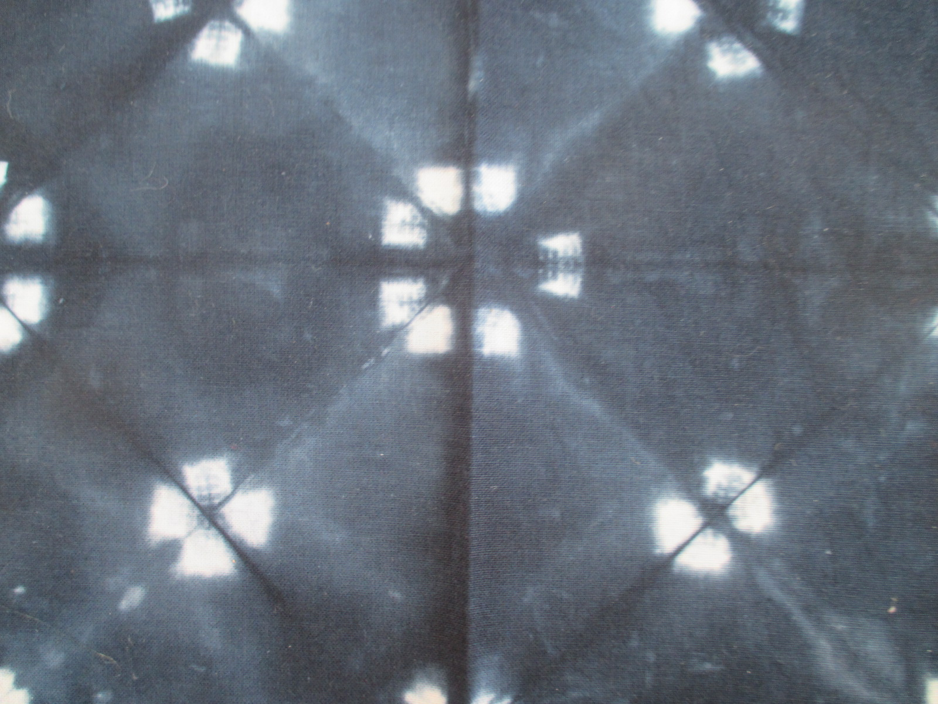
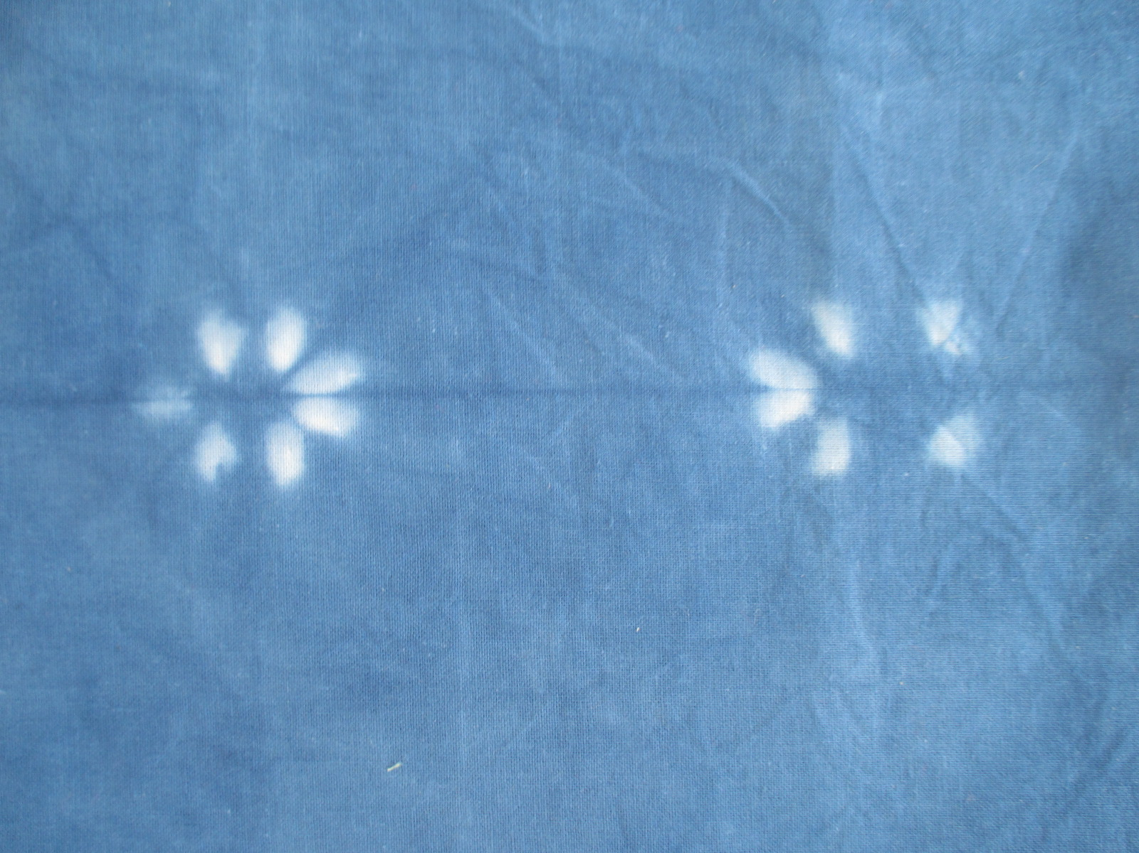

Slide 47
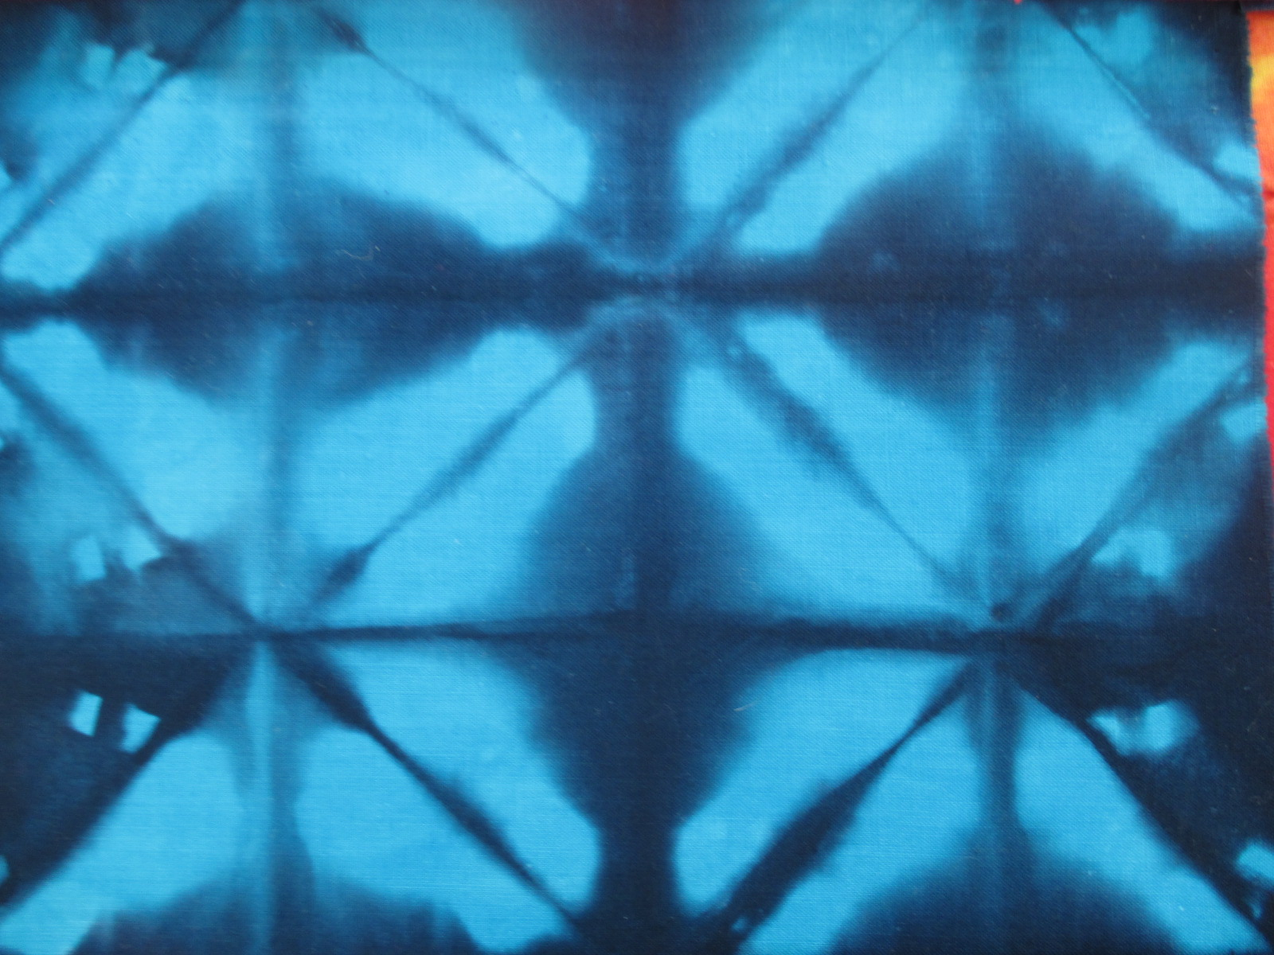

Slide 49
Round forms and prevention

Slide 50
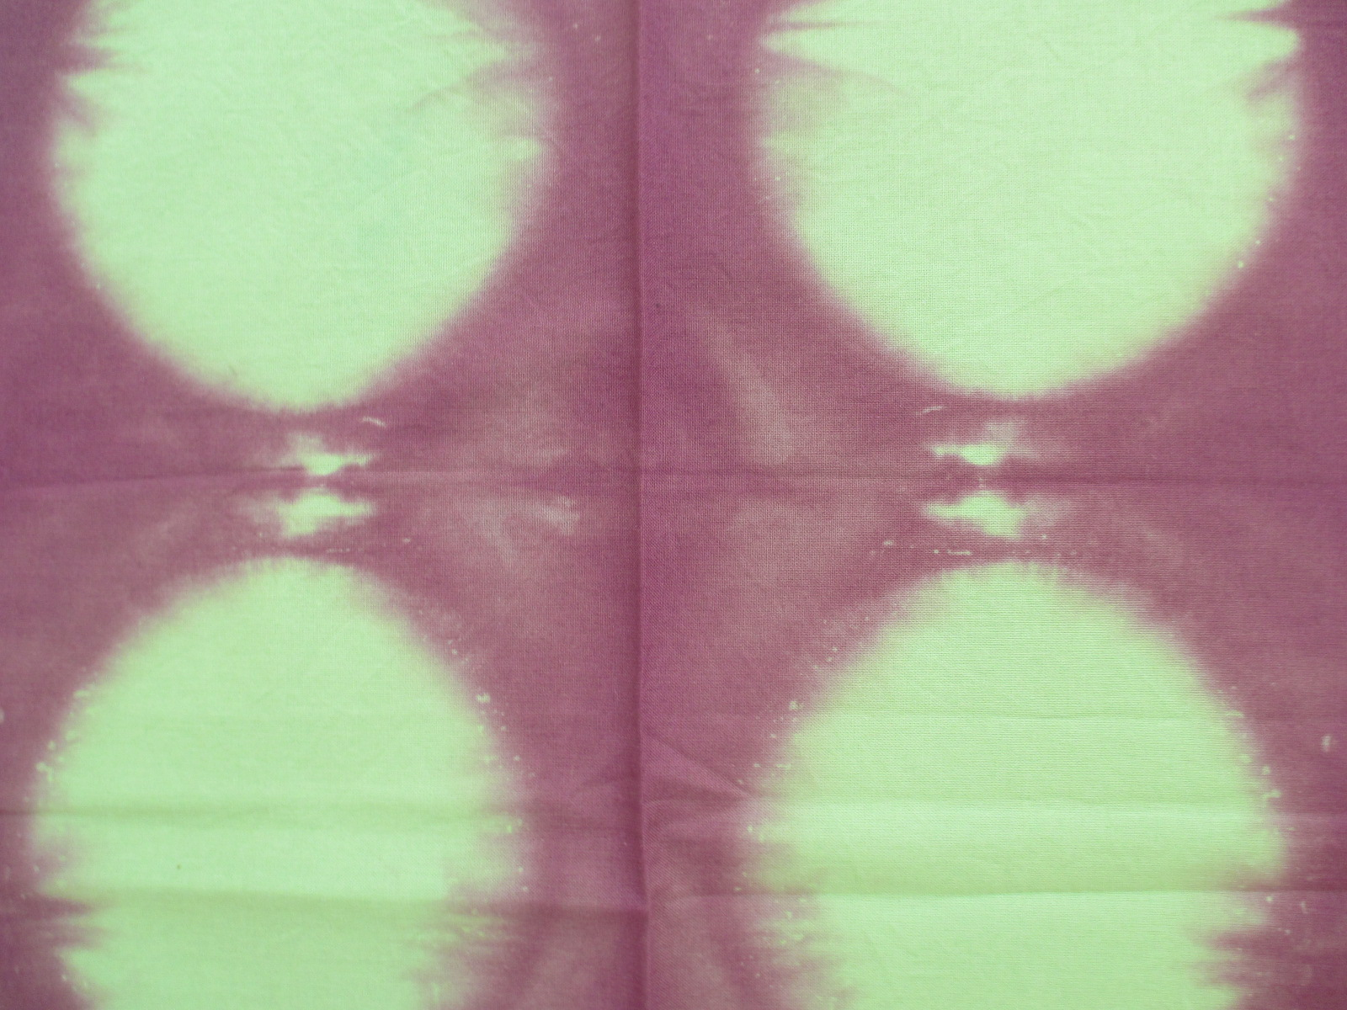

Slide 54
In all methods mentioned up the unifying thing is that the prevents make the repeat and the composition.As preventing tools can be used rubber bands, squeezers, tieing and folding in different

Slide 55
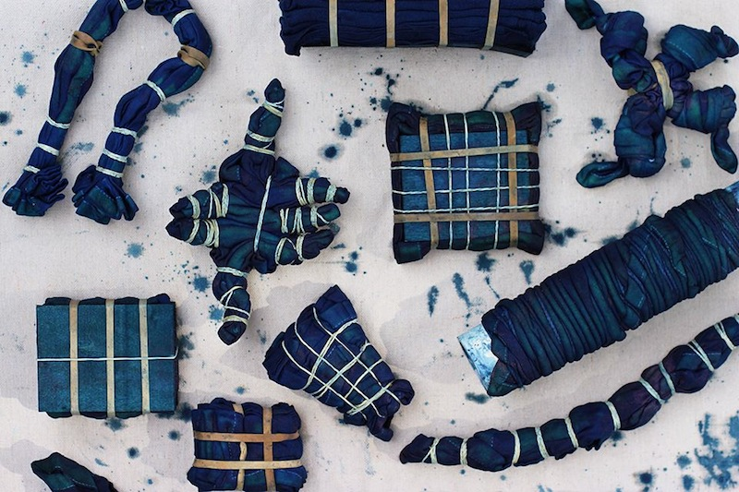
Tie and dye method is a creative way of working, which still demands patience and systematical thinking. The order and directions and turns of the folds matter as much as in origamis.

Slide 56
Litterature
Shibori,Designs and Technics.Mandy Southan.Search Press 2014
Paper works.Ginko Press.Sandu publishing 2012
The beauty of the fold.A conversation with Joan Sallas. Edit Caharlotte Birnabaum.
Strenberg press 2012
Digital textile design .Melanie Bowles and Ceri Isaac. Lawrence King publishing 2012
Shadow folds .Easy to make geometric designs in fabric .Jeffrey Rutzky and Chris K.Palmer.
Kodanhsa USA 2011
Värimenetelmät.Maija Forss. 2000 Taik books b 60.

