Slide 1
Sui Dynasty & Republic of China
Lauri Vesala

Slide 2
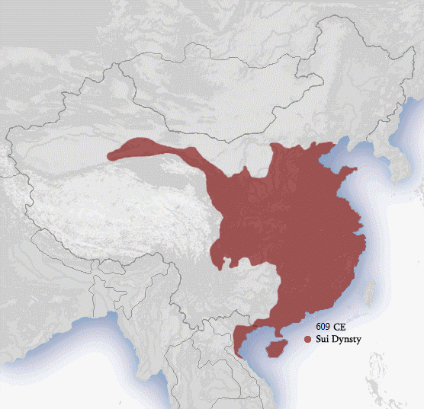
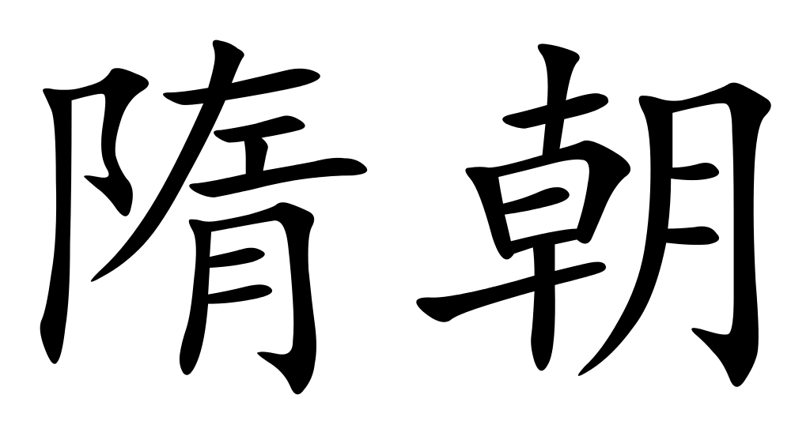
Sui Dynasty (581-618)

Slide 3
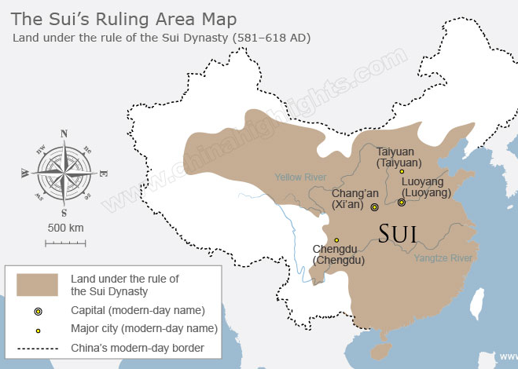
Quick Facts
Preceded: Northern and Southern Dynasties (420-589)
Succeeded: Tang Dynasty (618-907)
Monarchy
Emperor Wen (581-604)
Emperor Yang (604-617)
Capital
Daxing (581-605) (Today Xi’an)
Luoyang (605-610)
Religion: Buddhism
Relatively short dynasty

Slide 4
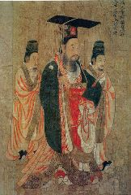
The Dynasty under Emperor Wen
Emperor Wen was previously known as Yang Jian
Yang Jian took control of the Northern Dynasty by usurping the throne, initiating the Sui Dynasty
Wang initiated several reforms which strengthened the empire for future conquests
In 588 Wang led a conquest to conquer the southern Chen Dynasty, which he did in 589.
This unified China.
Wang bankrupted the treasury with warfare and construction projects.
Wang aimed to improve the infrastructure
Establishing granaries as sources of food, regulating the market
Policies resulted in an agricultural surplus
Wang reconstructed the Great Wall to protect the dynasty from a Turkic Khaganate from the north
Wang lead an a massive invasion to Goguryeo in Korea, which he lost.
The loss lead to a substantial financial and manpower deficit, from which the Sui couldn’t recover

Slide 5
The Dynasty under Emperor Yang
Emperor Yang ascended the throne, possibly by murder, after the death of Emperor Wen
Yang was known to be tyrannical
He carried out expensive construction projects, by using free peasant labor.
Was assassinated by one his ministers, after losing public support.
Built the Grand Canal of China
Improved transportation and trade
Lead expeditions to Vietnam

Slide 6
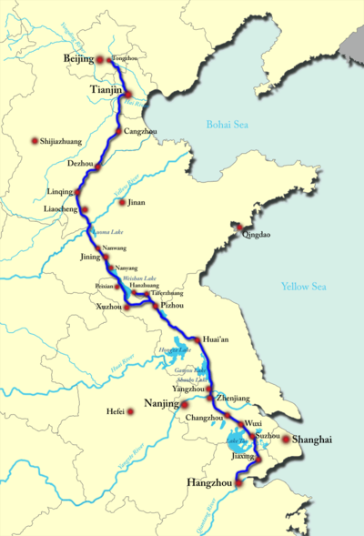
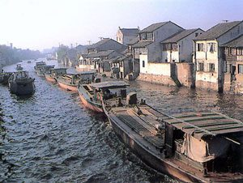
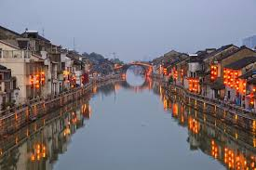
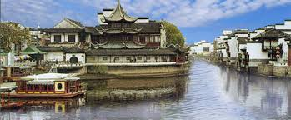
The Grand Canal

Slide 7
Republic of China (1912-1949)

Slide 8
Quick Facts and Timeline
Preceded: Qing Dynasty (1636-1912)
Succeeded: People’s Republic of China (1949-present)
President
Sun Yat-sen (1912-1949)
Li Zongren (1949-1950)
Capital
Peking (1912-1928)
Nanking (1927-1949)
Chungking (1937-1946)
Timeline of Key Events
Wuchang Uprising (1911)
Establishment of the Rep. of China (1912)
Yuan Shikai abdicates and dies (1916)
Warlord Era (1916-1925)
Sun Yat-sen dies (1925)
Civil war Begins (1927)
Long March
2nd Sino-Japanese War (1937-1945)
Peoples Republic of China (1949)

Slide 9
End of Qing Dynasty – Beginning of the Warlord Era
Qing Dynasty
The final dynasty of China
Was getting weaker from Sino-Japanese war and Colonial Rule
People were discontent that the Emperors were not modernizing China
Xínhai Revolution (Chinese Revolution)
Began from the Wuchang Uprising (1911)
Sun Yat-sen was elected as the provisional president.
China was declared a republic as Sun was sworn in.
Xínhai Revolution continued
Yuan Shikai, a military commander, was asked to pressure the Qing dynasty to surrender, with the promise of becoming the president.
6 year old Emperor Puyi was forced to abdicate, ending the Qing Dynasty (1912)
Yuan became president but establishes himself as new emperor. He abandons the empire and dies in 1916
The warlord era begun.

Slide 10
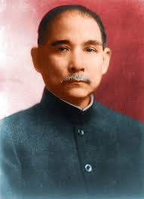
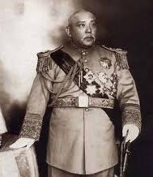
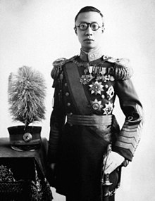
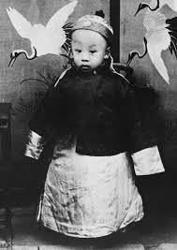
Sun Yat-sen, Yuan Shikai, Emperor Puyi

Slide 11
Warlord Era – Start of the Civil War
After Yuan’s rule ended, China was controlled by separate warlords.
No centralized leadership
Each warlord controlled a military
Sun Yat-sen was in exile, but returned to the Guangdong province.
He establishes a revolutionary government.
He desires to re-establish the Republic of China
Passes away in 1925
Kuomingtang (KMT) (Nationalist Party of China
Was originally created by Sun
After Sun’s death, Chiang Kai-shek became the new leader of Kuomingtang (1926)
Chiang Kai-shek
Chiang continued Sun’s mission to unify China.
He defeated the Biyang Government, and some of the warlords, while allying with other warlords.

Slide 12
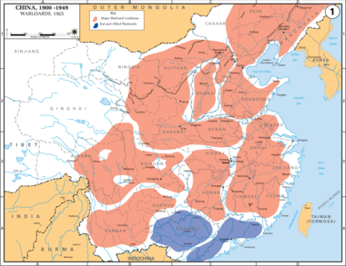
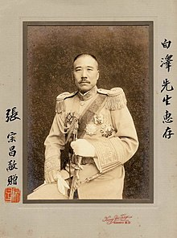
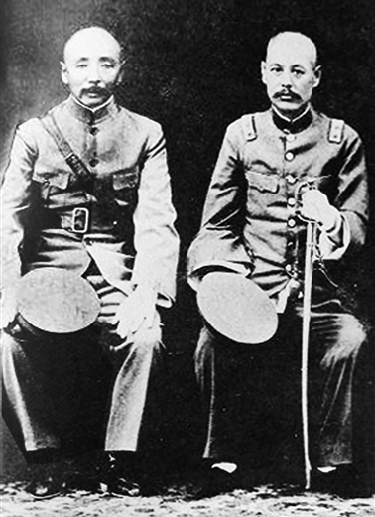
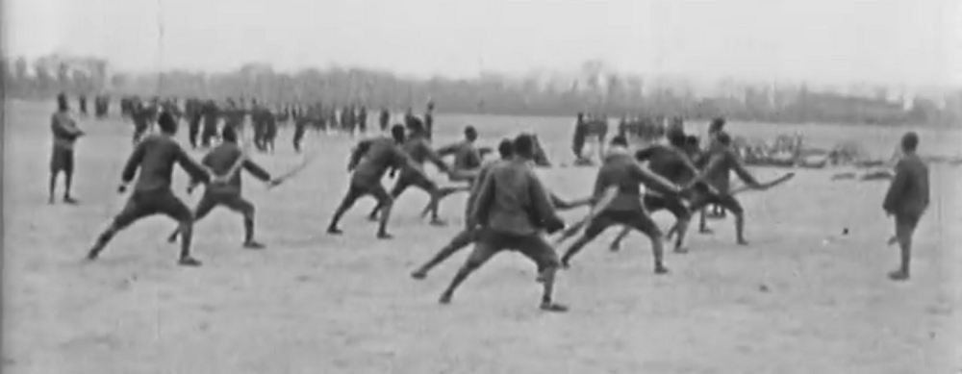
Warlords of China

Slide 13
Civil War
Emergence of Communists
Previously the nationalist party (KMT) received support from the Soviet Union.
Chiang was worried of communist influence on China and KMT
The start of the Civil War
In 1927, Chiang arrested and killed hundreds of communists in Shanghai.
The conflict between KMT and Communists began
Communist Army
Initially: Chinese Workers’ and Peasants’ Red Army
Later: People’s Liberation Army
Civil War
Initially, the KMT held a significant advantage, with victories in the Nanchang Uprising.
Communists had to fight from the country side, but were eventually surrounded and nearly crushed by KMT.
Long March
Communists escaped the KMT as 3 armies from Jiangxi Provence in the south (1934)
They marched west, and then to the north, where the 3 armies met in the Shaangxi Province a year later (1935)
Long March was gruesome for the communists, but they managed to survive as a fighting force

Slide 14
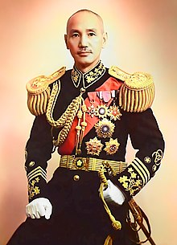
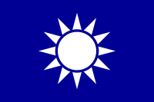
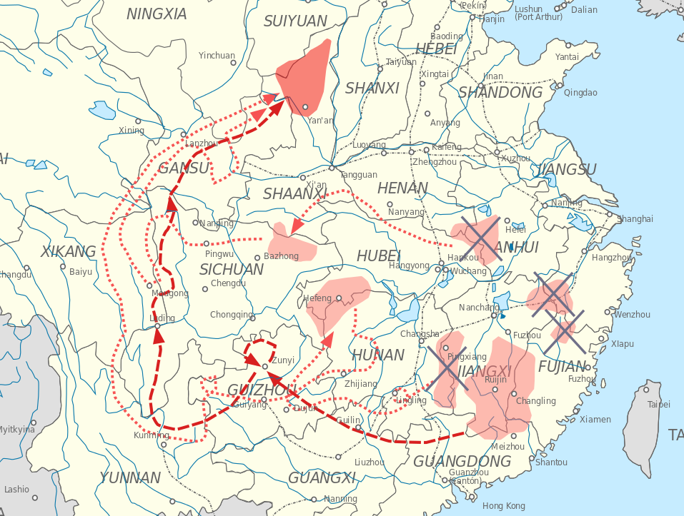
Chiang Kai-shek, Kuomingtang, Long March

Slide 15
Civil War
Mao Zedong’s success during the Long March established him as the leader of the communist party.
KMT’s other struggles (Early 1930’s)
Internal rivaling factions of KMT cost them significant losses
The Japan Conflict
Japan invaded Manchuria (1931)
Communists and Nationalists called a truce to fight the Japanese
Second Sino-Japanese War (1937-1945)
Japan occupied Beijing, Shanghai and most of the east cost by 1940
After the Pearl Harbor attack in Hawaii, the conflict merged with World War II.
Continuation of the Civil War
Japan surrendered in 1945, and the communist and KMT fighting continued.
The Communists emerged in a stronger position after WWII.
Fighting continued in 1946

Slide 16
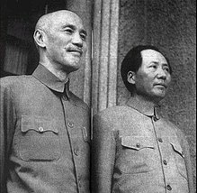
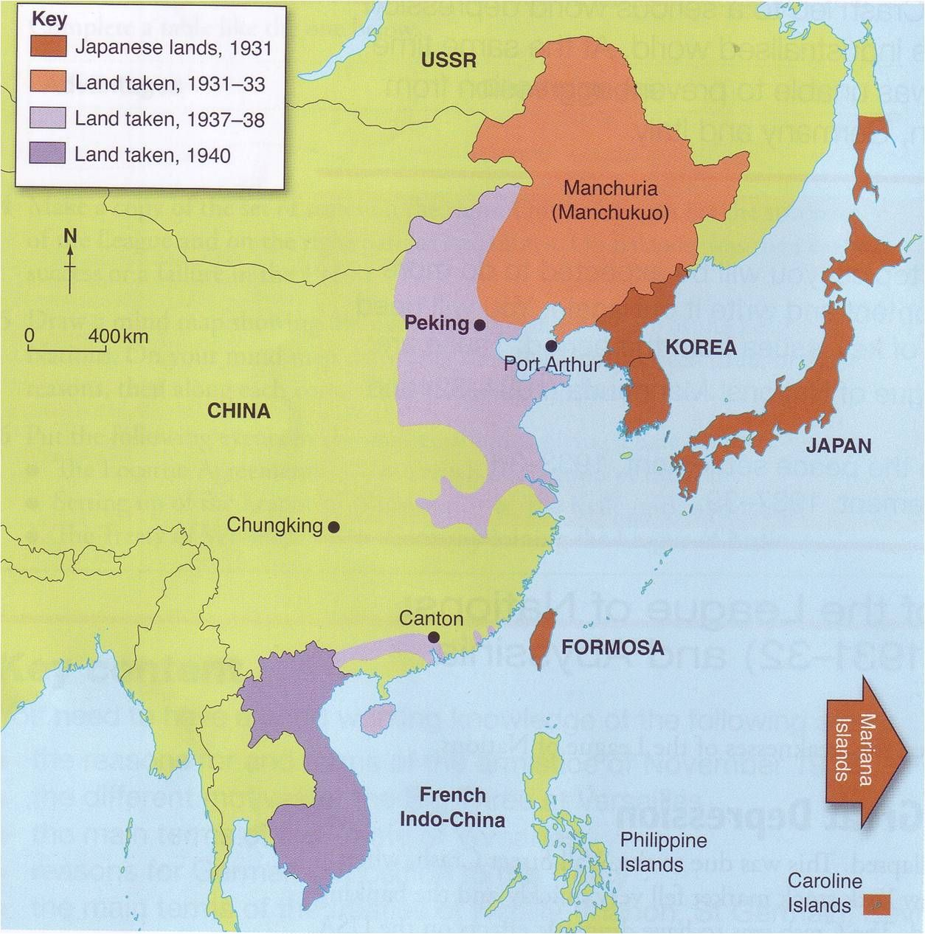
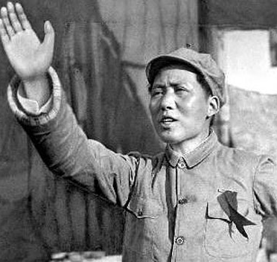
Mao Zedong, Japanese Invasion

Slide 17
Civil War
Tactics of Mao
Mao held a mobile warfare style
He sacrificed territory if it spared his men, and was greatly supported by the rural population.
Mao recruited surrendered KMT forces to his army to further increase his strength.
Fights were intense in Manchuria, and the communists took control of the north in 1949
Fall of KMT
The capital, Nanjing fell.
KMT was forced to relocate to Taiwan December 1949
People’s Republic of China
PRC was proclaimed in October 1, 1949.
Beijing became the capital

Slide 18
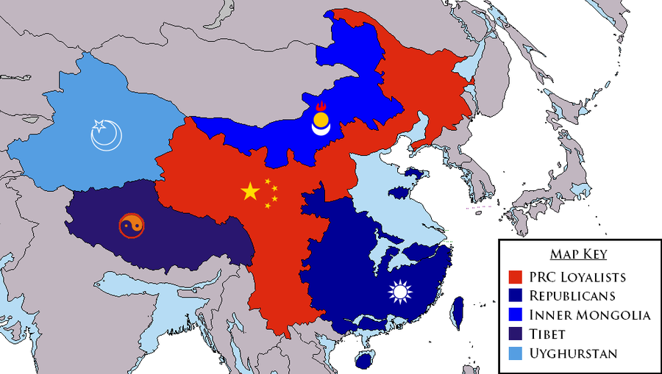
Civil War Map

