Slide 1
Welcome!
Product Architecture Design MUO-E3001
Eero Miettinen
April 16th 2019

Slide 2
Teaching & Tutoring
  Eero Miettinen, professor of practice
  Heli Säde, industrial designer/M.A.
  Aalto Ventures Program
    Håkan Mitts
    Johannes Kaira
    Lidia Borisova
  Katja Hölttä-Otto, professor
  Elina Kuusisto-Korczak, assistant

Slide 3
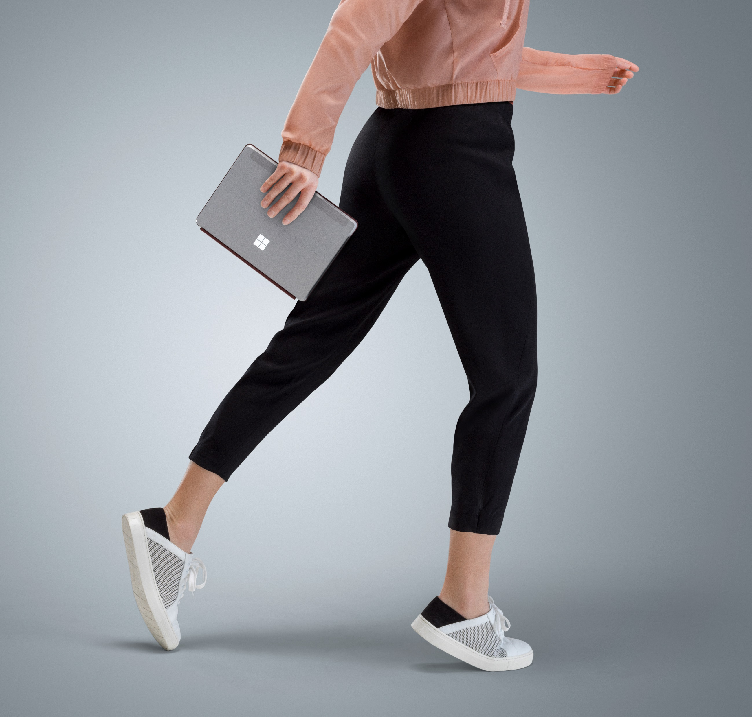

Slide 4
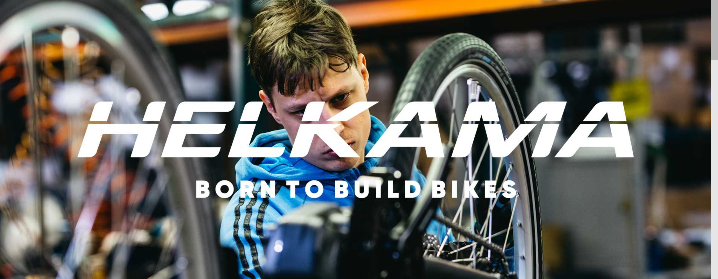

Slide 5
Course Structure
  Weeks 16 – 19: Product Portfolio analysis from PAD perspective
  Theory of PAD
  Company briefings & excur.
  How to do User Research, Customer Segmentation, User Testing and business modelling (AVP)
  Mid-Review Presentations
  Weeks 19 – 21: Product Concept Development
  Tutoring of concept development
  Questions & Answers -sessions (AVP)
  How to present (AVP)
  End Presentations & Essay for booklet

Slide 7
1st Week Schedule
17.4. Wednesday:
9.00 – 12.00: Briefing Microsoft Oy, Meeting place lobby Microsoft, Keilalahdentie 2-4 at 9 AM
18.4. Thursday:
9.00 – 10.00: Product Architecture Design lecture, Katja Hölttä-Otto
10.30 - 12.30: Briefing Helkama Velox Oy, Tero Valtonen

Slide 8
Important dates
3.5. whole day: Excursion Helkama Velox at Hanko
8.5. 9 - 12: Mid-Review Microsoft Oy
9.5. 13 - 16: Mid-Review Helkama Velox oy
23.5. 13 - 16: End presentations, Helkama Velox
24.5. 9 - 12: End presentations, Microsoft
27.6. Essay deadline

Slide 9

During Easter:
Choose the company (MS or HV) and
Book yourself in a group in MyCourses (3 persons in a group)

