Slide 1
Session 3
How does a Brand Manager Speak?
What does he speak of?

Slide 2
Some Practicalities
4 Make-up assignments on Mycourses (Assignments)
Final Presentation Schedule
Answering a short mid-course survey
Finalizing Group Members

Slide 3
Tom’s Contact Details
Tom Tuiskula
PH: 050 466 6776
Email: tom.tuiskula@gmail.com

Slide 4
Presentation Schedule
DATE | GROUP NAME | TOPIC | PAPER
29.05.2019 | Group H | Cultural Approaches to Branding | Diamond 2009
29.05.2019 | Group F | Cultural Approaches to Branding | Deighton 2002
06.05.2019 | Group G | Branding Services | Berry 2000
06.05.2019 | Group B | Branding Services | Brodie 2006
08.05.2019 | Group I | Brand Management in a Glocal World | Conejo 2015
08.05.2019 | Group C | Brand Management in a Glocal World | Cayla 2008
13.05.2019 | Group A | New Media & New Opportunities | Dessart 2015
13.05.2019 | Group D | New Media & New Opportunities | Deighton 2009
13.05.2019 | Group E | New Media & New Opportunities | Gensler 2013

Slide 5
What is Branding?
“Your brand is what people say about you when you’re not in the room.”

Slide 6
De-Mystifying the Vocabulary
Sources of Branding

Slide 7
Ingredient Branding

Slide 8
USP Branding
The key to branding is that consumers perceive differences among brands in a product category.
- Kevin Keller

Slide 9
USP Branding

Slide 10
USP Branding - Coke

Slide 11
USP Branding – Red Bull

Slide 12
The Biggest Branding Opportunity since…

Slide 13
Reflection Exercise -5 minutes
What are the necessary condition for USP branding to be successful?
What were the things you agreed with?
What were the things you disagreed with?

Slide 14
One set of answers
Predictable Consumer Needs and wants
Branding as added value
Source of Differentiation
Where is the consumer?
Who gets it?

Slide 15
Source: Business Owner Elevation

Slide 16
De-Mystifying the Vocabulary
Brand Actions

Slide 17
Brand Positioning OR STP
Developing Key Brand Associations
For The Appropriate Audience
To establish (and own) a clear space

Slide 18
Brand Architecture: House of Brands/Brand House/

Slide 20
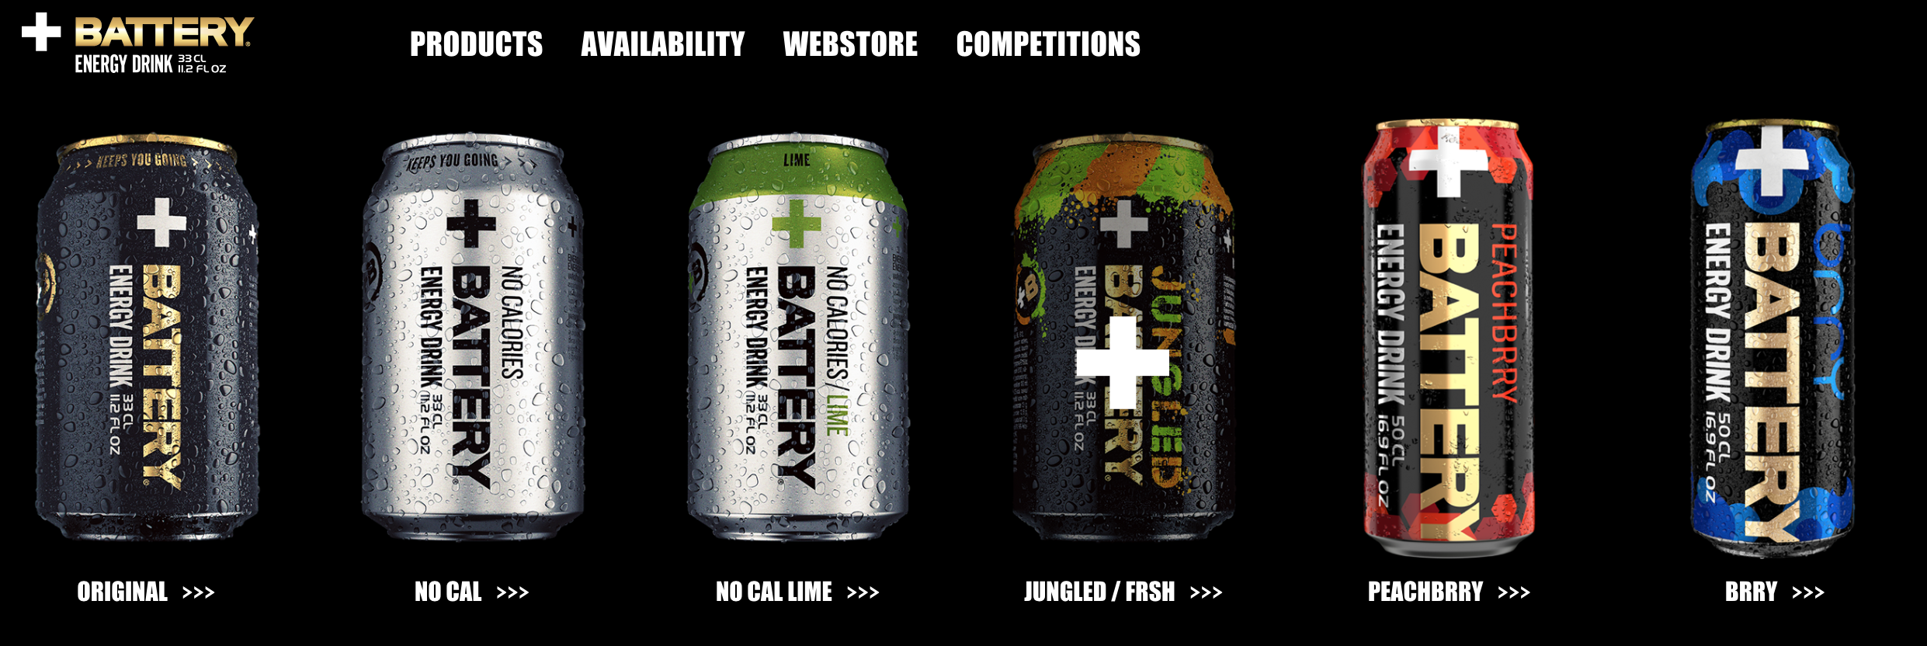
Brand Extension – Line Extension

Slide 21
Brand Extension – Category Extension

Slide 22
De-Mystifying the Vocabulary
Managerial Actions

Slide 23
Brand Audit
What problem does your brand solve?
What is the brand’s value proposition? What is the brand’s unique selling proposition?
How is your brand priced compared to the market?
Who are the three biggest competitors?
How do competitors define their brands?
What is the most disappointing thing about this brand?
What do you get from this brand?
Are there things this brand should be doing that it is not?
Would you ever use this brand? Why or why not?
If you could do one thing to improve the brand, what would it be?

Slide 24
De-Mystifying the Vocabulary
Measurable Outcomes

Slide 25
Brand Equity
Added value a product, service, person or organization accrues through investments in marketing activities for the brand
Bridge between what happened to the brand in the past and what might probably happen to it in the future

Slide 26
EXAMPLE

Slide 28
Recruitment

Slide 29
Brand Identity

Slide 30
Instructions for Article Presentation
Key Concepts/Terms and their explanations (2-3 slides)
Empirical Story / Line of Argumentation (2-3 slides)
Recommendations and Implications (2-3 slides)
Reflection – Insight (1-2 slides)

Slide 31
Key Concept – Brand Equity
Added value a product, service, person or organization accrues through investments in marketing activities for the brand
Bridge between what happened to the brand in the past and what might probably happen to it in the future

Slide 32
Key Concept - Loyalty
Stickiness of the brand
Strength of connection – rational, Emotional, experiential
Antecedents: Satisfaction

Slide 33
Key Concept – Leadership-Quality
Leading the category
Judgment of Quality

Slide 34
Key Concept - Differentiation
Uniqueness
Personality
Organization

Slide 35
Key Concept - Awareness
Recognition - Opinion

Slide 36
Key Concept - Market
Share of Market (halo)

Slide 37
Implications
Think of Brands as Complex Entities
Manage consumer perceptions with appropriate brand communication

Slide 38
Reflections
Not possible in an era where brands have conversations

