Slide 4
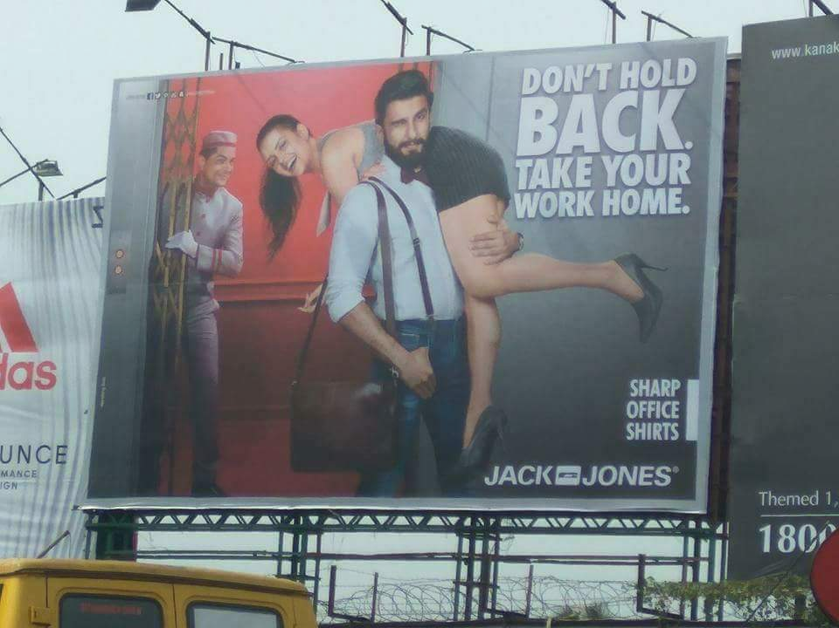

Slide 5
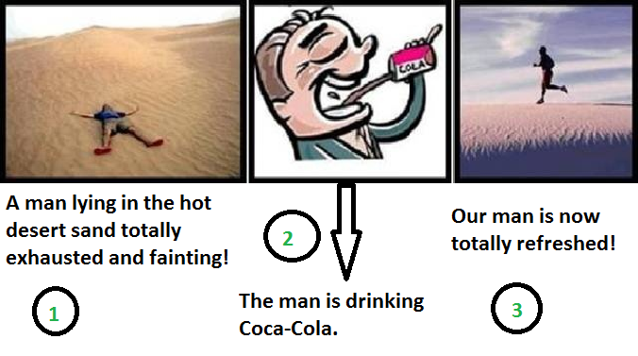
Interpret This!!

Slide 6
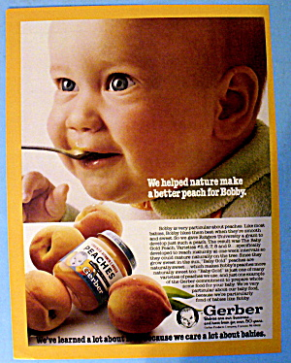

Slide 7


Slide 8
Branding in a Glocal World
Challenges of branding in a glocal world
  Cultural Misalignment
Strategies to counter branded misalignment
  Authenticity (Common Mythic Past, Country-of-Origin)
  Identifying and aligning with cultural universals
  Piggyback on donor cultures (French cuisine, Hollywood)
  Making the core brand idea polysemic
Notes:
Nike India ad, Harley Davidson, McDonalds in India, Appadurai’s scapes

Slide 9
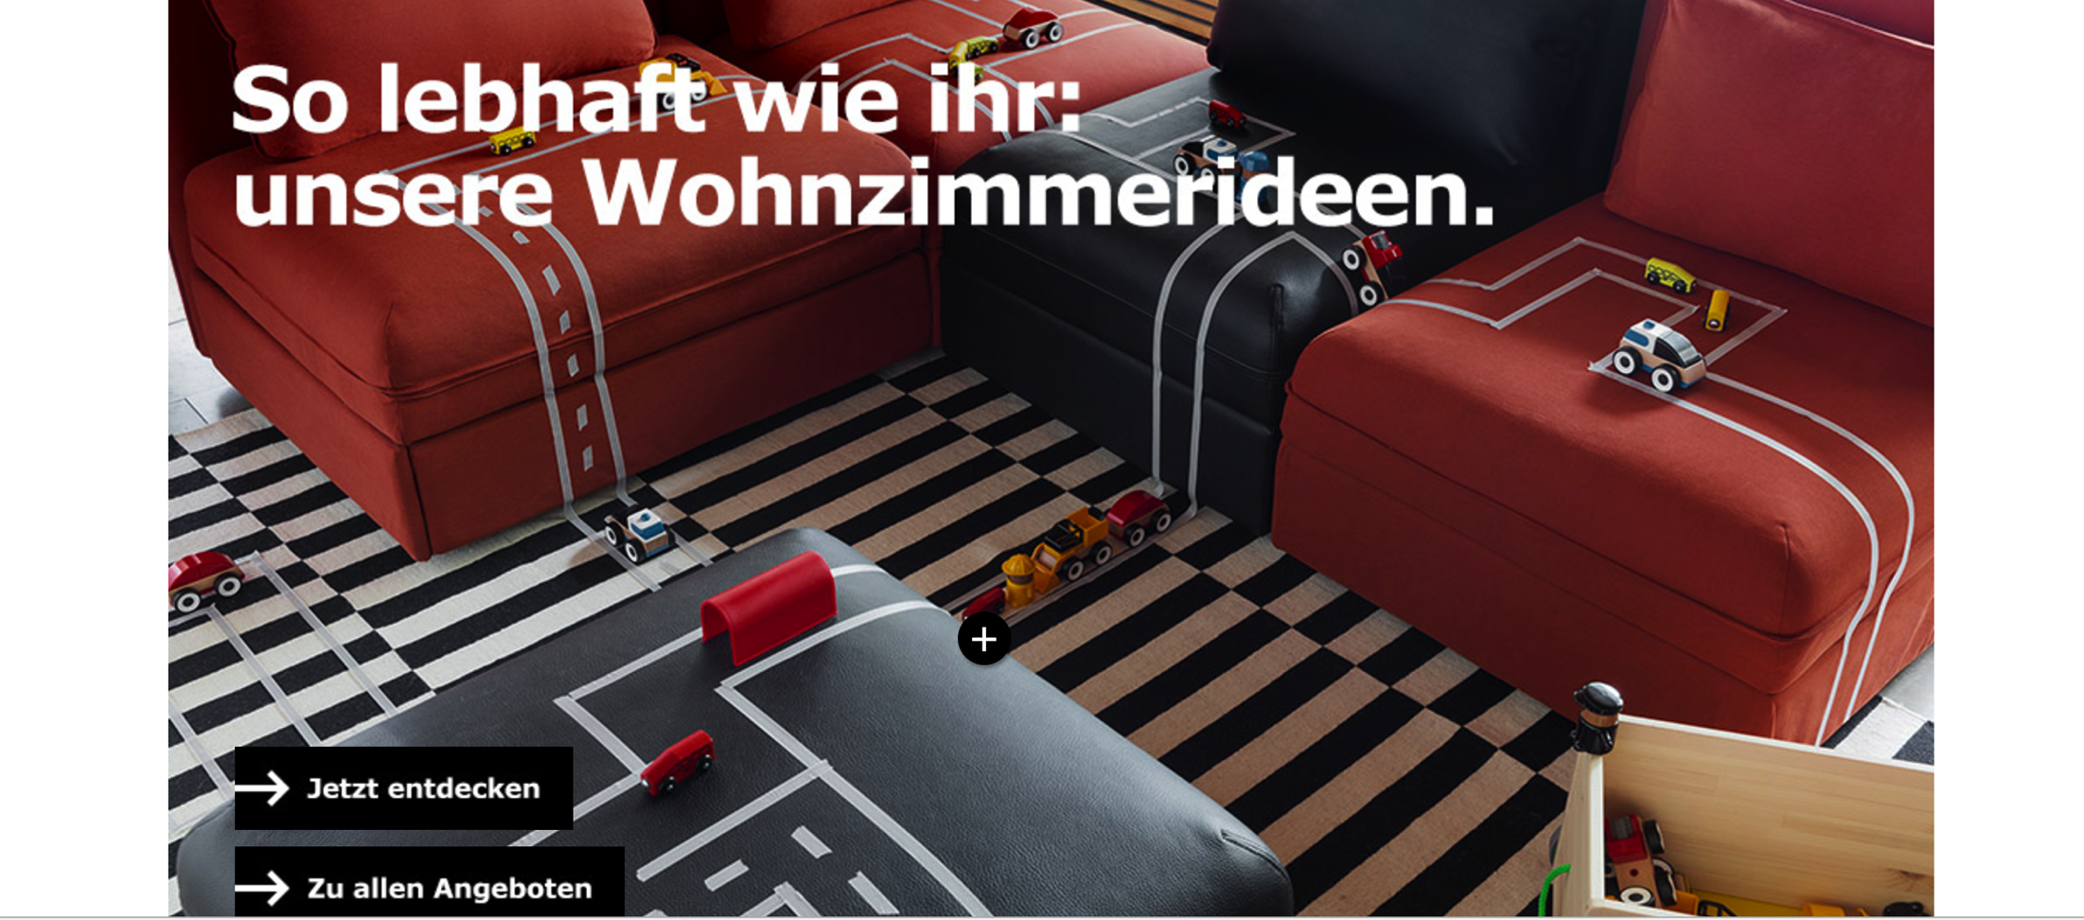
Italy

Slide 10
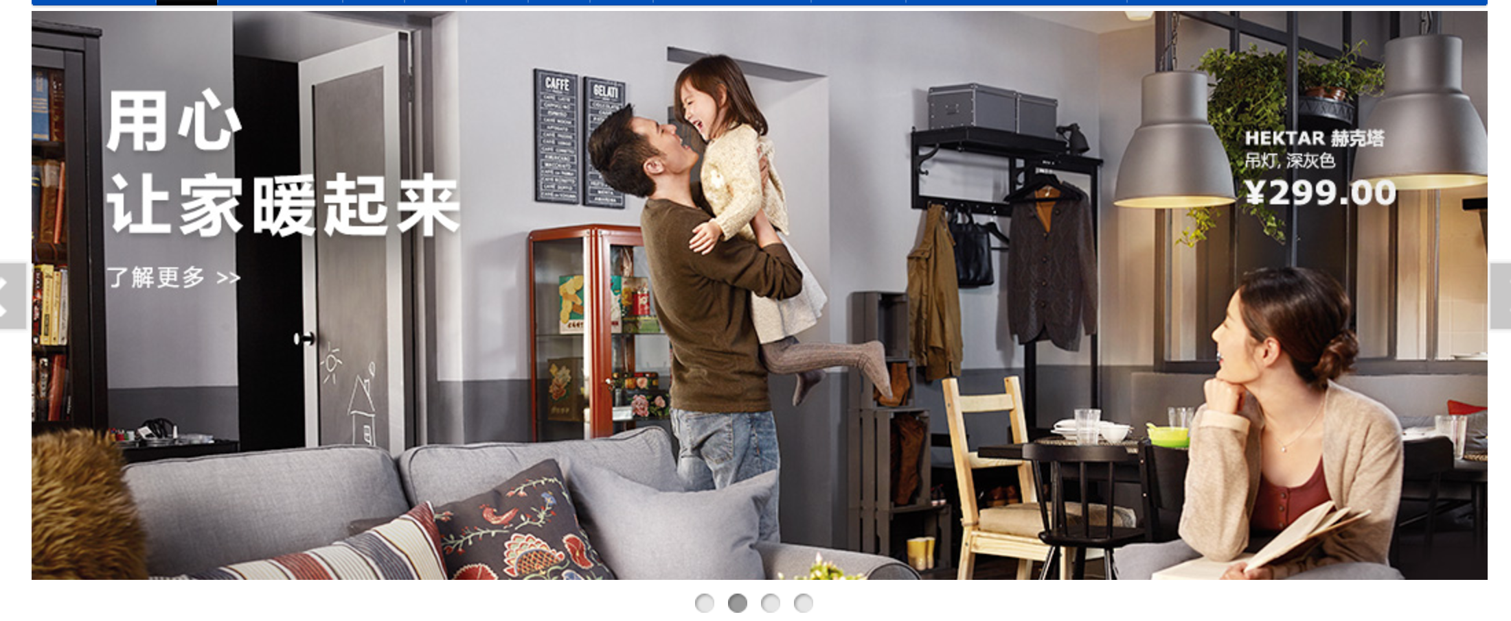
China

Slide 11

Canada

Slide 12
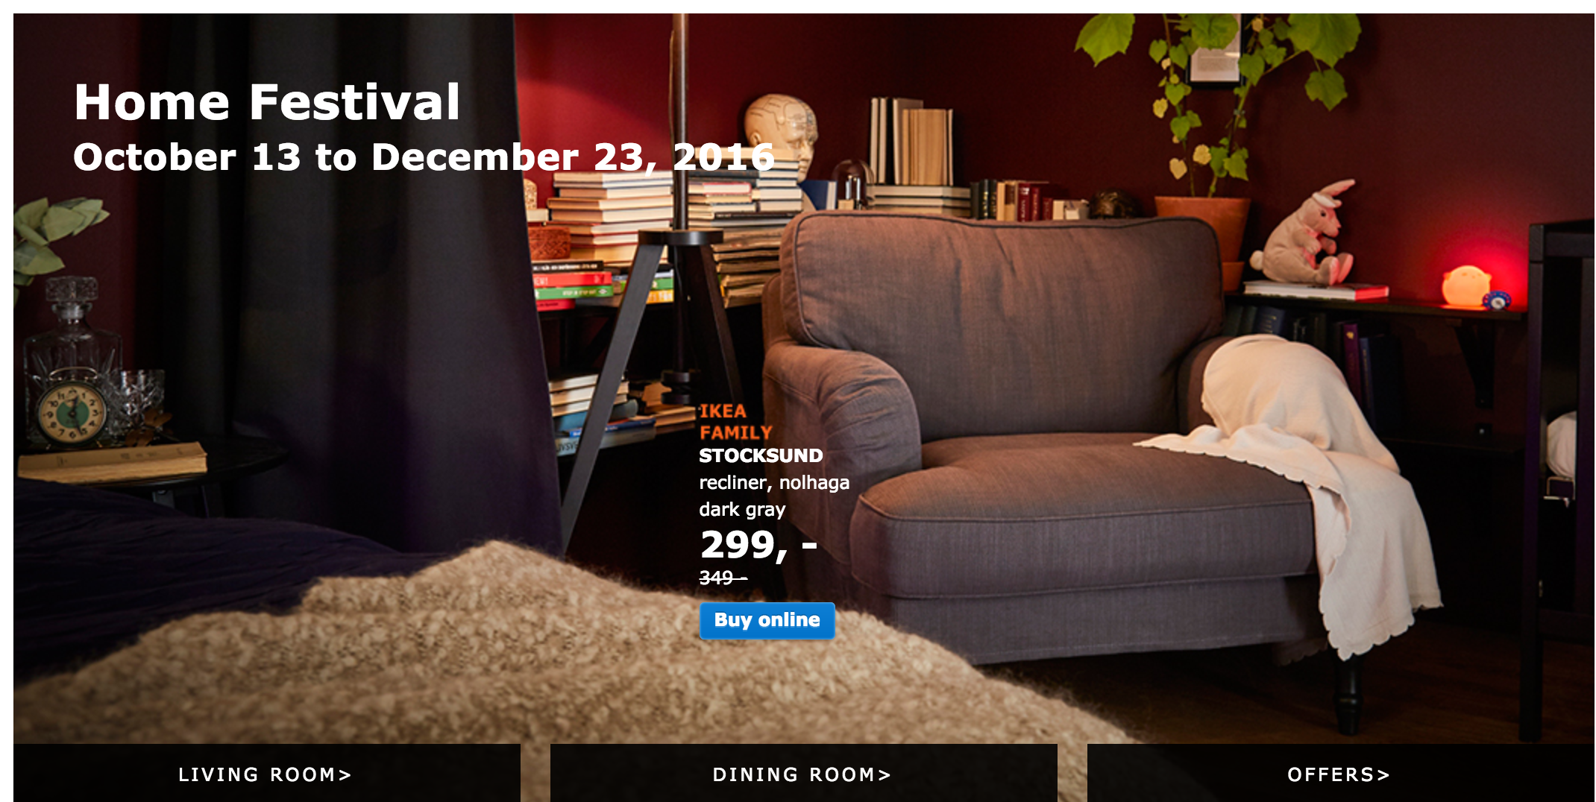
Finland

Slide 13
Nike India
Cult of the Amateur cricketer
https://www.youtube.com/watch?v=JtxLmInvFcw

Slide 14
Why is it so difficult – part 1
Notes:
Photo of iceberg – Explicit and Implicit

Slide 15
Why is it so difficult – part 2

Slide 16
Clifford Geertz
Culture imposes meaning upon experience.

Slide 17
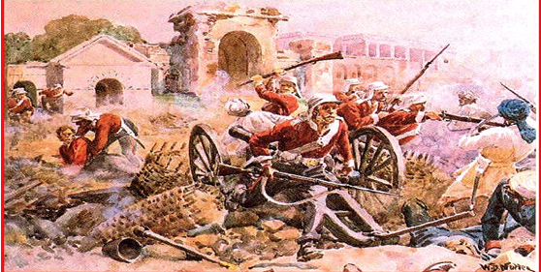
The revolt of 1857

Slide 18
Bungled Brand Management circa 1857
England’s East India Company lost control of its most profitable colonial outpost
Failure to account for local tastes and preferences

Slide 19
The End User
There were over 300,000 sepoys in the army, compared to about 50,000 British.

Slide 20

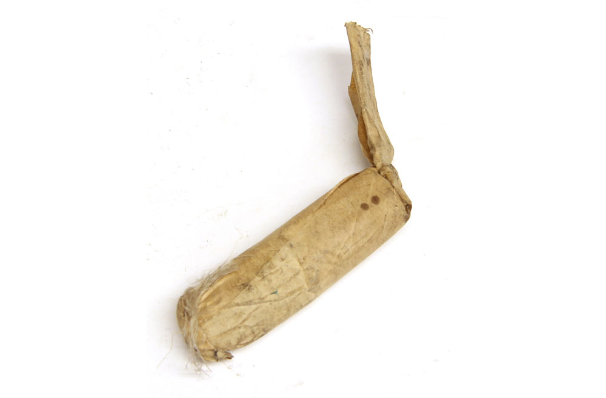
The Product

Slide 21
Misalignment
Indian soldiers were furious when they realized that cartridges had beef tallow and pork grease

Slide 22

The Revolt of 1857

Slide 23
The result
The East India Company lost control of India to the British Crown

Slide 24
Brands which have done well

Slide 25
Common Mythic Past

Slide 27

Yoga
Spiritual practice linked with magic, mysticism and asceticism

Slide 28
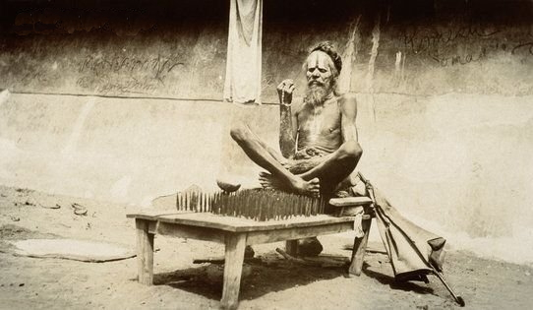
Magic

Slide 29

Mysticism

Slide 30
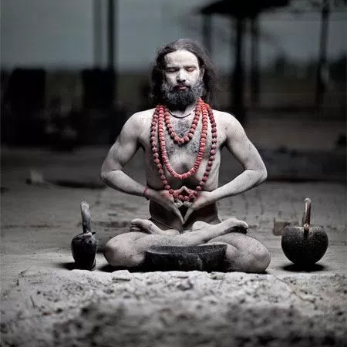
Asceticism

Slide 31
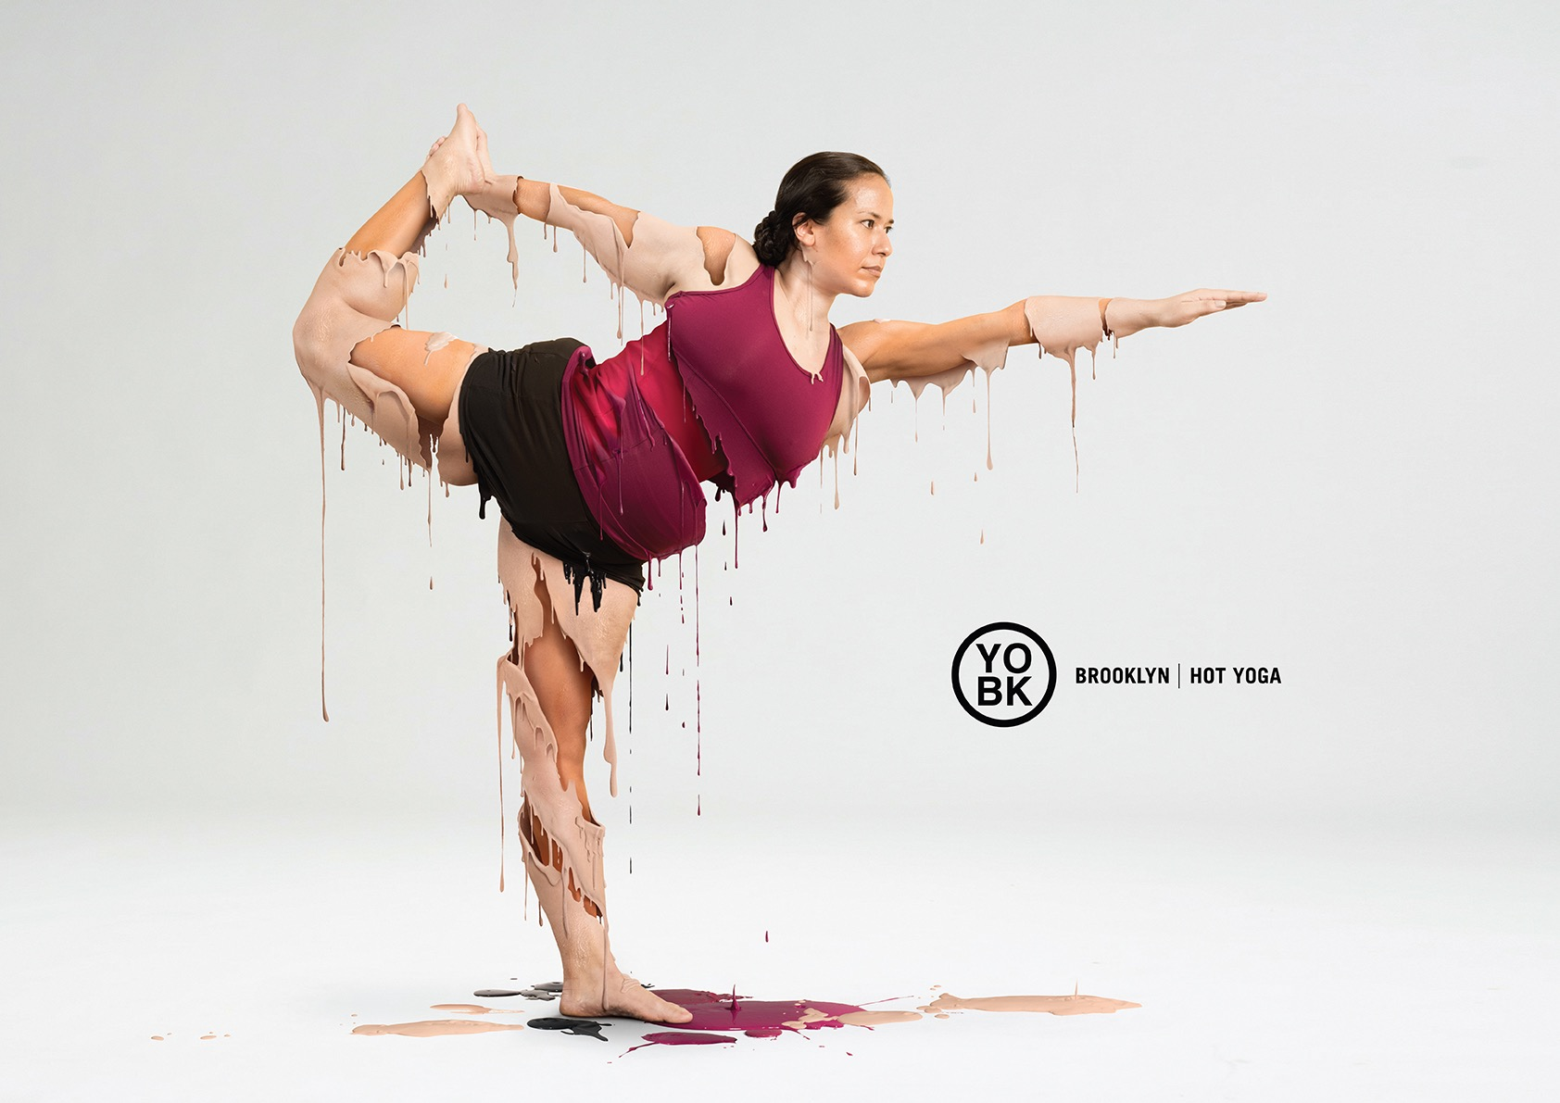

Slide 32
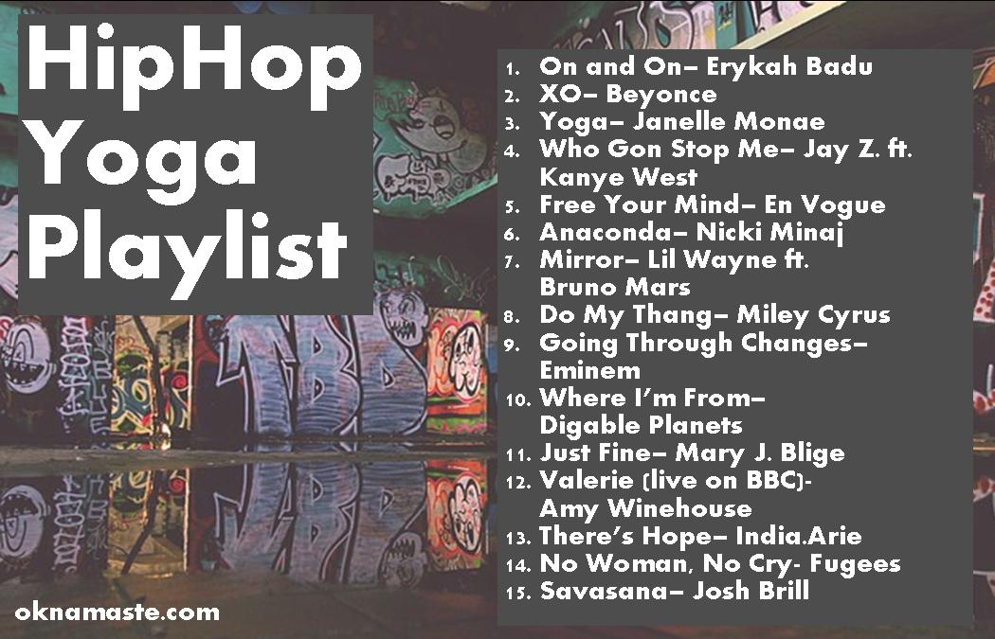

Slide 33


Slide 35
Identifying Cultural Universals

Slide 36
Dove-speak
“Real women have real bodies with real curves. And Dove wants to celebrate those curves.”
"Models weigh an average of 23 percent less than the average woman. Twenty years ago, models weighed an average of 8 percent less."

Slide 37
Tapping into media-created anxiety
The beauty industry has relied on idealized portrayals of women to engage female consumers.

Slide 38
Dove’s Aim
Dove’s mission is to make more women feel beautiful every day by broadening the narrow definition of beauty and inspiring them to take great care of themselves.

Slide 39
Brand Manager’s key call
It is not about making women feel more beautiful
It is about making more women feel beautiful

Slide 40
Donor Cultures

