Slide 1
Managing Digital-Social Brands/Branding

Slide 2
Photo courtesy Eudaimonia

Slide 4
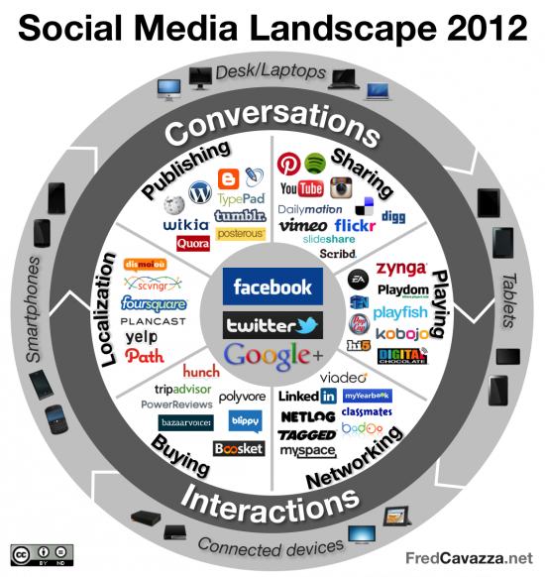
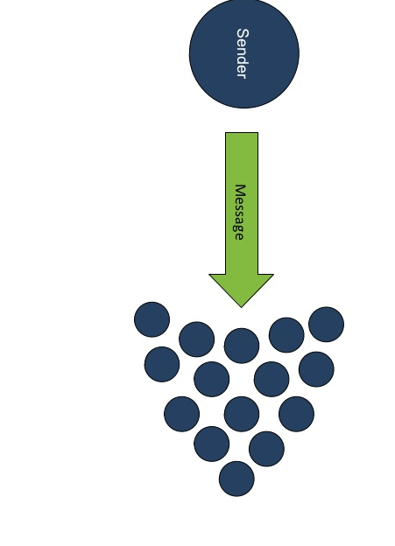
Traditional Interactions
Contemporary Interactions

Slide 5
DIGITAL
BRANDING

Slide 6
Agenda
Managing Digital/Social Brands
What is it
How is it different
How is it changing Branding and Brand Management

Slide 7
What is Social-Digital Media?
What is Asocial/Analog Media?

Slide 8
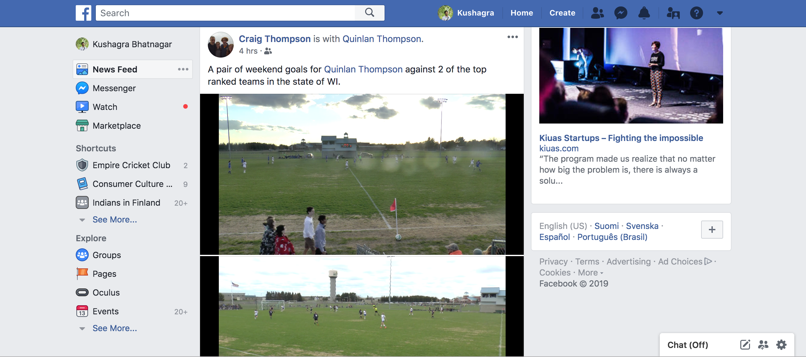
Digital/Social Media – Built for Branding
Social Media IS Branding
Presentation of Self in Everyday Life
Curated Lifestyle, DP, hashtag#, views, likes, retweets …

Slide 9
Second-Screening, Live-tweeting

Slide 10
What does Digital add to branding?
Is it about the underlying technology?
Or is it about a new way of interaction?
Quantification of Interactions
Cognitive Surplus?

Slide 11
Branding Digitally: A brand manager’s delight
Every engagement can be measured
Every campaign can be analyzed
Social Media Marketing has measurable ROI

Slide 12
All brands are digital brands now
Influencers, Reviewers, Friends, Followers
ZMOT

Slide 13
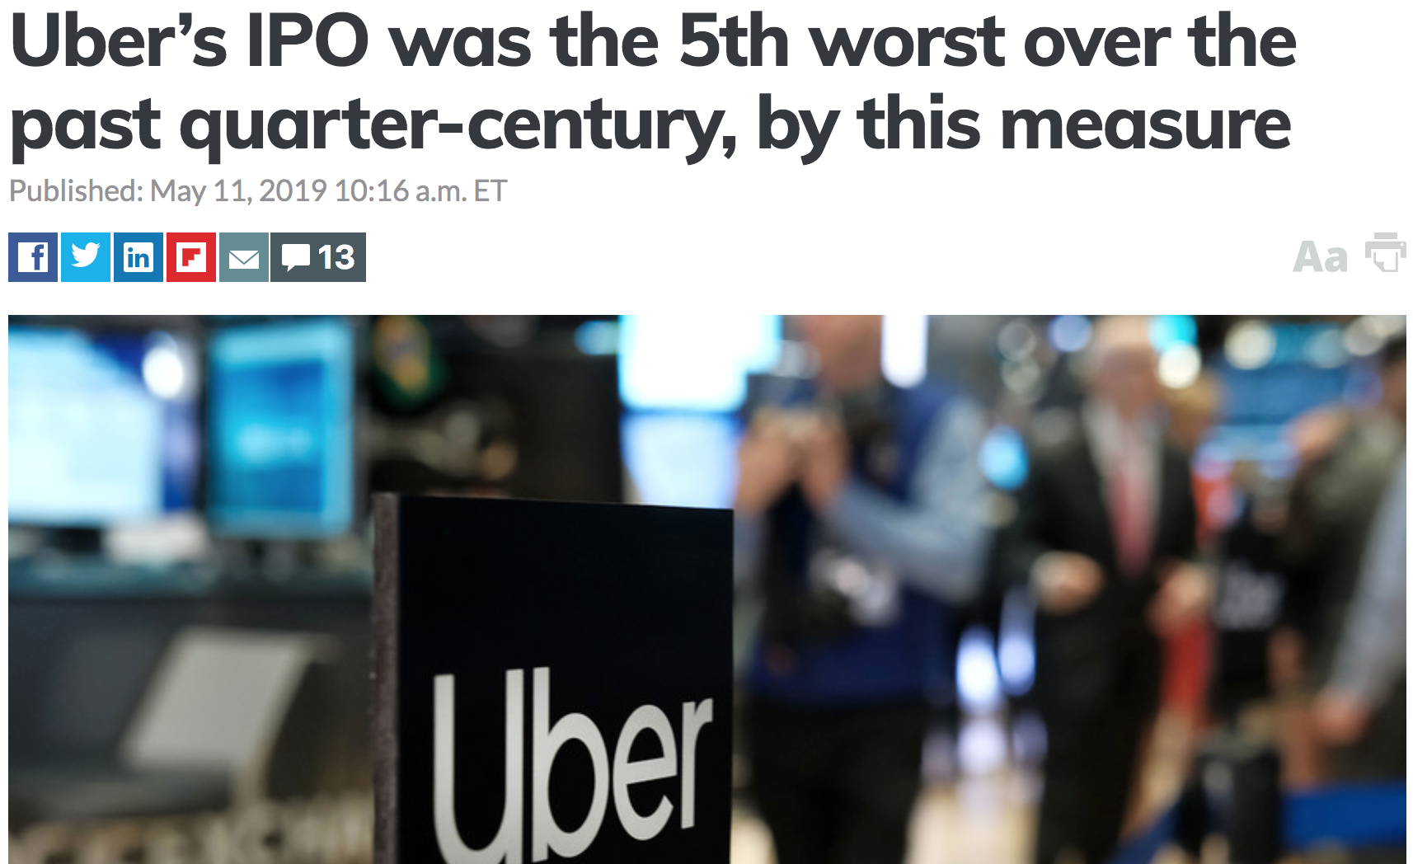
All digital brands are also brands

Slide 14
A New Metaphor
Engagement
That replaced the old traditional media metaphor of Impression
“We can’t just be getting people stirred up; awareness isn’t enough. We actually have to do something to change what’s happening.”
- Sharon Macleod, President – Unilever North America Personal Care

Slide 15
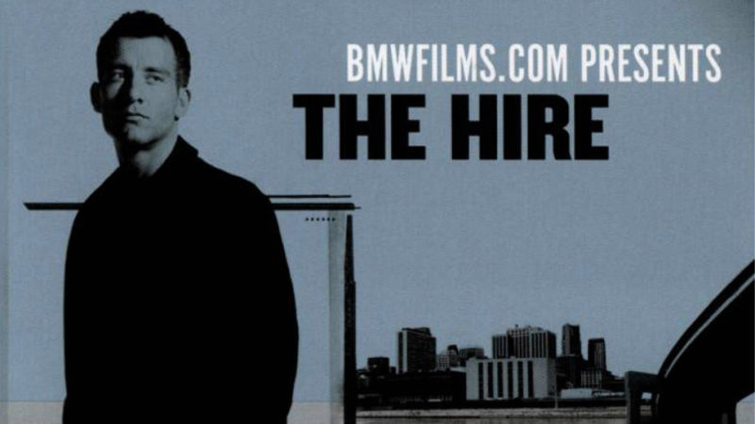
Engagement over what?
CONTENT

Slide 16
The rise of a new creative class
Youtubers
Influencers
Monetization the new buzzword

Slide 17
Social Media : Humanizing Brands
Brands no longer abstract entities or entries in company balance sheet
Consumers can have conversations with Brands as if they are real people
Anthropomorphizing brands
Notes:
You can friend a brand, tag a brand, complain to a brand, post on its facebook page or have an extended twitter conversation with the brand

Slide 18
Polarization – Taking Sides

Slide 19
Notes:
Be careful what you are going to measure

Slide 20
The Power of Social Media
Game of Thrones on twitter

Slide 21
Challenges of Social Media
Difficult to distinguish between branded and unbranded content
Difficult to distinguish between user-generated or firm-generated content

Slide 22
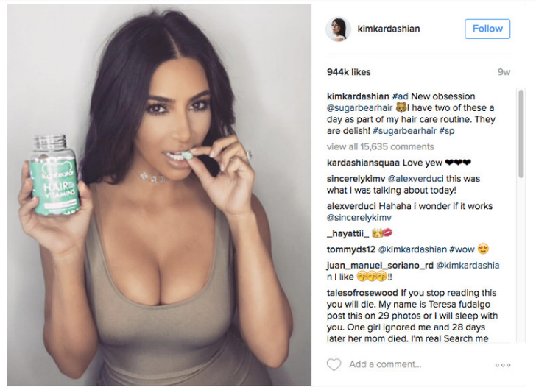
#sp

Slide 25
The Digitalized Challenges of Branding
Jonah Peretti, sweatshop, nike

Slide 26
Challenges of Social Media Marketing

Slide 27
The Full Circle
Death of Cognitive Surplus
Social Media borrowing codes from traditional media
New metrics that are not that different from old metrics
Engagement vs Impressions vs Eyeballs

Slide 28
As a Final World
Brand Manager as Content Orchestrator
From Impressions to Engagement
Brand Manager as Statistical Analyst
Carefully choose what to measure when everything can be measured
Consumers live blended lives

Slide 29
Questions?

