Slide 1
Enlivening Brands

Slide 2
Challenges of Branding in the 21st Century

Slide 7
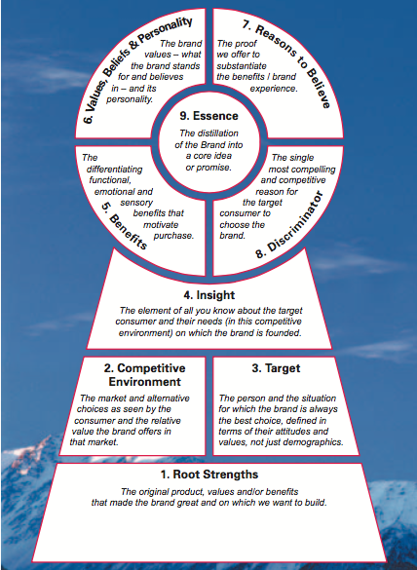
Moving Beyond Gatekeeping

Slide 8
Identifying Cultural Conversation
“Mothers were tired of the sexualization of littlegirls, tired of making children grow up too fast,”
Pleasant Rowland

Slide 9
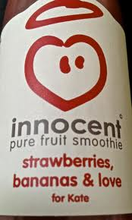
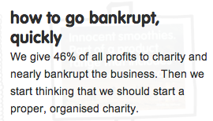
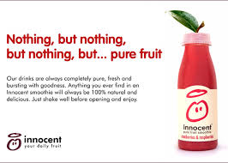
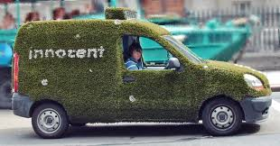
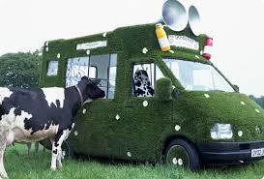
Unbranded Branding

Slide 10
BRAND MADONNA
Leveraging the authenticity paradox

Slide 12
The Authenticity Paradox
Market for cultural authenticity
Tourism
History
Food
Collections
Media (Reality TV)
“A culture of the factitious”
Baudrillard

Slide 13
Questions for Discussion

Slide 14
How do different branding approaches understand the relationship between the company, the product, the brand, and the consumer?

Slide 15
How do different branding approaches (USP branding, Emotional branding, cultural branding) influence the role of the brand manager?

Slide 16
Which of the branding approaches do you think work best in the contemporary environment? Explain your choice with a current example?

Slide 17
What kinds of brands or categories can be more sensitive to branding approaches other than what you have explained in the above answer?

Slide 18
Pick a recent case where a brand's strategy was not successful? Try and identify the reasons for its failure and what it might have done differently?

