Slide 1
riikka.i.makikoskela@aalto.fi
elisa.dametto@aalto.fi

Slide 2
Cultural Approach to Sustainable Society
Doctor of Arts Riikka Mäkikoskela
Sculptor, Visual Arts Teacher and Researcher
Executive Director, The Finnish Association of Art Schools
for Children and Young People

Slide 3
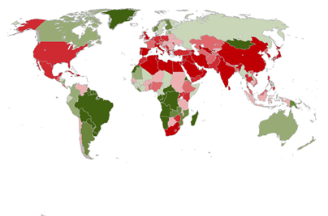

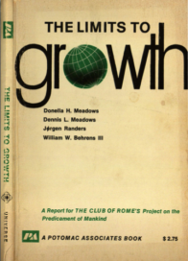


Boundaries

Slide 7
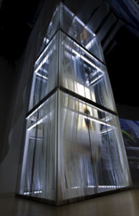
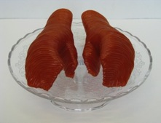
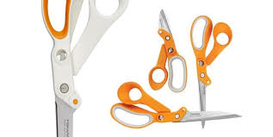
NEW WAY TO THINK AND ACT
Kone Oyj Elevator
DESIGN THINKING
SYSTEMIC THINKING
MATERIAL DEVELOPMENT
CREATIVE MAKING
ARTISTIC THINKING
Mäkikoskela, R. 2011.
From Hand to Mouth.
PRODUCT DESIGN
PRODUCT DEVELOPMENT
INNOVATIVE ACTION
Fiskars scissors
BREAKING OUT THE SILOS

Slide 8
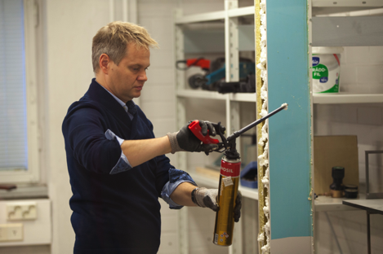
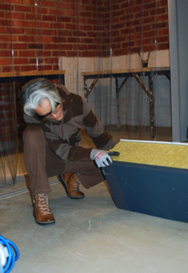
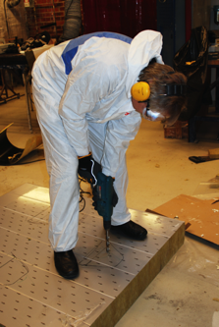
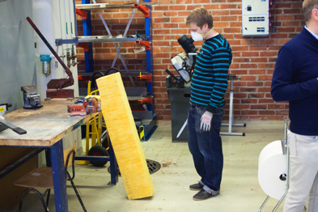
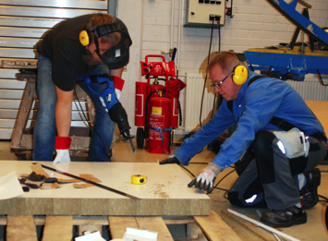
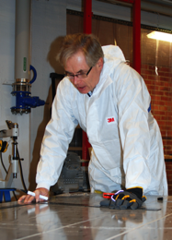
Instead of brainstorming and ideation on paper, workshop participants now work on sandwich panels by hand

Slide 9
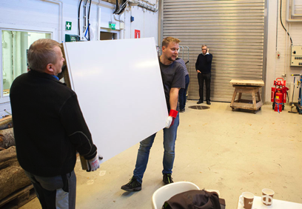
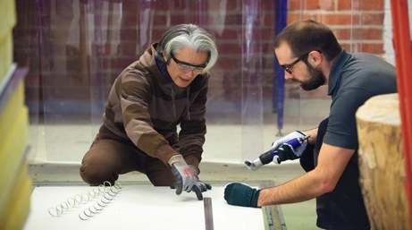
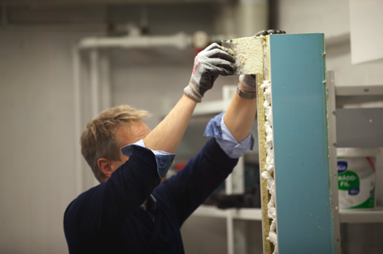
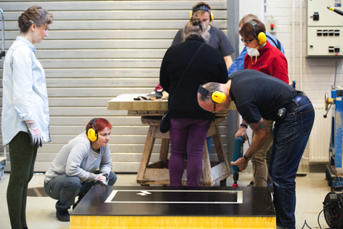

Slide 10
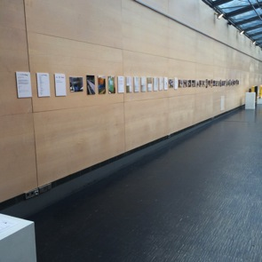
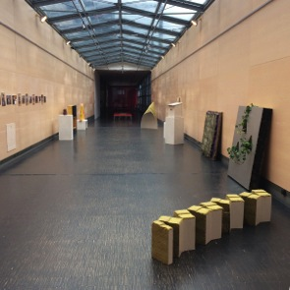
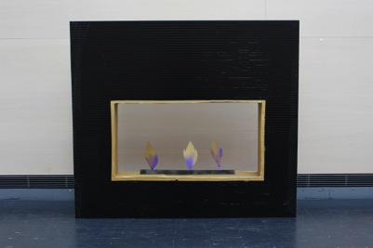

Slide 11
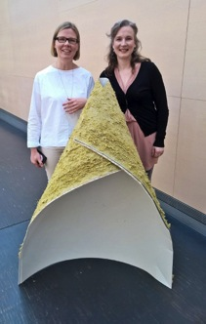
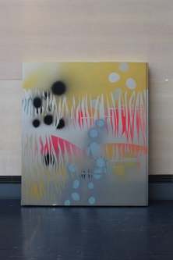
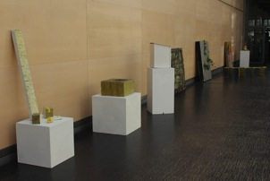

Slide 12
Art and design practices promoting sustainable society and circular economy
Circular economy can be seen as a change of consumer culture in society
The importance of the cultural dimension has strengthened in ecological thinking (Soini & Dessein 2016)
The cultural and social play a key role in consumption and recycling

Slide 13
Art and design practices promoting sustainable society and circular economy
In material circulation, besides concrete materiality, mental images and cultural and social materiality are important
The communal, social, and cultural material inexorably influence consumption habits
Changing the consumption culture towards circular economy requires multidisciplinary cooperation (Pajunen et al. 2013)

Slide 14
Art and design practices promoting sustainable society and circular economy
The key factors in the sustainable change of consumer culture are the knowledge of the significance of art practice and creative thinking and the production of culture in the overall picture of the circular economy
In art, we can work on the cultural and social material that play a key role in consumption and recycling
In art, we can, in addition to concrete materiality, work on imaginative
Thus, it is time to understand the possibilities of artistic methods in creating cultural change towards regenerative sustainability

Slide 15
Art, art-making, artistic thinking, design thinking, creativity
Embodied
Knowledge
Humanity
Emotions
Empathy

Slide 16
Art and design practices promoting sustainable society and circular economy
Art practice is considered as thinking linked to action, in which new ideas can be experienced, tested, trialed and challenged (Mäkikoskela 2015)
Do – undo – redo (Bourgeois 2018)
> CYCLICALITY/CIRCULARITY
Open-ended practice
Art-making processes contain a lot of sensory and embodiment and are thus challenging to disassemble by the means based on reason and linearity

Slide 17
Art and design practices promoting sustainable society and circular economy
In contemporary and environmental art and environmental pedagogy, aesthetic, ethical and ecological already intertwine
Creative practices employ various means

Slide 18
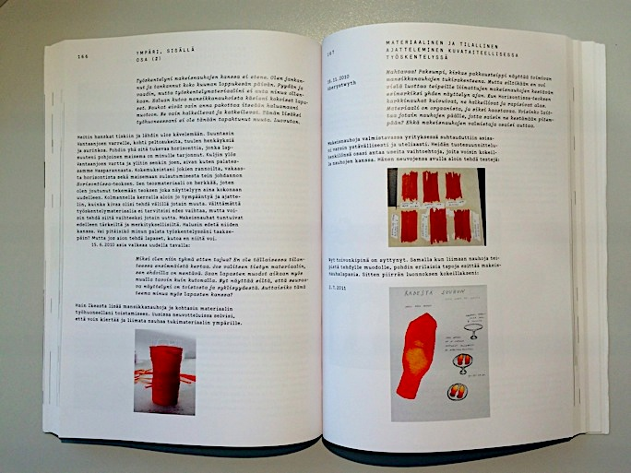

Slide 19
Synnyt / Origins 3-2018:
https://wiki.aalto.fi/pages/viewpage.action?pageId=145123907
Mäkikoskela, Riikka. 2018. FROM FAR TO CLOSE (AND BACK). MATERIAL RESISTANCE AND CHANGING PERSPECTIVES IN VISUAL ART PRACTICE. Synnyt/Origins Journal, Issue 3: Special issue on Catalyses, Interventions, Transformations, 349–378, http://wiki.aalto.fi/display/Synnyt

Slide 20
Creative practice, for example art-making, can make new ideas visible but also visualize and create new possible cultural ways of acting
BUT…
Circular economy requires change in art world: the traditional notion of a unique work of art does not allow the recycling of the work

Slide 21
Recycle Even the Unique!
The uniqueness and singularity of visual arts
Recycling of works of art?
Can we reuse the artwork?
Finding innovative ways to use limited natural resources
in a sustainable way
Public art & public pedagogy > material cycles

Slide 22
Pasi Karjula and Marko Vuokola, Olo n:o 22, 2000
polished steel, Hietalahti, Helsinki

Slide 23
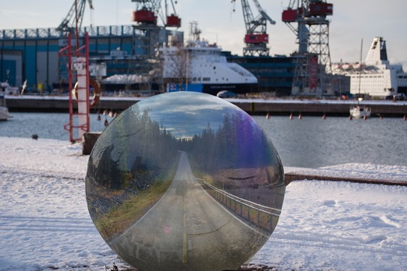
Adel Mekhane’s, Vesteri Ollinen’s, and Aaro Packalén's student work for We comment! assignment. The students commented the themes of traveling, transportation, and climate change. They combined the visual experience of the environment and digital image processing.

Slide 24
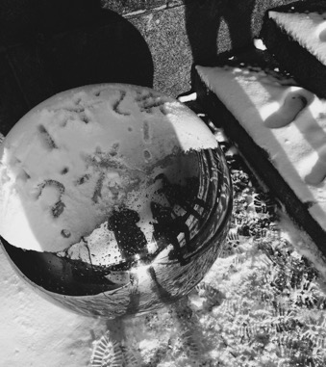
Aino Hörkkö’s, Katariina Kujapelto’s, and Julianna Tiirikka’s comic commentary
on Pasi Karjula’s and Marko Vuokola’s artwork. The students took a stand for
social and environmental issues in the winterly and urban environment.
The authors of the statement and the urban environment of the public artwork are
reflected in the underlying part of the artwork.
Notes:
art

Slide 25
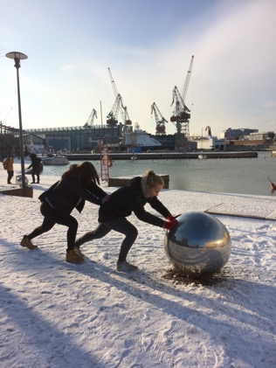
Silja Lampinen, Iina Martikainen, and Siri Piippo-Pinho worked on the We comment! assignment kineticly and performatively. The students used their own bodies as material of the new artwork they created.

Slide 26
Course diary
The students keep a course diary (for example, in the digital form or as a portfolio), where they discuss and reflect on the questions raised in the course, both from the point of view of their own field and from the point of view of artistic methods, and where they present the course assignments. The course diary has to be handed in to pass the course.
2.
Pick one project presented today on the Test Site and reflect on:
A Why is the project interesting from the point of view of your own field?
B Why is the project important from the point of view of sustainability and circular economy

Slide 27
For the next meeting, Wed 24.4.
Soini, K.; Dessein, J. Culture-Sustainability Relation: Towards a Conceptual Framework. Sustainability 2016, 8, 167
https://www.mdpi.com/2071-1050/8/2/167
Mäkikoskela, Riikka. 2018. FROM FAR TO CLOSE (AND BACK). MATERIAL RESISTANCE AND CHANGING PERSPECTIVES IN VISUAL ART PRACTICE. Synnyt/Origins Journal, Issue 3: Special issue on Catalyses, Interventions, Transformations, 349–378, http://wiki.aalto.fi/display/Synnyt
https://wiki.aalto.fi/pages/viewpage.action?pageId=145123907

