Slide 1
On Materiality of Art and Pedagogy
Taneli Tuovinen 24042019 onni.tuovinen@aalto.fi

Slide 2
Circular economy: from regenerative system of resources to way of thinking the cultural change
The importance of the cultural dimension has strengthened in sustainable development (Soini & Dessein 2016)
Changing the consumption culture towards circular economy requires multidisciplinary cooperation (Pajunen et al. 2013)
Nowdays the term encompasses more than the sustainable production and consumption of material, goods and services. It includes discussion of the radical intertwinement of aesthetical, ecological and ethical processes and the way we are experiencing them. This way the original idea of material processes extends towards ideas of experiential and social materials. (Mäkikoskela & Tuovinen 2018)
Notes:
The way we experience = makes the homebase - how to change your way to experience? ( lots of talk about changing your values, updating the information) -examples from everyday life? Excerxices?
Ecology (from Greek: οἶκος, "house", or "environment"; -λογία, "study of")
Ecologists seek to explain:
Life processes, interactions, and adaptations
The movement of materials and energy through living communities
An economy (from Greek οίκος – "household" and νέμoμαι – "manage")
The successional development of ecosystems
The abundance and distribution of organisms and biodiversity in the context of the environment.

Slide 3
“The environmental crisis is possible because there already has been a environmental crisis in human mind”
Tere Vaden (1969 - )
-We have lost our Origins (syntytieto)
Check: Salminen, Antti & Vadén, Tere: Energy and Experience. An Essay in Nafthology. Chicago: MCM’ 2015. ISBN 978-0-9895497-1-4.

Slide 4
3. What kind of material is described here?
https://www.youtube.com/results?search_query=Ingen+känner+det+som+du.

Slide 5
“The Imagination is not needed for escaping the reality but for engaging with it”
-Paul Klee (1879 – 1940)

Slide 6
Changing experience through skill:
1. Act of practice is performed.
2. Skill is purposefully developed.
Procedures in the skill are identified in order to know it.
Skill (practitioner) becomes conscious of its epistemic nature
These ideas can be found in Book 6 in Aristotle´s The Nicomachean Ethics, where he discusses skill, teaching and mastery
Notes:
To become more better in what you do is one way to change the way you experience

Slide 7
What matters?
Where is resistance, there is something real:
-resistance positions the pratitioner in reality and reduces “belief-character” of the practice Main de Biran (1766 – 1824)
Without resistance methodical progress do not introduce new or foreign elements, only recognition of how everything happens or “works”. (Varto 2018)

Slide 8
Admiting it or not, living together, education ja learning are part of a process of socialisation/indoctrination
-> cultural pedagogy
-> ubiquity of learning
-> unlearning
Notes:
Skill and learning we don’t recognize, we take for granted
Cultural pedagogy - where does the meaningful learning take place?
Vrt. Metaphores we live by (Lakoff and Johnsson)
ART ED methods are very often based on gaining new understanding by first changing the everyday practices.
-Learning, education and pedagogy as proader phenomena, not just something schooling like.

Slide 9
Models for higher artist/arts education
who (student) what (subject) how (pedagogy)
ACADEMY talent technique imitation
BAUHAUS creativity medium invention
CONTEM PORARY attitude practice deconstruction
(Bailey 2007)
Notes:
all the social practices could be examined as material for art or performance

Slide 10
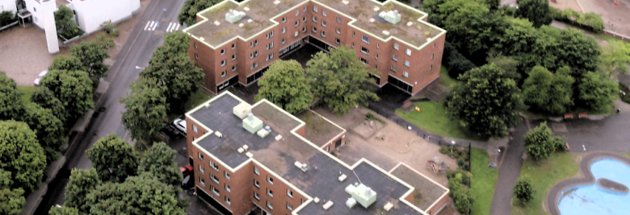
Socially angaged art as access to social material flows
Tellervo ja Oliver Kalleinen:
AVATAR INFLUENCE GAME @ MAUNULA, HELSINKI, JUNE 2018
In Avatar Influence Game, three different groups from Maunula neighbourhood try to influence their surroundings through an avatar. They control the avatars real time – played by actors Outi Vuoriranta, Niina Sillanpää and Max Bremer – as the avatars move within the local ‘game zone’.
Public can follow the gaming 6 June 5-8pm / 7 June 2-6pm / 10 June 1-6pm at Maunulatalo.

