Slide 1
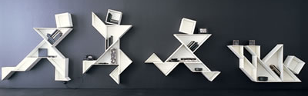
Product Architecture
Product is a puzzle. Some building blocks can be shared through the product family. Some components will complete/ vary/ the function and apperance to defined customer

Slide 2
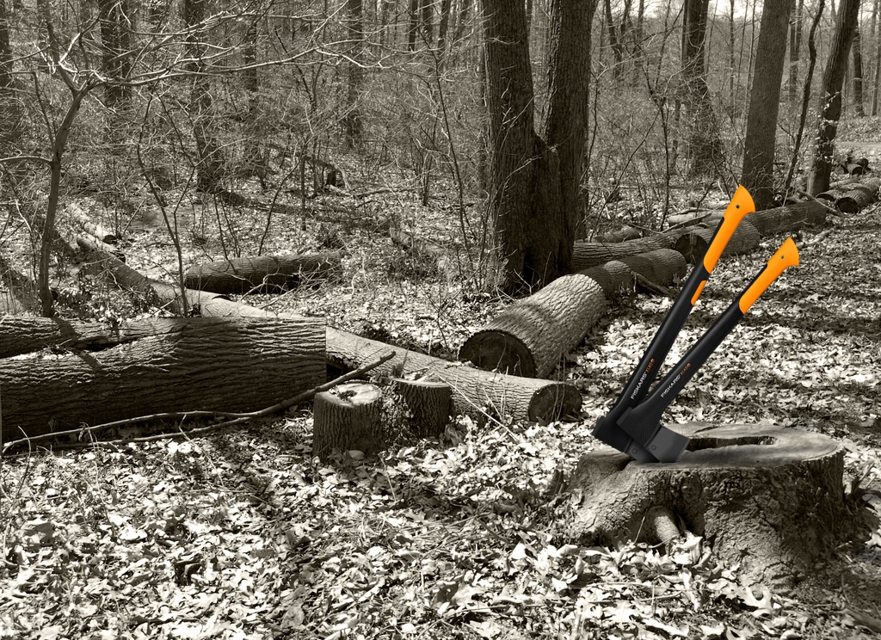
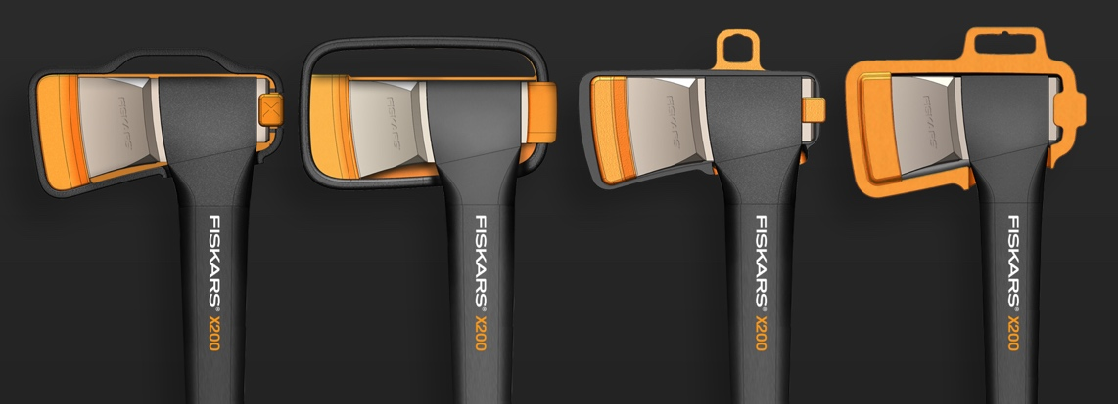

Slide 3
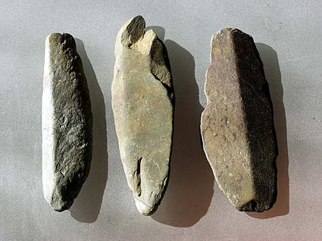
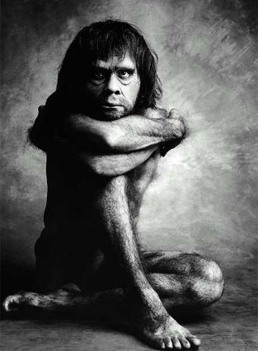
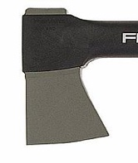
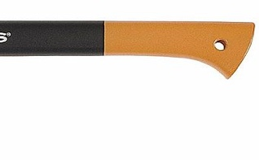
New generation of axes
Revision – Evolution - Revolution
Familarity of the new

Slide 4
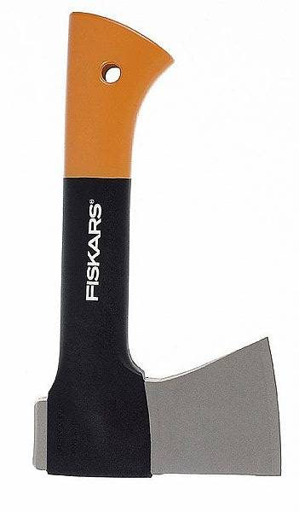
Fiskars axe business
Since 1992
6,5 million Axes
74.5 M€ net sales
Small camping axe 500
Splitting axe 1100
Universal axe 1300 Pro
Splitting axe 1500 Pro
Carpenter´s axe 1000
Universal axe 1250
Splitting axe 1400
Heavy splitting axe 2400
Camping axe 600
1,3

Slide 5
Why new range?
Push
Competition
Range has remained the same for 15 years
Pull
Production tooling is partly worn out
Promising technology for soft touch
Advanced knowhow

Slide 6
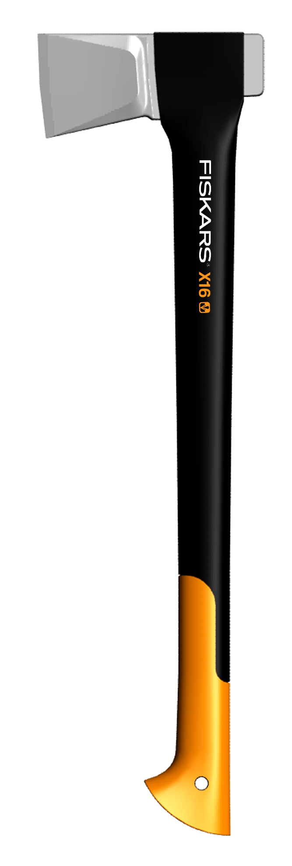
Improvements and lessons learned
1. New blade geometry
2.Bigger hammer
3. Shaft marking/ naming
4. Improved process control
5. Soft grip
New sheath
New packaging card
New master packagings
New displays

Slide 7
Axes by lenght and weight
1m
1 kg
2 kg
3 kg
1300, 1500
X30
1250, 1400
X20
2400
X14, X16
X10, X12
1000, 1100
0.5 m
600
X6
500
Existing axes
New range

Slide 8
Individual and shared elements
6 Shafts
1
1
3 Grips
8 Tools
5 Blades
2
2
1
3
3
4
5
2
4
6
7
5
8
6
3

Slide 9
New axe range
X3 Brush hook
X6 Universal blade / 0,6 kg
X10 Universal blade / 1,0 Kg
X12 Splitting blade / 1,2 Kg
X14 Universal blade / 1,4 Kg
X16 Splitting blade / 1,6 Kg
X20 Splitting blade / 2,0 Kg
X30 Maul blade / 3,0 Kg

Slide 10
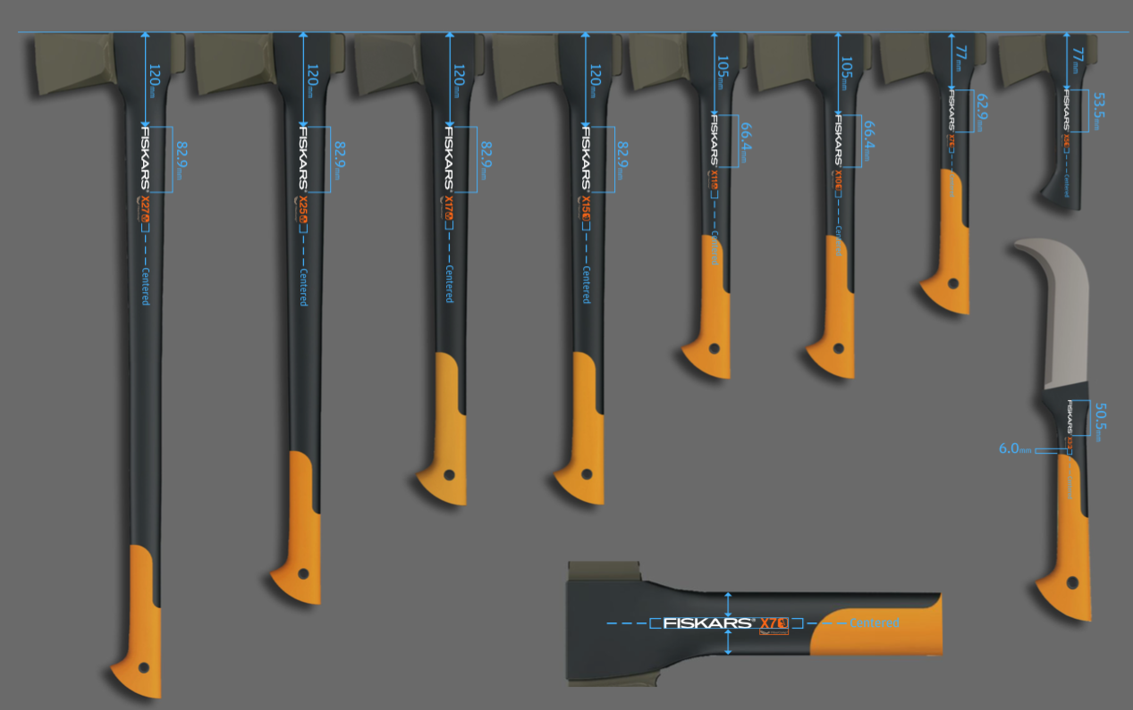
Notes:
8 axes
5 blade
3 sock
4 blade cover

Slide 11
Naming layout
Universal chopping
Splitting

Slide 12
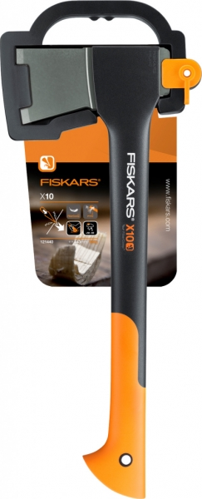

Slide 13
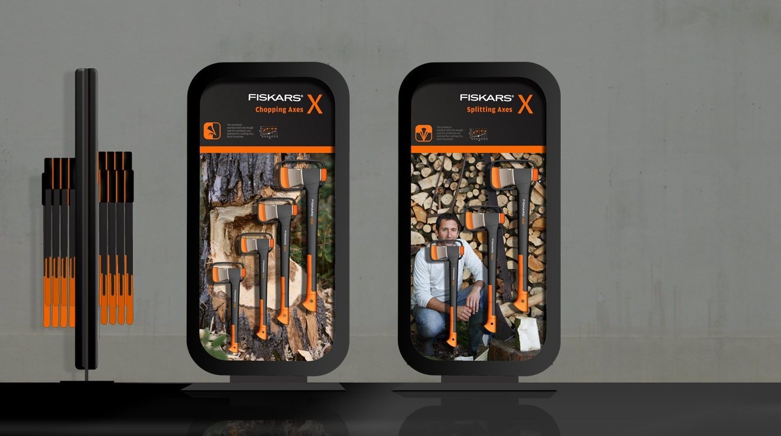
Displays

Slide 14
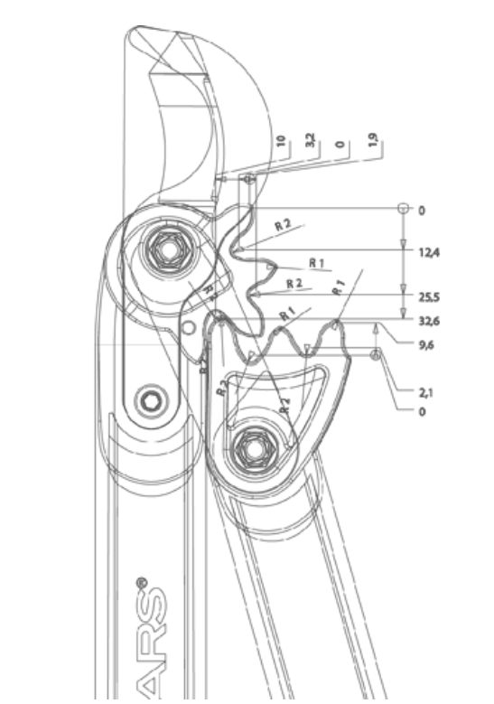
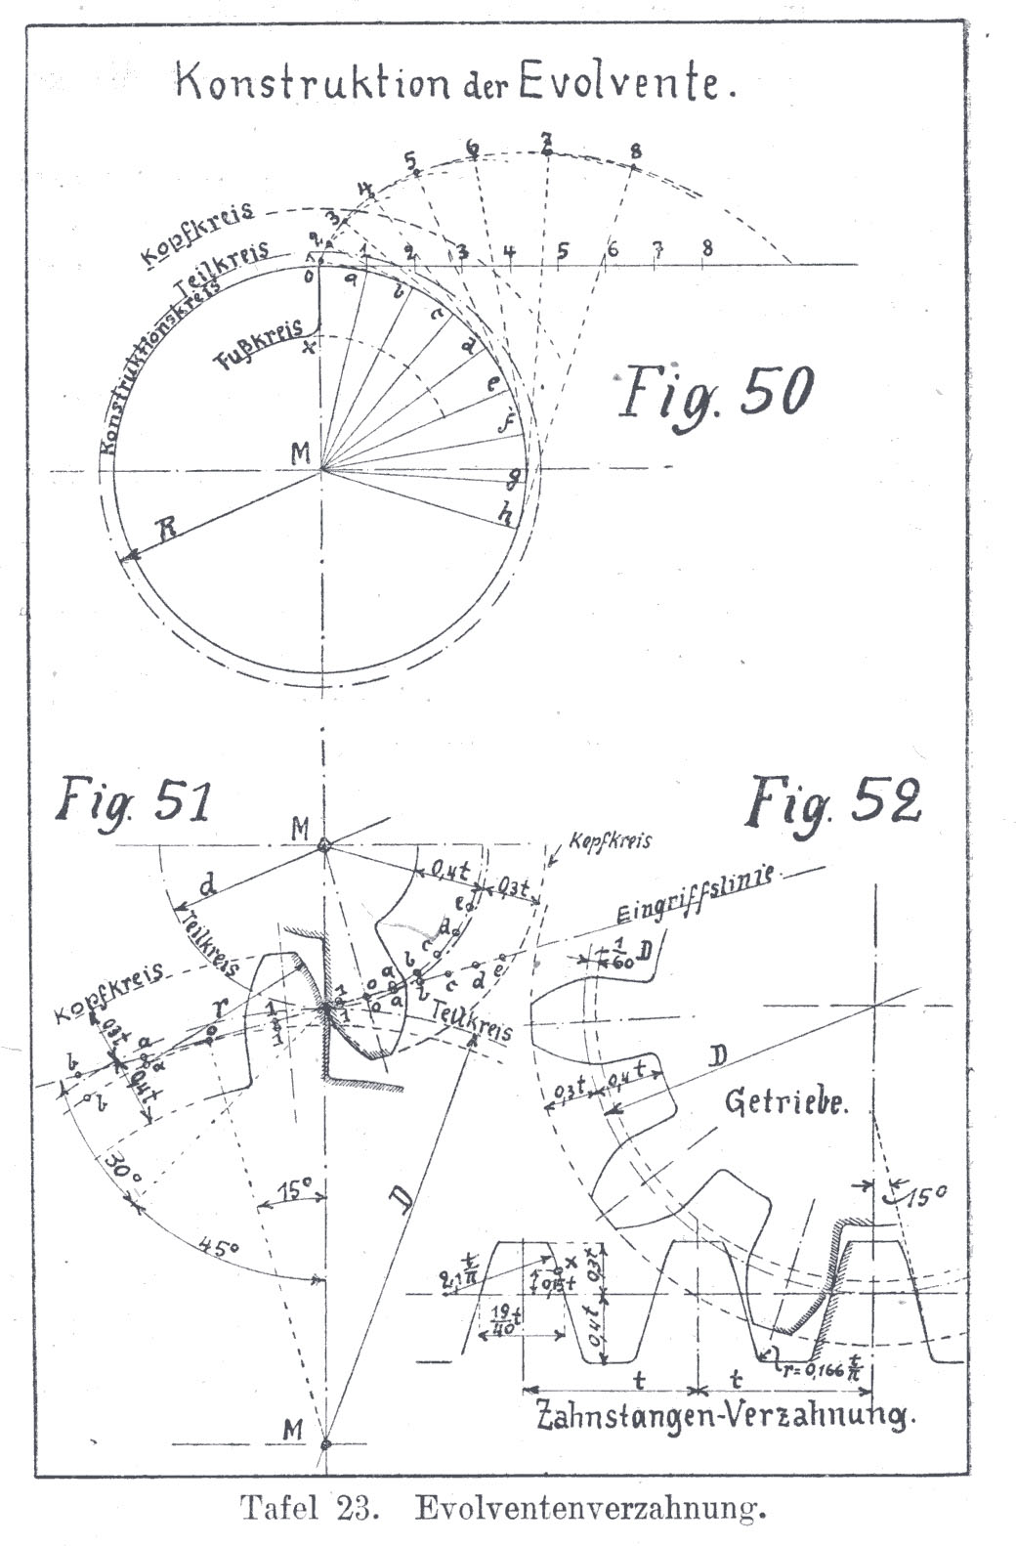

Slide 15
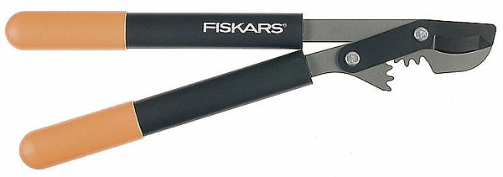
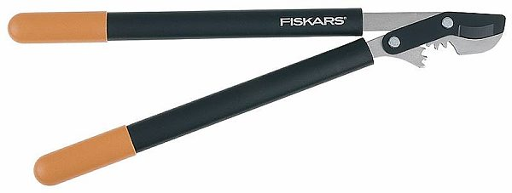
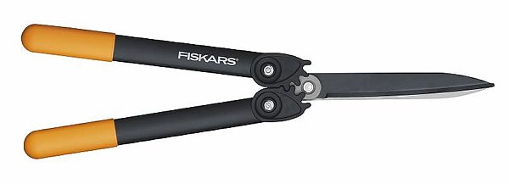
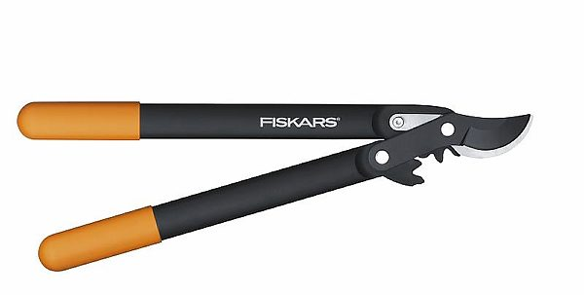
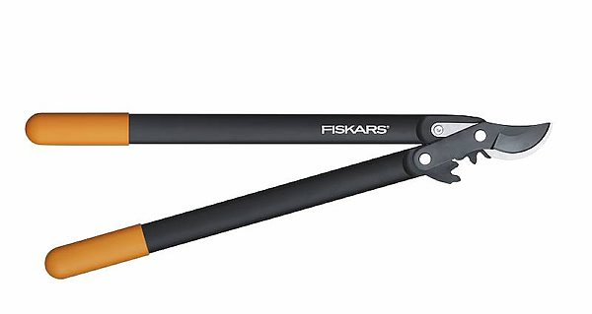
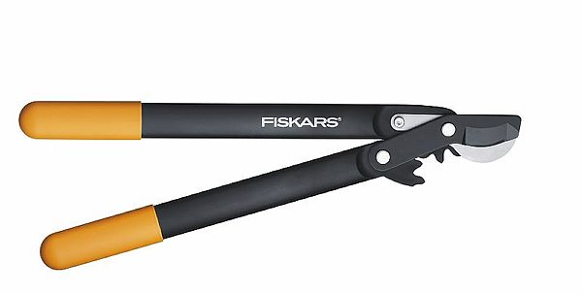
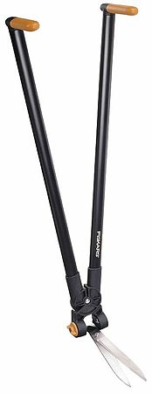
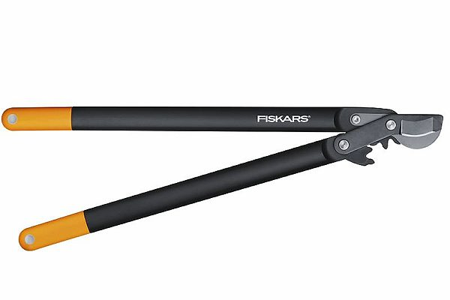
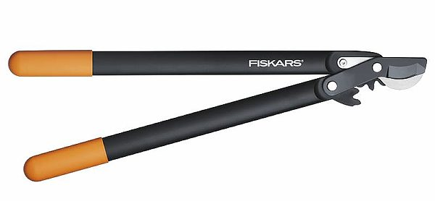
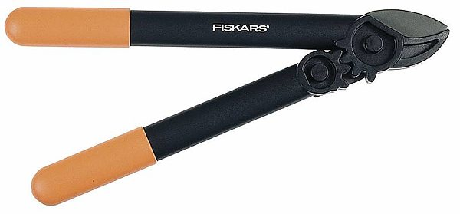
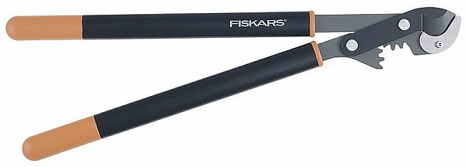
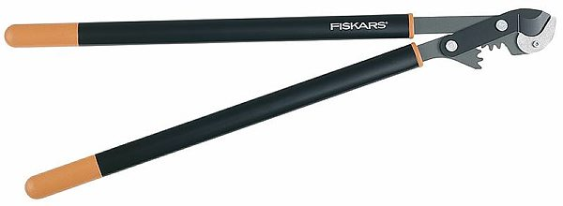
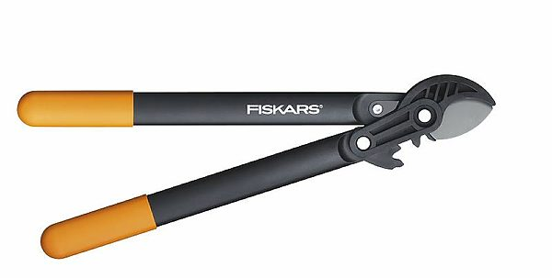
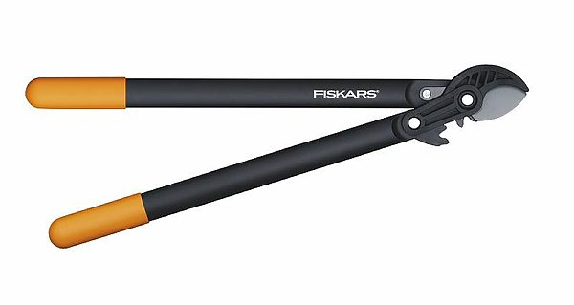
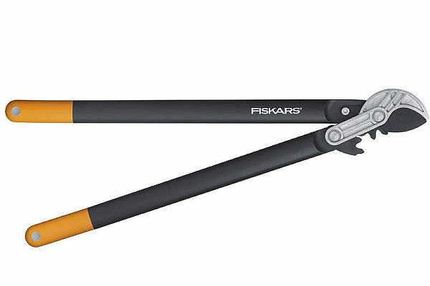
Power Gear Bypass Loppers
Hedge shears
(S) 9625
(S) with longer handles 9627
Power lever 114750
(M) 9637
(L) 9647
Power gear 114790
Power Gear Bypass Loppers, Scissor head
Power gear 114770
(S) 112200
(M) 112300
(L) 112XXX
Power Gear Bypass Loppers, Hook head
Power lever grass and hedge 113710
(S) 112190
(M) 112290
(L) 112590
Anvil Gear Lopper 9617
Power Gear Anvil Loppers
(M) 9638
(L) 9648
Weed pullers
Power Gear Anvil Loppers
Weeder 139910
(S) 112180
(M) 112280
(L) 112580

Slide 16
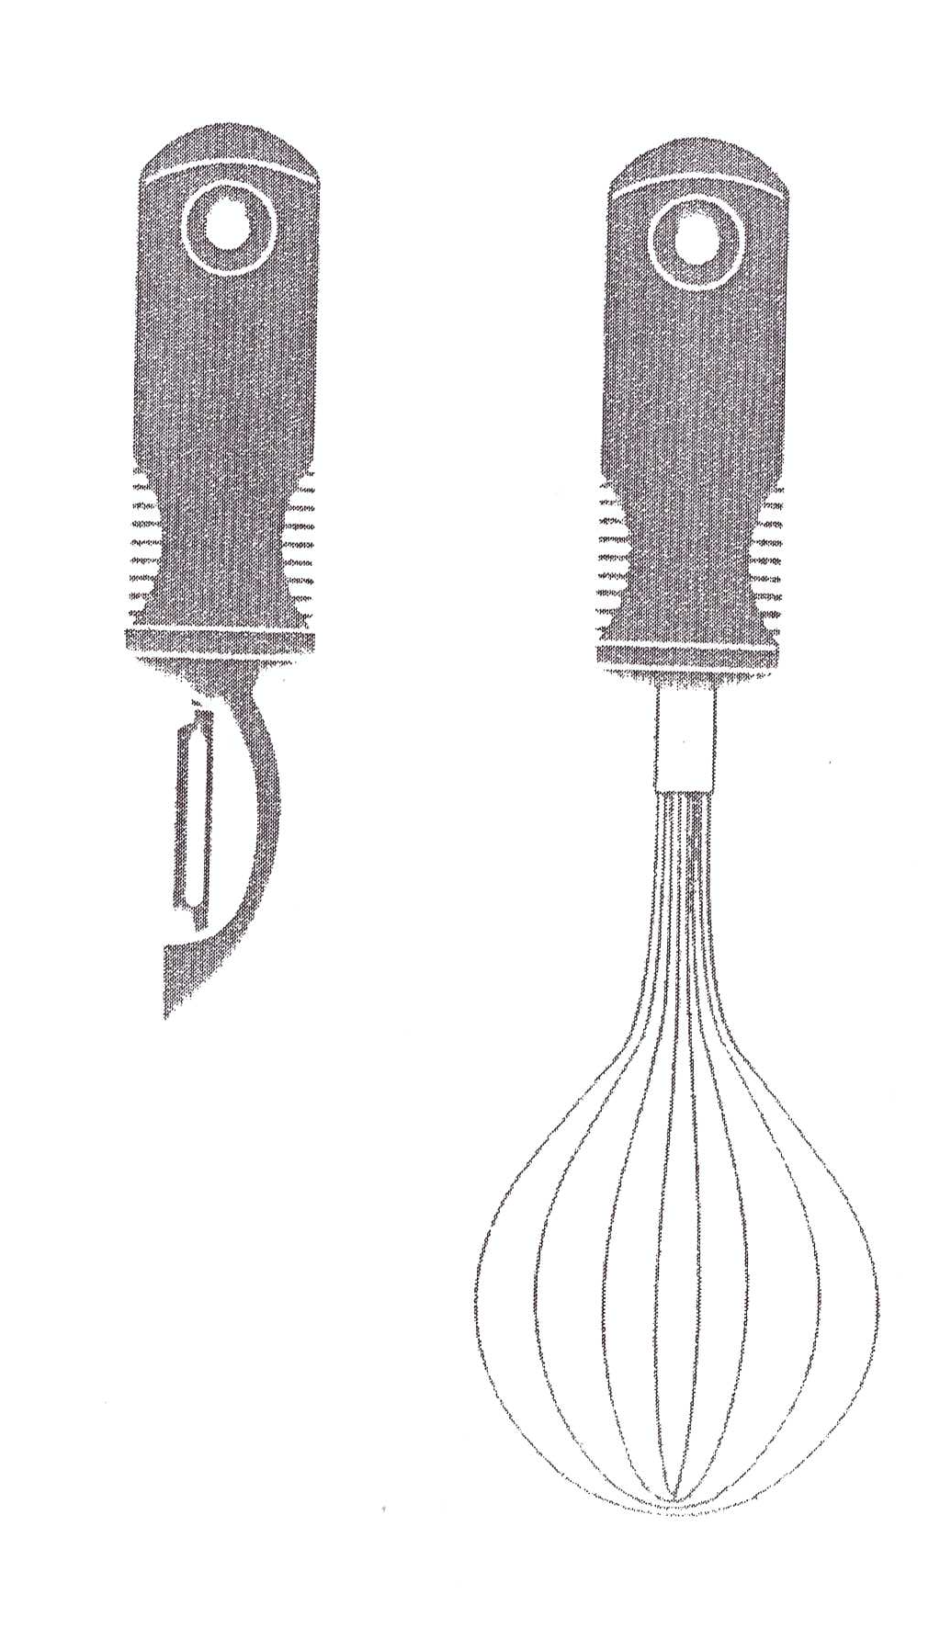
OXO Good Grip example

Slide 19
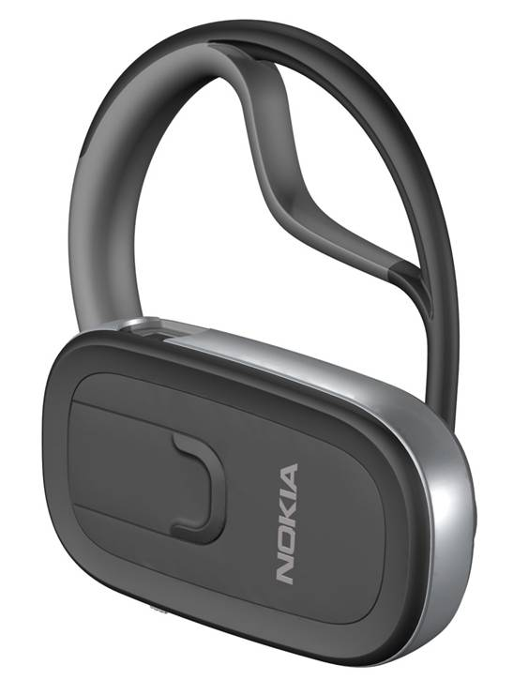
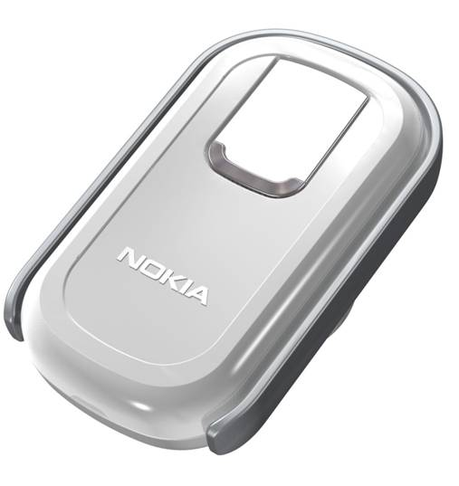
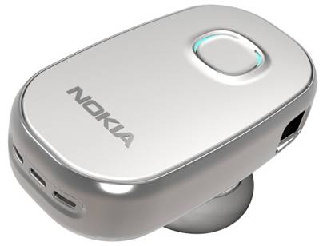
Nokia Mobile Enhancement example

Slide 20
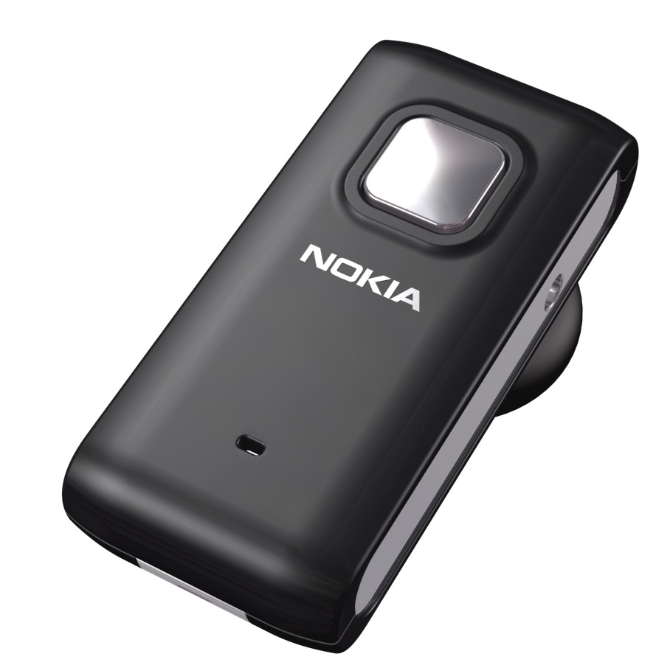
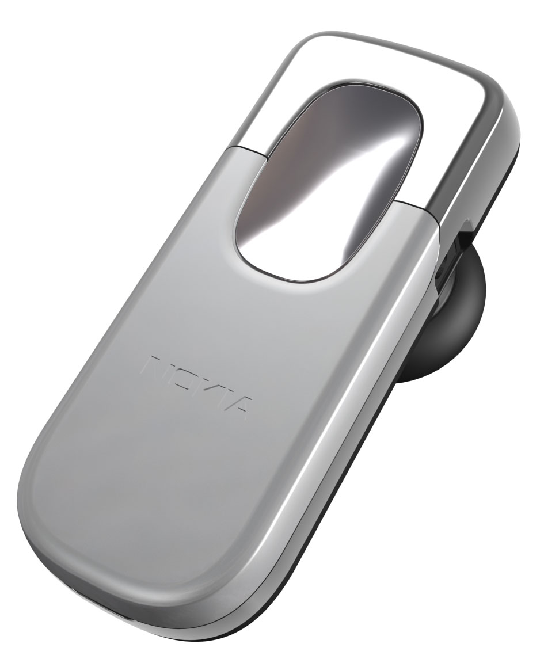
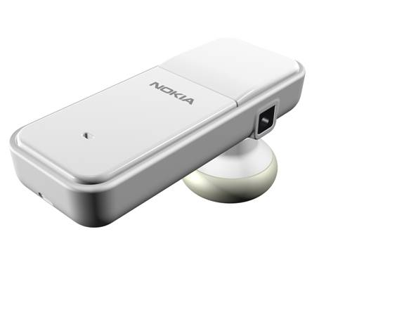
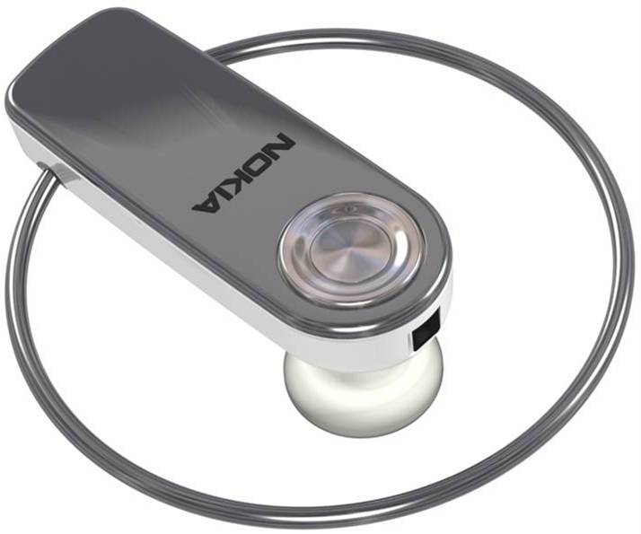
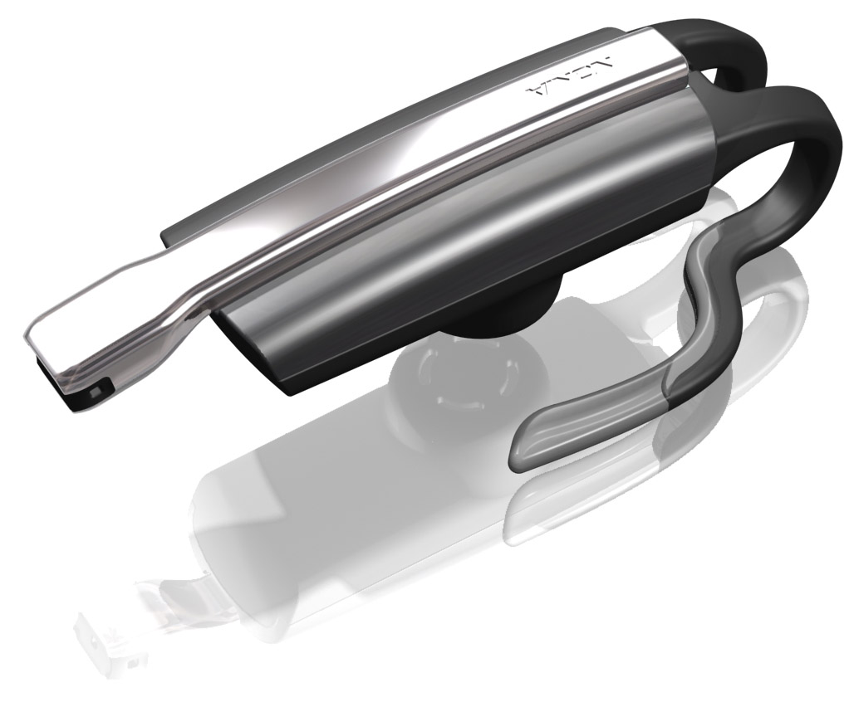
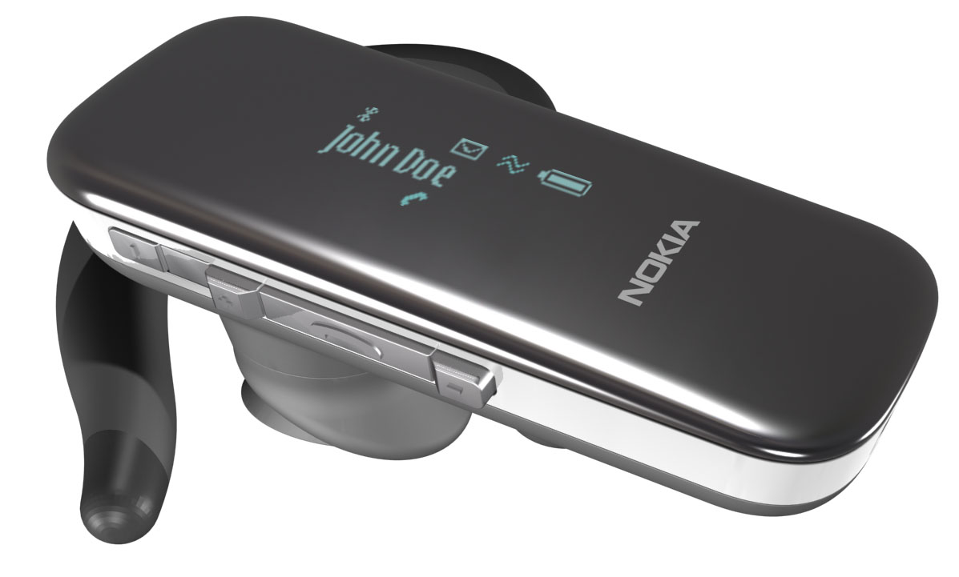
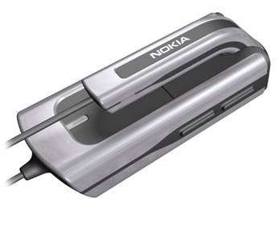
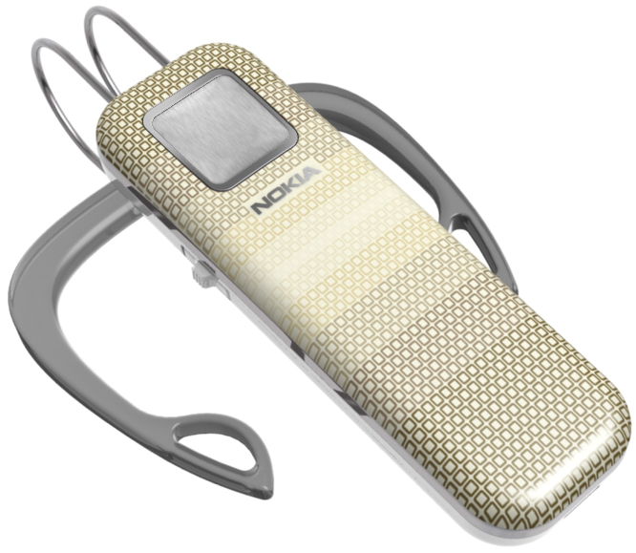
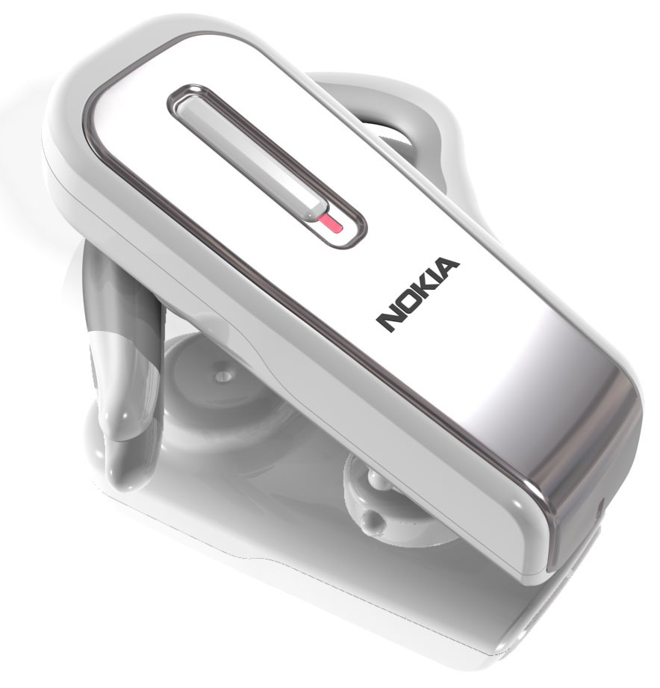
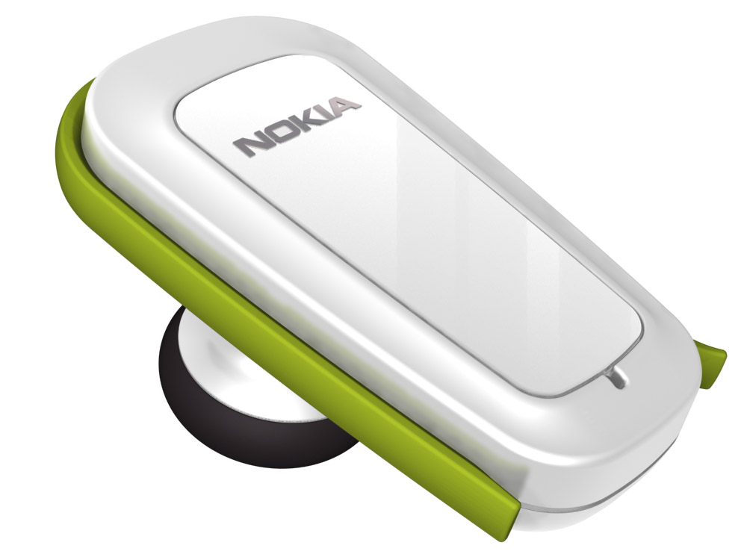
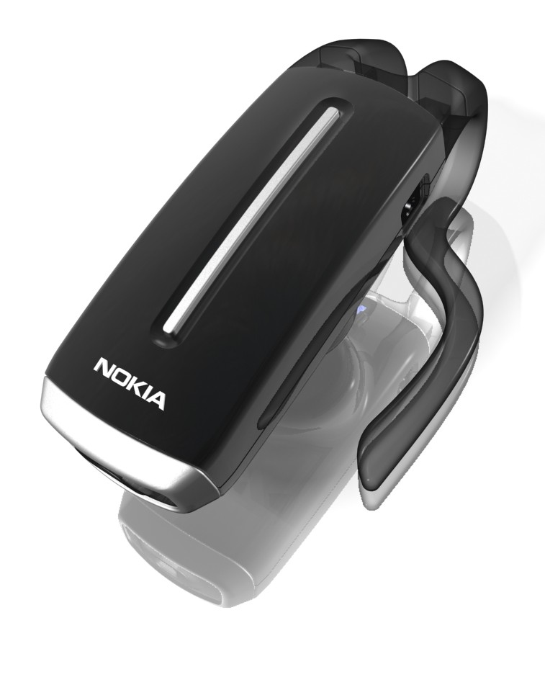
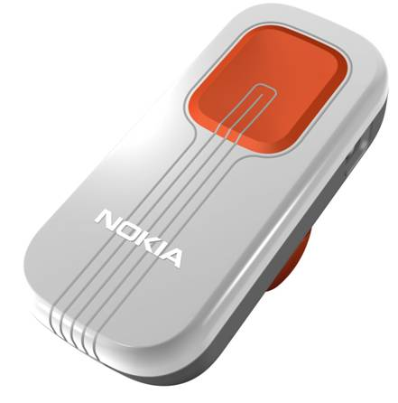
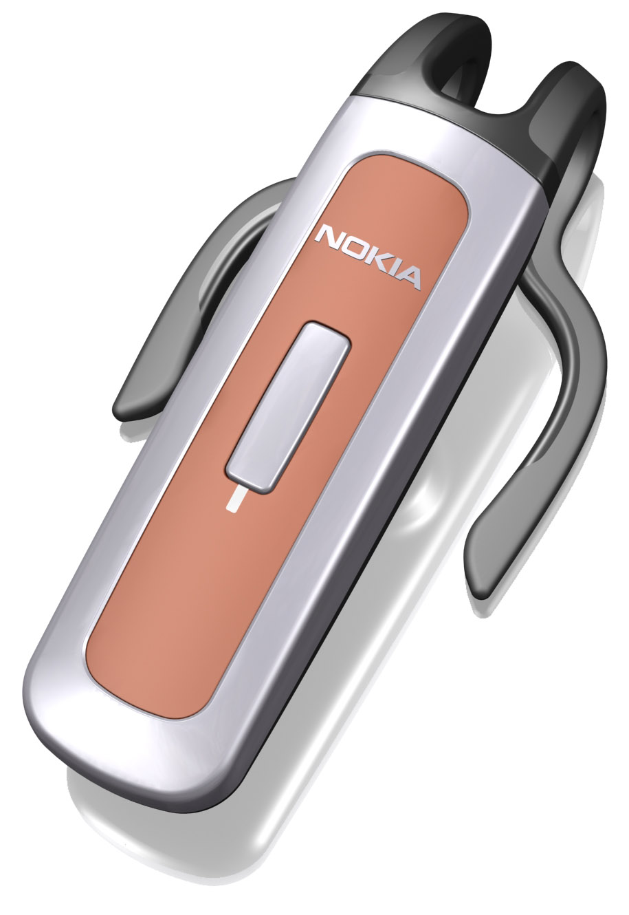
Wireless mono headsets
2006
BH-800 / HS-24W / Simba
Premium
BH-801 / HS-xxW / Nala
BH-700 / HS-57W / Sarabi
Style
BH-xxx / HS-xxW / Ring
BH-900 / HS-25W / Timon
Performance
BH-xxx / HS-902 / Ronald
BH-901 / HS-xxW / Wilma 2
BH-301/ HS-51W / Clips
Very long talk time
Value
Ikaros 5 ?
BH-600/ HS-59W / Oliver 2
Wiima
Progressive 1/4. Lillan type
with advanced earhook
and changeable covers.
BH-300/ HS-50W / Lillan
Kutter
Classic. HDW-3 type of wearing
Customising
BH-201/ HS-52W / Nohook
BH-200/ HS-58W / Nasu
4 Operator colour variants
Classic.
HS-11W type of wearing
OEM
OEM
Ikaros 4 ?
BH-300/ HS-26W / Pumba
+ new spring colours
Tata
Lowest cost
Lillan type wearing

Slide 21
Wireless Headsets Strategy
Category key drivers
The strategy:
Offer portfolio of BT headset products targeted for selected customer segment.
Clear customer promise with categories and key drivers
Different wearing and mechanics solutions to meet diversified user preferences
Actively seek new concepts
Promote universal compatibility with other brand terminals & devices
PREMIUM
Premium headset functionality
Usability with terminal
STEREO
Music audio quality
Wearing comfort
Outlook
Mono
PERFORMANCE
Audio quality
Talk time
Wearing comfort
STYLE
Product outlook & materials
Small size & weight
Wearing comfort
MONO
VALUE FOR MONEY
Price
Still having good outlook
Personalization

Slide 22
Fixed Component layout
Benefit:
-Ready layout
→Supplier chosen
→Tested and verified and approved.
→Production line ready
→Faster make the product variations
→Some modifications possible

Slide 23
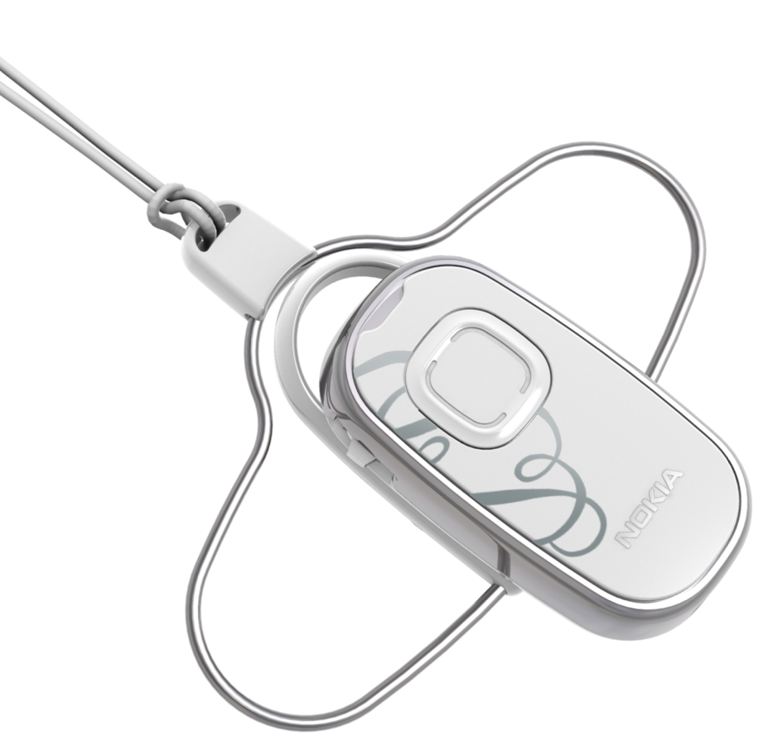
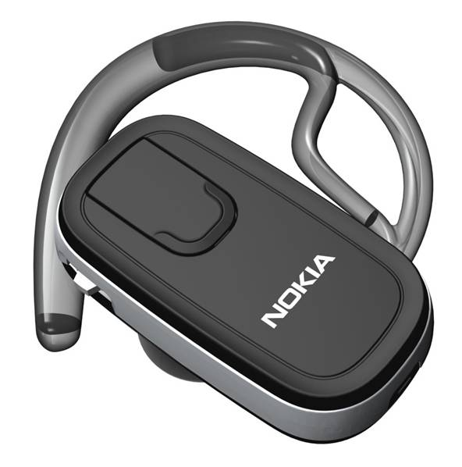
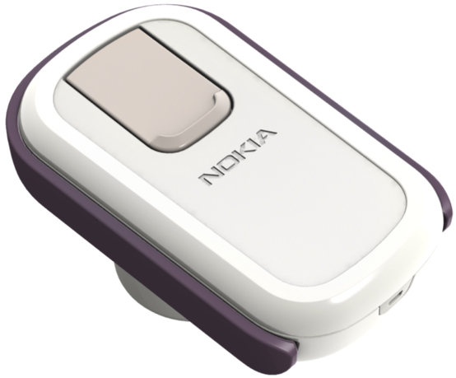
VALUE CATEGORY
PD4 P01/07
PD4 P04/07
PD4 P05/07

Slide 24
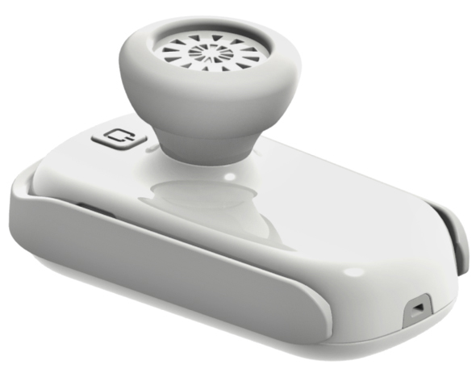
TATA

Slide 25
VIIMA

Slide 27
WIIMA

Slide 28
WIIMA
7
8
9
10
11
12

Slide 29
KUTTER
1

Slide 30
KUTTER
1

Slide 31
No Hook 2
1.
elastomer send/end
laser engraved graphics & logo (matte)
volume
lacquer coated a-cover, no paint
elastomer loop hook

Slide 32
No Hook 2
power key
changeable ear rubber, three size variants
microphone
dc jack

Slide 33
No Hook 2

Slide 34
Ronald

Slide 35
Ronald
DRAFT HOLDER CONCEPT
clip
release direction

Slide 36
Value. Powder Box.
CMG 671 satin
power
dc
LED
send/end
volume
chromed plastic or silver painted

Slide 37
Style. Cuff Link.
send / end
bendable boom
power
volume

Slide 38
Style. Cuff Link.
CMG 730 satin
Chrome

Slide 44
Our Technology Goes Beyond Motorcycling
Power Sport Segments
Future Verticals
4-wheel racing
UTV
Cycling
Action Sports
ATV
Snowmobile
Law Enforcement
Industrial Applications

Slide 46
SPORT BIKES
CRUISER
TOURING, OFF ROAD

