Slide 1
Health Service
Operations Management of
Pathways
Prof.dr.ir. Jan Vissers
Dr. ir. drs Sylvia Elkhuizen

Slide 2
Objectives
Applying methods of OM to the management of pathways
Specific:
to identify OM aspects of pathways
To design, analyse and improve OM aspects of pathways

Slide 3
Content
Pathway and process
OM approach to processes
Methods of process modelling
Process analysis and improvement
Assignments

Slide 4
Pathway & process

Slide 5
Care pathway - definition
A care pathway is a "complex intervention to achieve common decision making and organization of care processes for a specific group of patients for a defined time frame“
Source: European Pathway Association

Slide 6
Care pathways - aims
Improving the quality of care
Improving patient outcomes
Increasing patient safety
Increasing patient satisfaction
Coordinating care
Optimizing use of resources

Slide 7
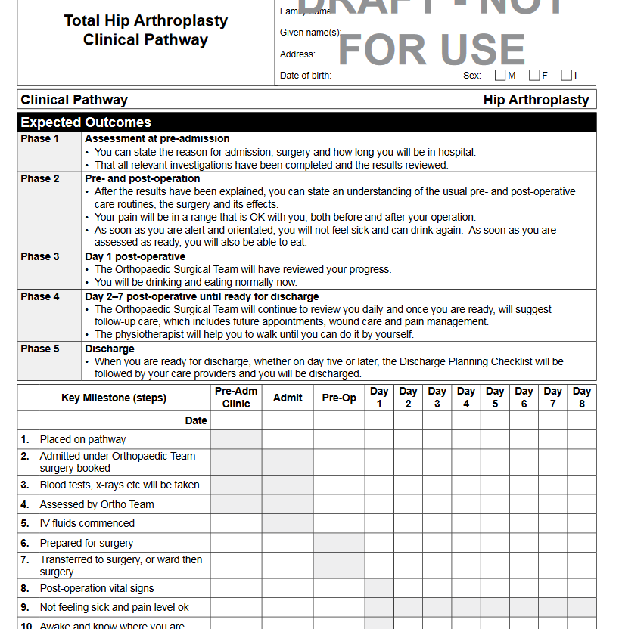

Slide 8
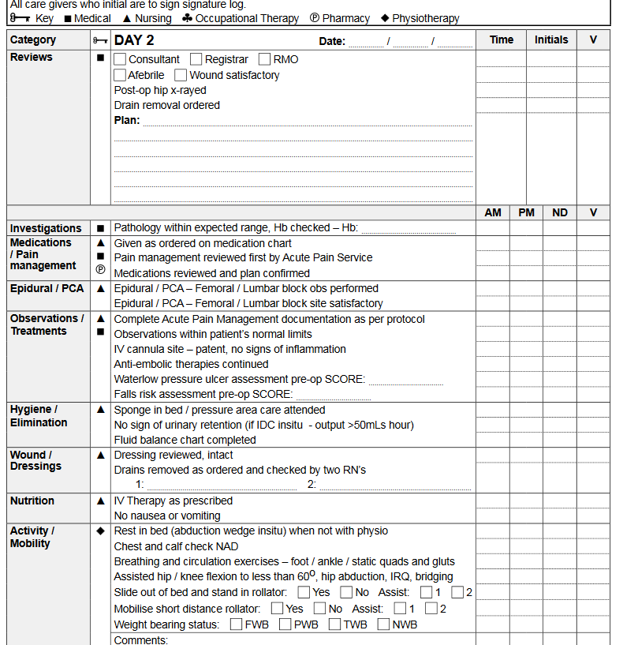

Slide 9
Characteristics of pathway methodology
Coordination of the care process by defining & coordinating the roles, and determining the order of activities
Recorded in patient documentation
→ support the communication
Standardized care
→ with monitoring and evaluation of deviations
Based on scientific evidence

Slide 10
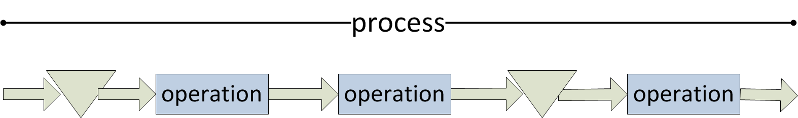
Patient Process - definition
  series of operations that need to be performed to produce a particular health service

Slide 11
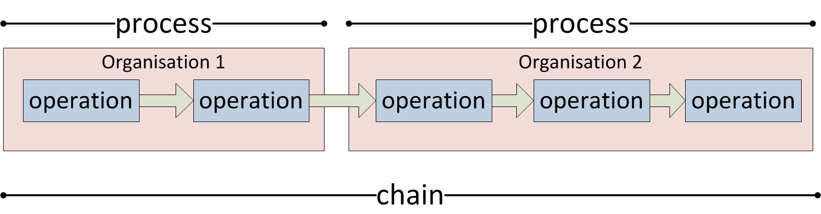
Processes & Chains
Chain: series of operations crossing the boundaries of providers
However, a complex process in a hospital involving many
units might also be considered as an internal chain
Notes:
A complex process in a hospital involving multiple units is sometimes also referred to as an “internal” chain

Slide 12
OM of processes and chains
management of patient processes (and chains), as well as the required resources and corresponding patient flows, in and between organizations
patient
General Practitioner
Ambulatory care
Hospital ward
Home care
Notes:
Operational coordination
Structural coordination
Aggregate coordination

Slide 13
Care process and other processes

Slide 14
Characteristics care process from OM perspective
Scheduled (elective) or non-scheduled (emergency)
Short term, long term or chronic care
Predictability – deterministic or stochastic
  Number of steps
  Duration of operations
  Sequence & routing
Complexity
  Variety in operations
  Linear or Cyclic
  Variety in specialties/departments/organisations involved

Slide 15
Process: phases and decoupling points
Reasons for decoupling points:
change in predictability
change in resource constellation
optimal use of a very expensive resource
Decoupling point
Diagnosis
Treatment
referral
2wk
1st visit to surgeon
X-ray
radiology
`2nd visit to surgeon
8 wk
pre-op
stay
surgery
post-op stay
6wk
followup visit
end

Slide 16
Relations between processes and specialties

Slide 17
Pathway and process
 | Pathway | Process
Focus | Content of care | Organisation of care delivery
Process | Specification of the process | Planning of the process
Resources | Resource requirements | Scheduling of resources
 | What & How | How Much & When

Slide 18
Modelling methods of processes

Slide 19
Process modelling
Operations Management
  Process flow mapping
  Value stream map
Service Management
  Service blueprinting
  Service user journey

Slide 20
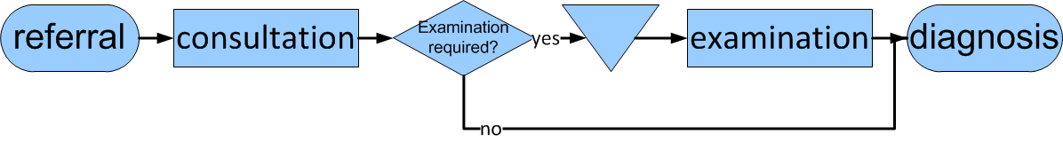
Process flow mapping symbols
Example

Slide 21
Service blueprinting
Customer actions
Onstage contact
Backstage contact
Support processes
Line of interaction
Line of visibility
Internal interaction

Slide 22
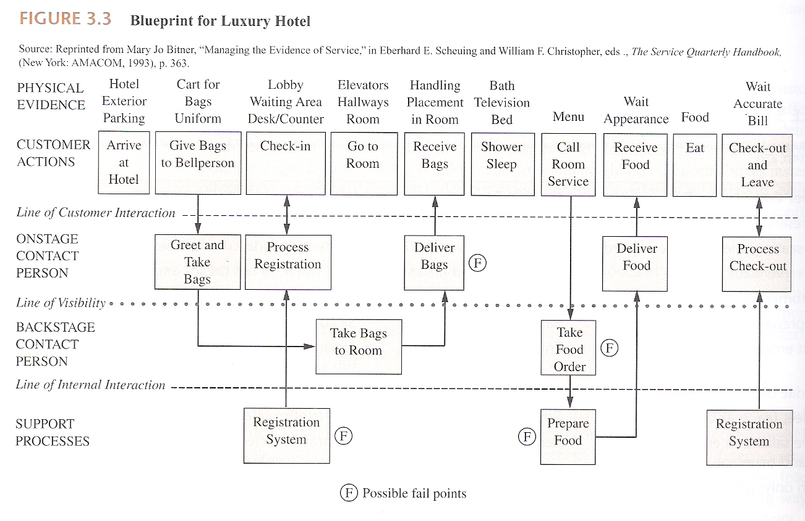
Example: blueprinting

Slide 23
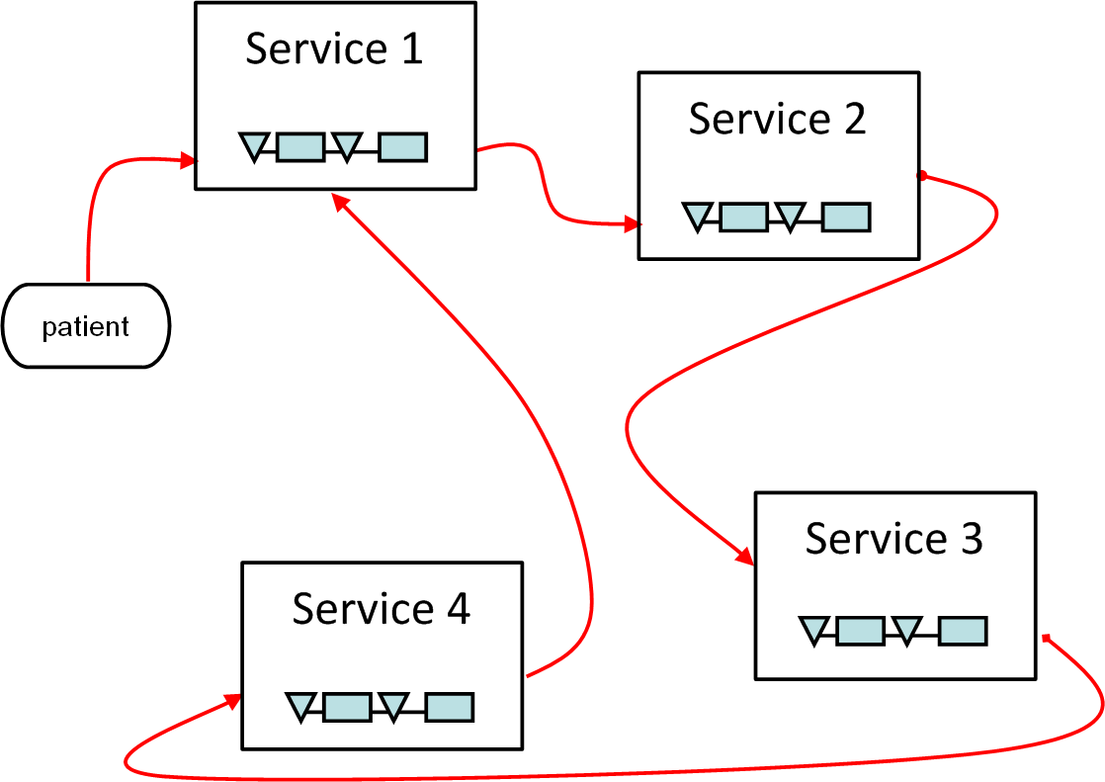
Service user journey

Slide 24
Health Service Management terminology for operational modelling health services
User service journey
Service
Service element
Resources
Front office service elements
Back office service elements
Self service elements

Slide 25
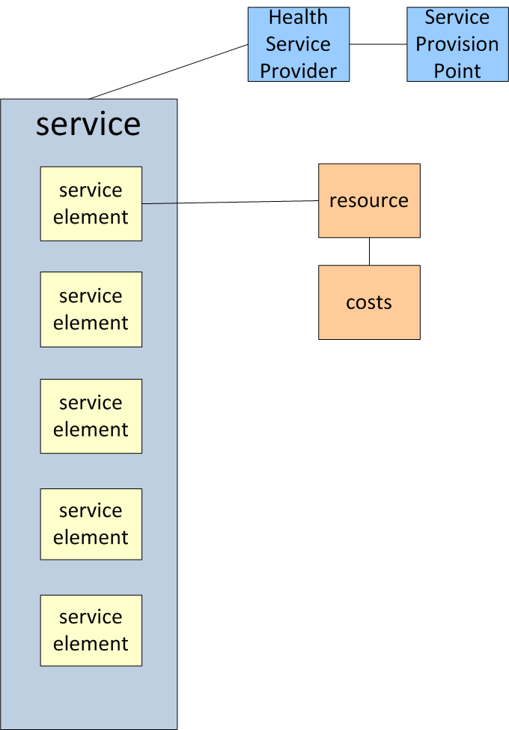
Hierarchy service modelling

Slide 26
Process analysis & improvement

Slide 27
Process analysis
Let’s consider a process for a patient requiring surgery
To decide:
- Level of detail chosen
- Layers of description
`reception
surgeon

Slide 28
Process: operation durations
Duration
average durations
variation in durations (stochastics)
→ representing a distribution

Slide 29
Example: length of stay

Slide 30
Process analysis: waiting times & throughput times
Notes:
Different types of waiting times
access time: to enter the process
(regular) waiting time: all times between operations/activities
lead time: productive waiting time
Throughput times: combination of waiting time and operation durations

Slide 31
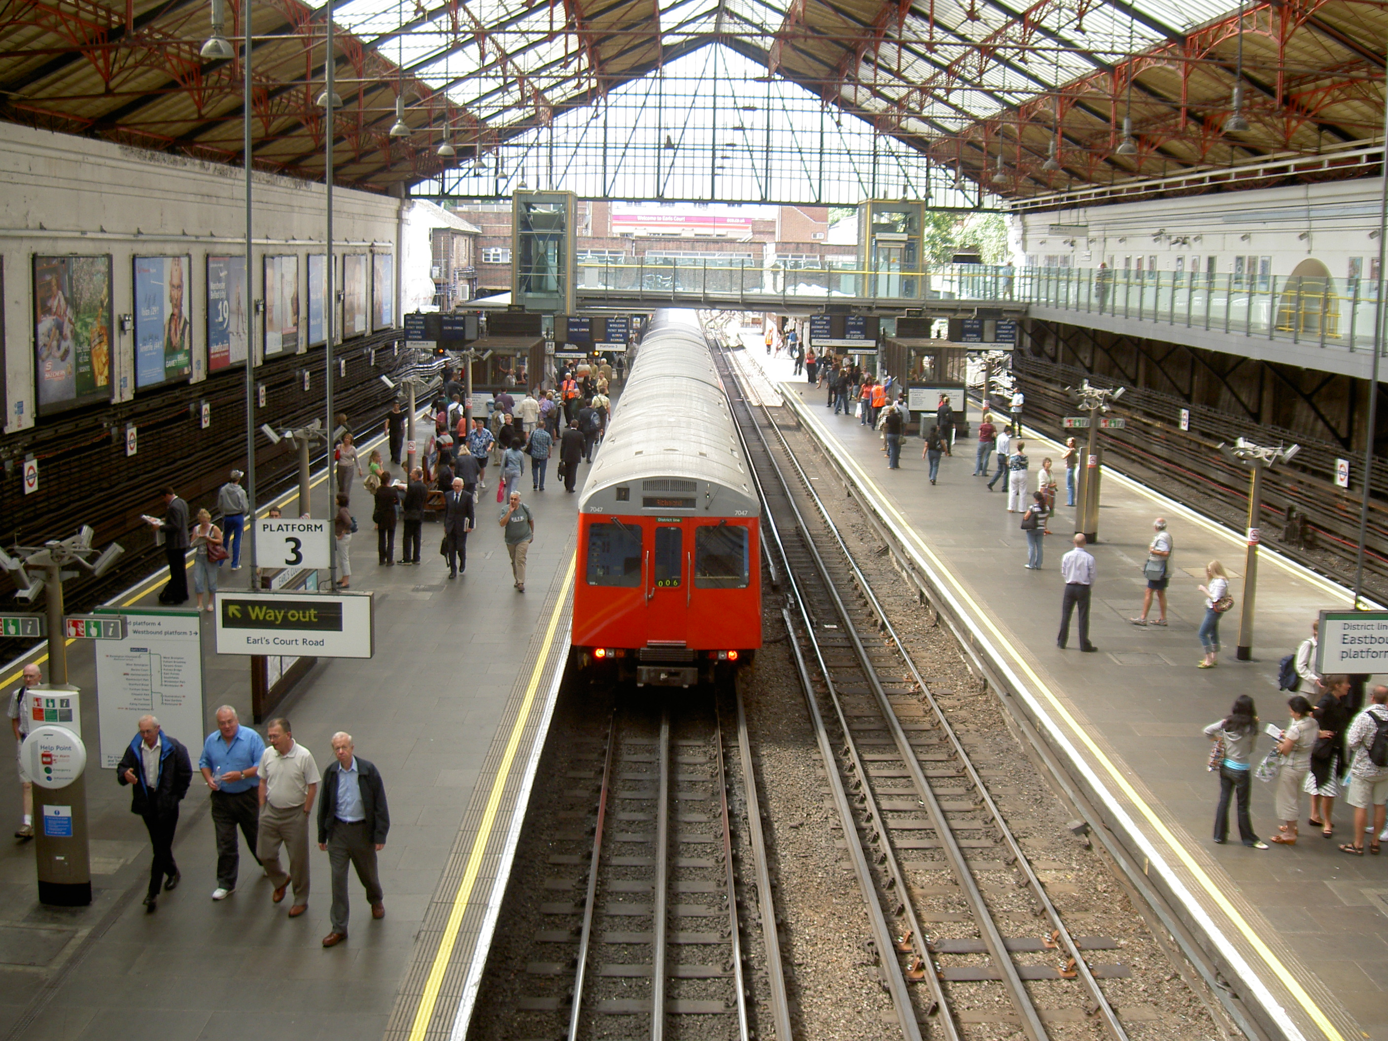

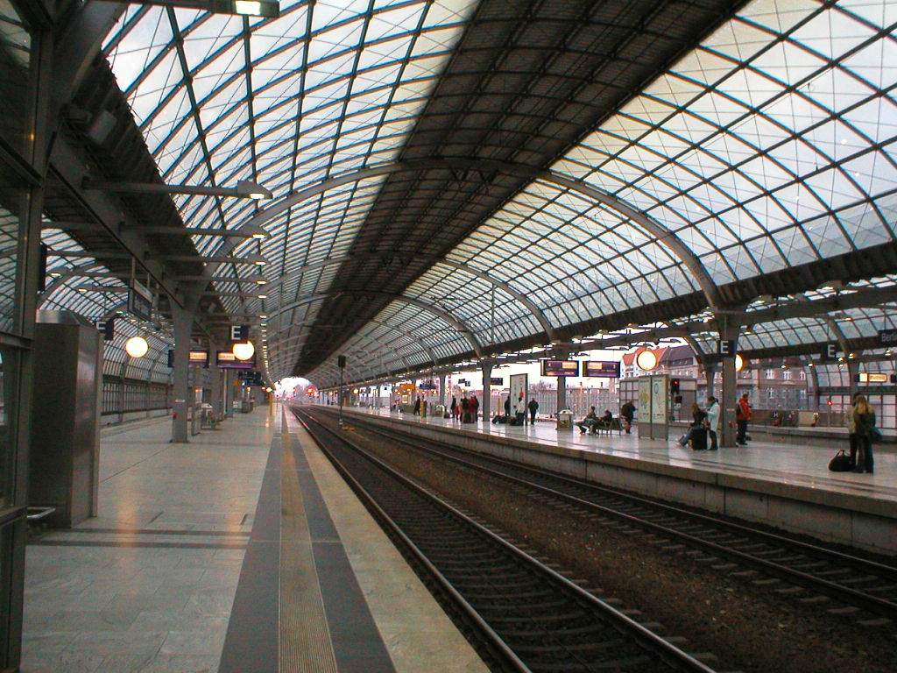

Analysis of process & chain: waiting times
Platform waiting time:
waiting time until service arrives
determinant: frequency of service
Queue waiting time
waiting time in queue
determinant: number of servers
Batch waiting time
waiting time till batch is completed
determinant: batch size
Notes:
Examples health care?
Queue: waiting on your turn in a queue: blood sampling, X-Ray
Platform: specific clinics on specific days
Batch: session is scheduled if at least 6 knee-surgery patients are waiting on the waiting list.
Different waiting times have different solutions

Slide 32
Analysis of process and chain: push & pull
Pushsystem
Each step scheduled after finishing the previous step
Resource oriented
32
Notes:
32

Slide 33
Analysis of process and chain: push & pull
Pull system
Pull: ‘backward’ planning
Shorter throughput time
Better prioritising
33
Notes:
33

Slide 34
Push and pull in care: combined
Push: resource oriented
  Operating theatre planning
Pull: process oriented
  admission and pre-op screening (before OT)
  discharge planning (after OT)
34
Notes:
34

Slide 35
Levels of control:
operational / tactical / strategic

Slide 36
Process and resources
RESOURCES
capacity of
outpatient dept
capacity of
outpatient dept
capacity of
diagnostic dept
specialist
capacity
day care ward
capacity
capacity of
operating theatres
diagnostic phase
therapeutic phase
visit
diagnostic
tests
visit
screening
day
care
surgical
procedure
visit
PROCESS

Slide 37
Units, chains and network
Diagnostic and treatment facilities / units
surgery
out
patient
clinic
traumatology
in patientward
oncology
vascular surgery
Radio
logy
OT
other
internal medicine
Lab
ICU
out
patient
diabetes
in-patient
Patient groups / pathways & processes

Slide 38
Levels of control
Operational control: day to day planning
Tactical control: allocation of resources to patient groups/pathways
Strategic control: increasing/decreasing the amount of resources available

Slide 39
Assignments

Slide 40
Assignment 1: process modelling
Study the data on patients in the file.
Map the process. Use the symbols that you learned in the lecture.
Half the groups uses the service blueprinting technique
Half the groups uses the process flow mapping technique
Reflect on your modelling technique.

Slide 41
Assignment 2: process analysis
Calculate:
The average access time for the first visit in the hospital.
  The average throughput time of the diagnostic trajectory.
  The average waiting time for the admission.
  The percentage of patients that needs home care.
  The average length of stay in the ward.
  Reflect on the results and give suggestions for improvement

