Slide 1
Microfabrication
Home 8: yield and economics
Due Monday 13th of May, 10 pm

Slide 2
1.
If multilevel metallization process in 65 nm CMOS consists of 10 layers, how many oxide plasma etchers are needed to etch contact holes in 50 000 WPM fab if oxide etch rate is 0.5 µm/min ?

Slide 3
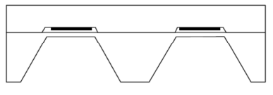
2. Pressure sensor dicing
How many pressure sensors can you reasonably make on a 150 mm wafer if membrane edge length is 1 mm? Read/google about blade widths, and make assumptions what should X be etc.
1000 µm
X µm

Slide 4
3. Yield and defect density
a) company is successfully producing 0.5 µm LW chips of 1 cm².
It wants to reduce the linewidth to 0.35 µm, which will reduce chip area by ca. 40%. What will happen to yield, if all the same equipment is used in the very same cleanroom ?
b) Company is asked to produce a 2 cm² chip using the exisiting 0.5 µm technology. What price should the company quote for such chips ?

Slide 5
4. Solar economics
A silicon solar cell is 17% efficient.
Customers pay 1$/peak watt; i.e. max sunshine is 1000 W/m² ➔ 170 W/m² achieved ➔ 170 $/m².
The factory processes 1M m²/year. Yield is 96%.
Calculate the economic effects of these options:
A tool investment costs 10 million euros, but raises yield to 98% (operating costs remain unchanged).
More pure silicon starting material will cost 5 million more annually but the cell efficiency will go up to 18%.

