Slide 1
PHYS-E0421 Solid State Physics Period V, spring 2019
Martti Puska
Rina Ibragimova
Hannu-Pekka Komsa
Arsalan Hashemi
Lecture 14, Monday 20.5.2019
Dielectric Properties of Solids
Magnetismivity

Slide 2
Magnetic properties
Response of materials to an external magnetic field
Magnetic quantities, magnetism is quantum mechanics (home work)
Quantum mechanical description
Atomic diamagnetism, paramagnetism (lecture work)
Response of free electron gas
Spontaneous magnetism (Ferromagnetism and antiferromagnetism)
Exchange interaction, H₂ molecule, Heisenberg spin Hamiltonian
Mean-field approximation for ferromagnetism of magnetic moments
Spin waves (low-energy excitations)
Free electron gas
Stoner model for ferromagnetism of itinerant electrons
Antiferromagnetism
Domain structure
The last lecture TODAY

Slide 3
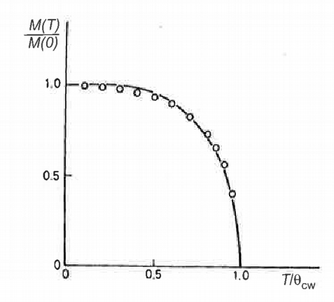
Ferromagnetism of Localized Moments, Summary
Mean-Field Theory
Self-consistent
solution
Exchange
interaction
External field
M in different temperature regions:

Slide 4
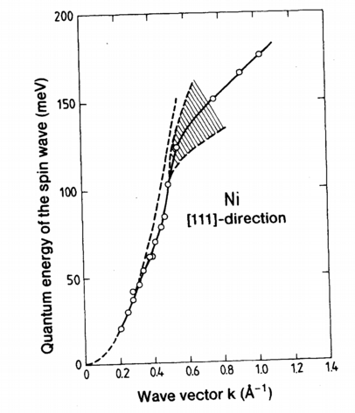
Ferromagnetism of Localized Moments, Summary
Beyond the Mean-Field Theory, magnons

Slide 5
Ferromagnetism of Free Electron Gas
(Elliott pp. 607-608)
➔ Applying quantitative band theory
(Infinite system)
Spin triplet, antisymm. orbital w.f.
”Proof”
Cf. H₂
[E(7.211)]
[E(7.212)]
q.e.d.

Slide 6
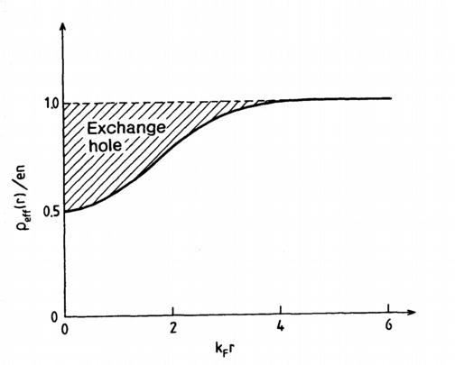
Exchange Hole
Central quantity in electron structure theories
A pair of electrons
Total electron density around a given electron i
Probability for another spin-up electron inside dr at r
Fix the origin at the electron at r_{i}
[~E(7.213)]
Insert
Average densities
Total (spin up + spin down) electron charge density
[E(7.216)]
Oscillations
Fast decay
Electron density → length scale

Slide 7
Exchange Hole
Total (spin up + spin down) electron charge density
[E(7.216)]
Sum rule
Exchange energy
Homogeneous electron gas
Hartree-Fock approximation:
Total energy = kinetic(+) + exchange(-) energies
See, Ashcroft-Mermin,
Chapter 17 (HF fails for EG)
e⁻ - e⁻ repulsion more accurately
Additional correlation energy(-)
Quantum Monte Carlo
Atomistic systems
Density-functional theory (DFT)
Exchange-correlation functionals
First-principles electronic structure modeling

Slide 8
Ferromagnetism due to itinerant electrons
(Elliott 7.2.5.3)
➔
Heisenberg Hamiltonian
Exchange interaction
Modeling magnetic 4f and 3d impurities
Free electrons
J > 0 (Ferromagnetic)
STONER BAND MODEL
Ferromagnetism of,
e.g., bulk Fe, Co, and Ni
Stoner model
Densities of states
Spin-up and spin-down densities
Self-consistent
solution
Strong ”Pauli paramagnetism”
with an internal B_{eff}

Slide 9
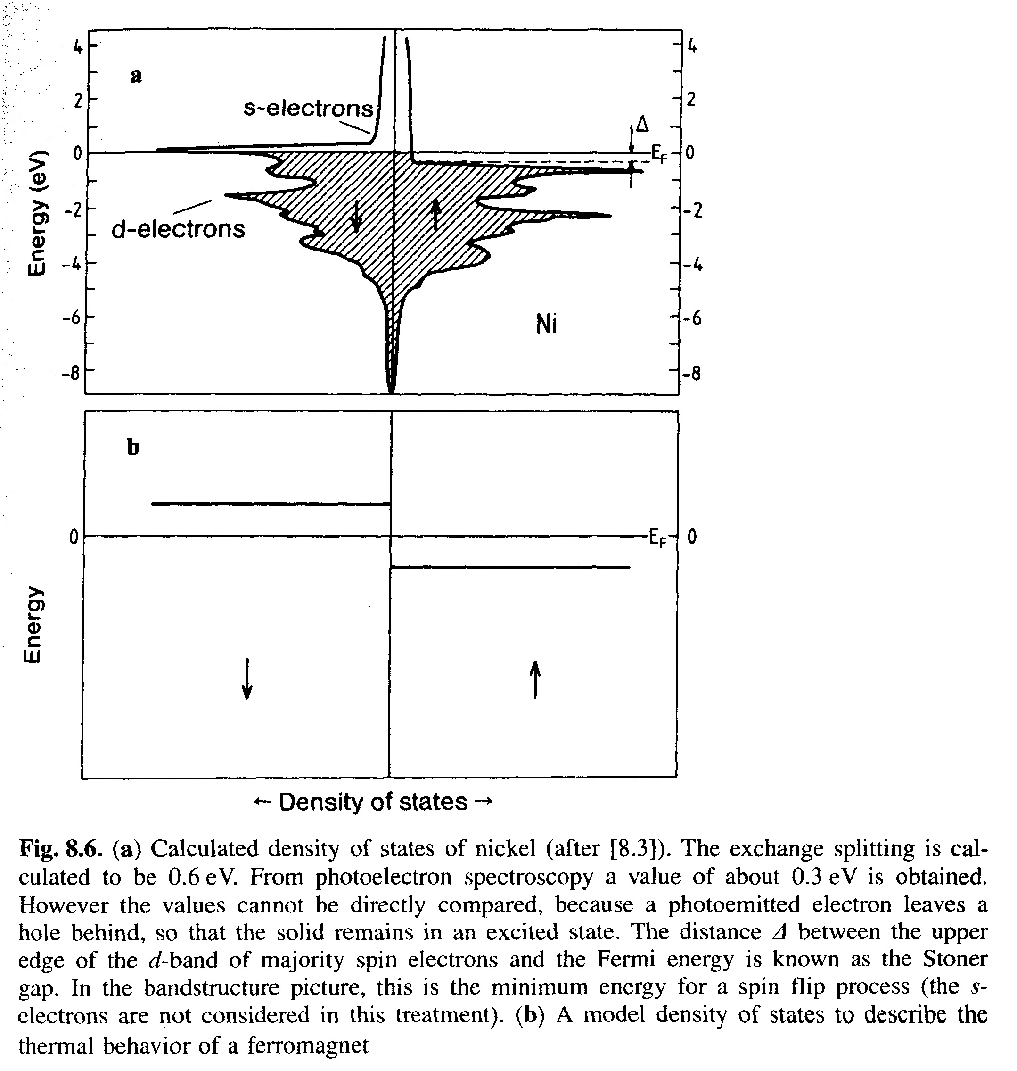
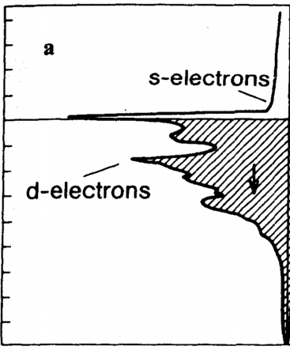
Stoner Band Model of Ferromagnetism
(Elliott 7.2.5.3)
Spin flips
Kinetic energy increases
DOS(E), Ni
Flat d bands ➔
High DOS(E_{F})
Small energy increase for a large number of flips
Exchange interaction lowers the energy levels of spin-up electrons
Stabilization of magnetic moment
Magnetic moments / atom
Ni: μ_{m} = 0.56 μ_{B}
Fe: μ_{m} = 2.2 μ_{B}
← Density of states →
Itinerant electrons ”decoupled” from ions
➔ μ_{m} = integer x μ_{B}
Quantitative materials parameters
directly related to electron bands
/

Slide 10
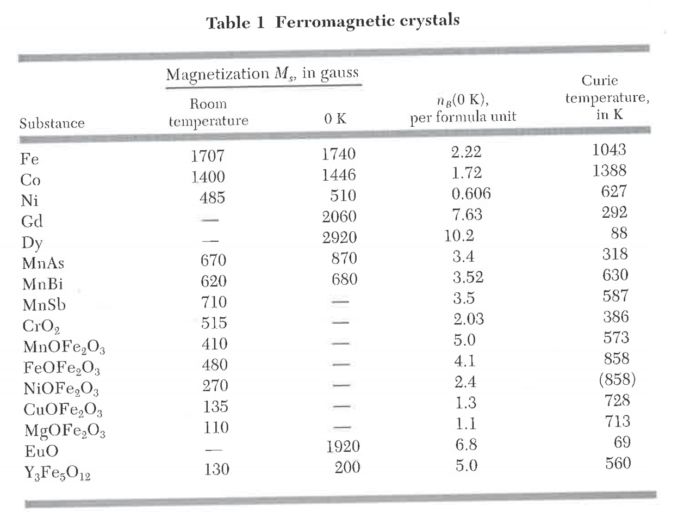
Ferromagnetic materials
μ_{m}
Kittel

Slide 11
Stoner Band Model of Ferromagnetism
➔ Quantitative criterion for existence of ferromagnetism
Exchange interaction
Lowering of bands is the stronger, the more there are electrons with the same spin
k-independent shifts for bands
[E(7.239)]
Stoner parameter
← Strength of exchange interaction
[~E(7.240)]

Slide 12
Stoner criterion of ferromagnetism
Fermi-Dirac statistics ➔ Occupation of spin-up and spin-down bands ➔ Δn
Total spin-degenerate DOS
(c.f. Theory of Pauli paramagnetism)
[~E(7.243, 245)]
Spin-compensated calculation
Stoner criterion
Δn is not calculated!
The criterion tells, is the spin-
compensated solution stable!
[E(7.246)]

Slide 13
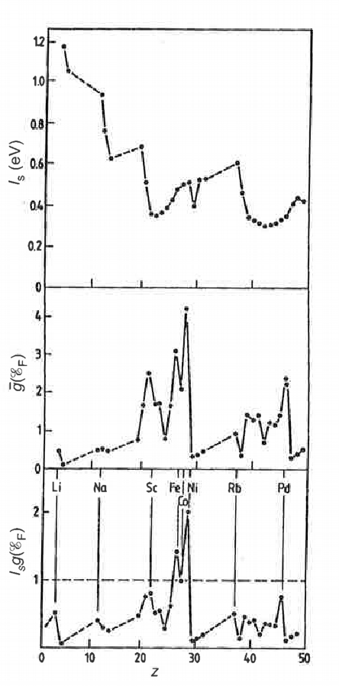
Stoner Criterion
Obtained from spin-compensated band structure calculation
Obtained from atomic orbitals

Slide 14
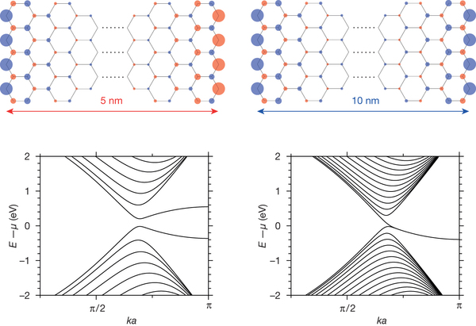
Stoner criterion fulfilled due to electron confinement
Electron confinement
Flat E(k) bands Large DOS(E_{F})
Magnetism
Examples
Pd surfaces (2D) 3) Zigzag graphene nanoribbons (Nature 514, 608 (2014) )
Atomic chains (1D)
Antiferromagnetic
←→
Ferromagnetic
←→
Ferromagnetic
←→
Flat bands at Fermi level

Slide 15
Stoner Model, Temperature Dependence of Magnetization
Ni
Are mean field theory and Stoner model related?
Can we find the same equation to be solved self-consistently?

Slide 16
Stoner Model, Temperature Dependence of Magnetization
Simplified picture around E_{F}
States furher below E_{F} in balance
(Elliott pp. 618-619)
Why E_{F}=0?
Two-level model in FD-statistics (E_{F} = 0), T > 0
Why still E_{F}=0?
[E(7.249)]
[E(7.250)]

Slide 17
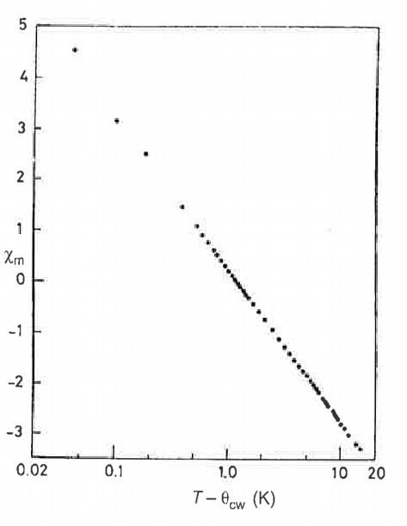
Stoner Model, Temperature Dependence of Magnetization
B₀ = 0
As in the mean-field model, but
Mf-model: total S of an ion ➔ M
Stoner model: Δn/atom ➔ M
Comparison with experiments:
Ni
Fe

Slide 18
Antiferromagnetism and ferrimagnetism
(Elliott 7.2.5.6)
➔ Microscopic origin
E.g. superexchange →
Exchange parameter J_{ij} < 0
Antiferromagnetism
Ferrimagnetism
Examples, Mn, Fe, Co, and Ni –oxides
- band model → metals
- electron-electron correlations (Hubbard model) → insulator, antiferromagnet
Examples, Ferrites (metal oxides)
Intertwined ionic and electronic structures:
- Cubic unit cell with metal atoms in 8 tetrahedral (A ) and 16 octahedral (B) sites
- E.g., Magnetite (lodestone) FeO Fe₂O₃ mixed valence system (Fe²⁺ , Fe³⁺ )

Slide 19
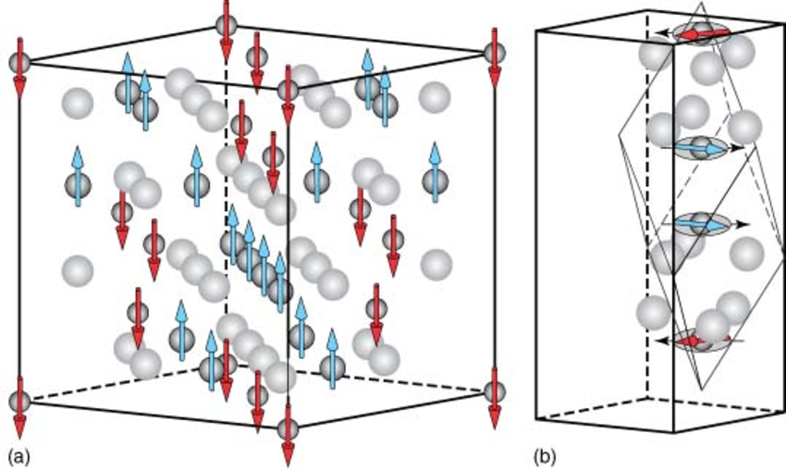
Ferrimagnetism and antiferromagnetism
➔ Microscopic origin
Example: Ferrimagnetic magnetite (lodestone) FeO Fe₂O₃
Tetrahedral sites,
8 / cube
Octahedral sites,
16 / cube
https://www.researchgate.net/publication/227992376_Spin_Structures_and_Spin_Wave_Excitations

Slide 20
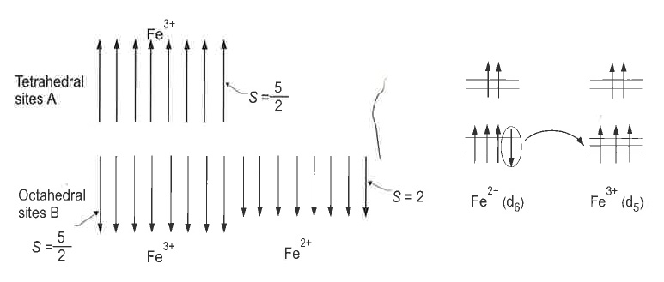
Ferrimagnetism and antiferromagnetism
➔ Microscopic origin
Example: Ferrimagnetic magnetite (lodestone) FeO Fe₂O₃
(d-electron levels spitted by
crystal field and exchange interaction)
8 tetrahedral
sites A
Superexchange
via O-ions
Antiferro-
magnetism
8+8 octahedral sites B
Double Exchange:
Electron transfer and
Pauli principle
→ Ferromagnetism

Slide 21
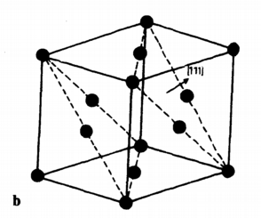
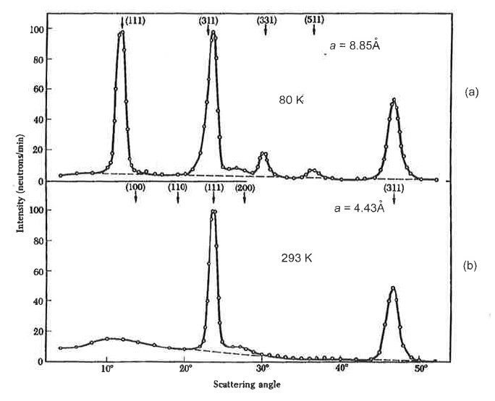
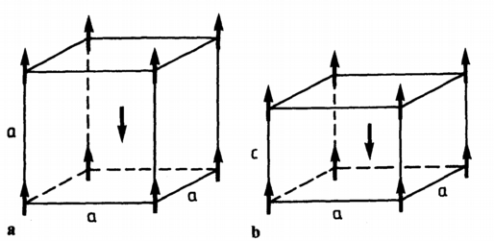
Antiferromagnetism
➔”Frustration”, neutron
diffraction
Example: (Hubbard) insulators Mn, Fe, Co, and Ni –oxides
NaCl –structure, two interpenetrating FCC’s
Metal atoms
O atoms
(fill in more)
indexes?
Compare peak shape changes at ~23º and ~47º ➔ ?
Monatomic BCC, SC structures
No frustration
MnO

Slide 22
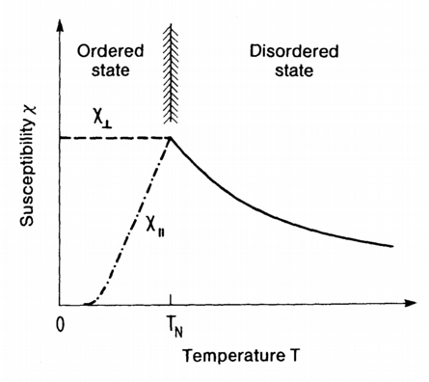
Antiferromagnetism
Susceptibility above and below critical temperature, Mean field theory
[E(7.279)]
[E(7.284)]
How do you explain the two branches below θ_{N}?

Slide 23
Ferromagnetic Domains, why do they exist?
(Elliott 7.2.5.5)

Slide 24
Ferromagnetic Domains, Domain Walls
Magnetic moments misaligned over domain interfaces
180º Bloch walls between domains
Bloch wall thickness d= ?

Slide 25
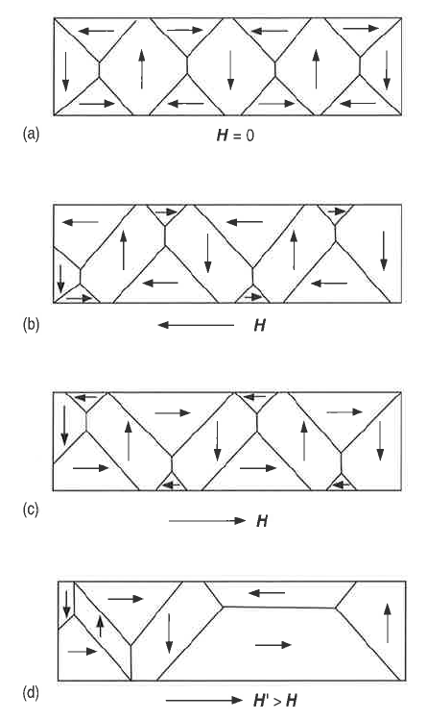
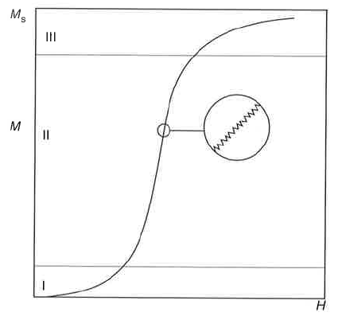
Ferromagnet in an External Field H, T < θ_{CW}
Initial magnetization curve
Saturation
Irreversible
Barkhausen
noise
Reversible movement
of domain walls
Reversible
Bloch walls sticked when crossing material inhomogenities
Irreversible
disappearence
of domain walls
Barkhausen jumps
HYSTERESIS
Resistance of saturation

Slide 26
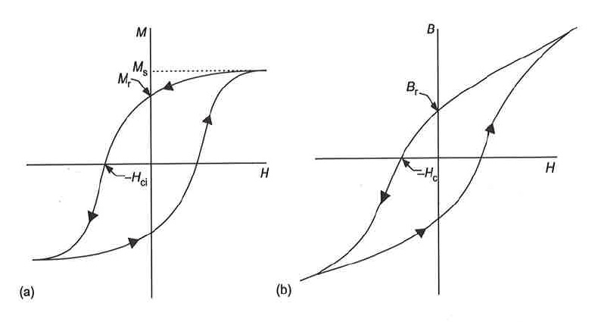
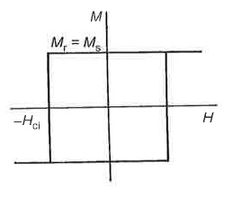
Ferromagnet in an External Field H, T < θ_{CW} , Hysteresis
⬅ Irreversible processes
Saturation
magnetization
Remanent
magnetization
Intrinsic
coersivity
Ideal permanent magnet
Transformer cores
Homogeneous materials
Freely moving domain
walls
Lamellar structure, high
resistivity
➔ Eddy current losses
B
Ideally:
H
Inhomogeneous material
➔ Pinning of domain walls

Slide 27
Magnetic properties
Response of materials to an external magnetic field
Magnetic quantities, magnetism is quantum mechanics (home work)
Quantum mechanical description
Atomic diamagnetism, paramagnetism (lecture work)
Response of free electron gas
Spontaneous magnetism (Ferromagnetism and antiferromagnetism)
Exchange interaction, H₂ molecule
Mean-field approximation for ferromagnetism of magnetic moments
Spin waves (low-energy excitations)
Free electron gas
Stoner model for ferromagnetism of itinerant electrons
Antiferromagnetism
Domain structure

